Slide 1
Gender Inequalities in NYC Public School Science Classrooms
Renee Jones
Urban Assembly for Future Leaders Academy IS 286

Slide 2
Six steps of the PPA
Define the social problem.
Gather evidence about the problem.
Identify causes of the problem.
Evaluating existing public policies.
Developing public policy solutions.
Selecting the best public policy solution.

Slide 3
Define the problem
On average, girls tend to do as well as boys on elementary and middle school math and science test. But, by the time these students enter High School, there is a big change in the amount of girls that enjoy and do well in the sciences and mathematics courses. This means that once these students get to college, there will not be enough women pursuing degrees in the sciences, computers, mathematics and engineering. A new study shows that this change might start as early as elementary school. In the NYC Public Schools, we need to do more to retain female students in science and math curriculum.

Slide 4
Gather Evidence
NYC services 1.1 million students. It is considered one of the most diverse districts in the nation. Female students start out doing well in the sciences and math, but by the time students in NYC graduate from colleges, only 38.9% have pursued degrees in the sciences. https://www.nytp.com/news-events/addressing-the-stem-gender-gap
Some reasons for girls not wanting to pursue the sciences could be that they feel isolated in a class dominated by males. Females not being encouraged to do well in the sciences because they can do other studies. Lots of females have also been told that the sciences are for males and not them. https://www.chalkbeat.org/2019/10/28/21109100/how-the-gender-gap-in-stem-might-get-its-start-in-elementary-school/

Slide 5
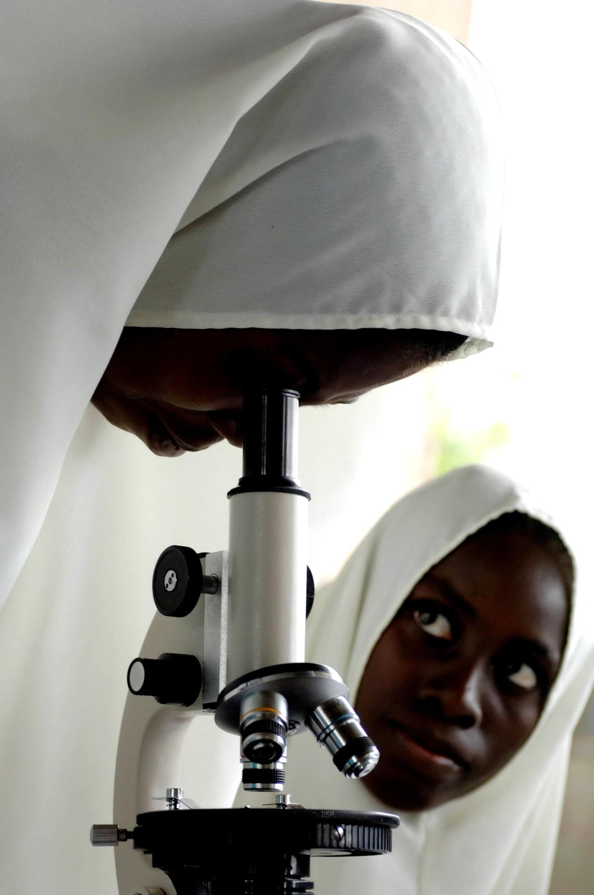
Identifying causes of the problem
From the time boys get into school, they are encouraged to do the difficult things in school ( math, science, sports, etc). The girls are usually told to play with the dolls and to be proper and learn basic stuff in school that will just get them through with a diploma. They are not taught how to excel and compete with their male counterparts. https://www.usatoday.com/story/opinion/2021/10/09/boys-falling-behind-how-schools-must-change-help-young-males/5913463001/

Slide 6
Evaluating existing policies
The US National Science Foundation’s programs focus on understanding and developing strategies to address differences in participation in STEM education and career outcomes by gender. There is research that is trying to improve the quality and effectiveness of formal and informal STEM education at all levels for all genders. This means from early childhood all the way beyond college. Also trying to address the social and systemic issues that create barriers for females to participate in STEM related classes and careers. https://new.nsf.gov/funding/initiatives/broadening-participation/supporting-women-girls-stem

Slide 7
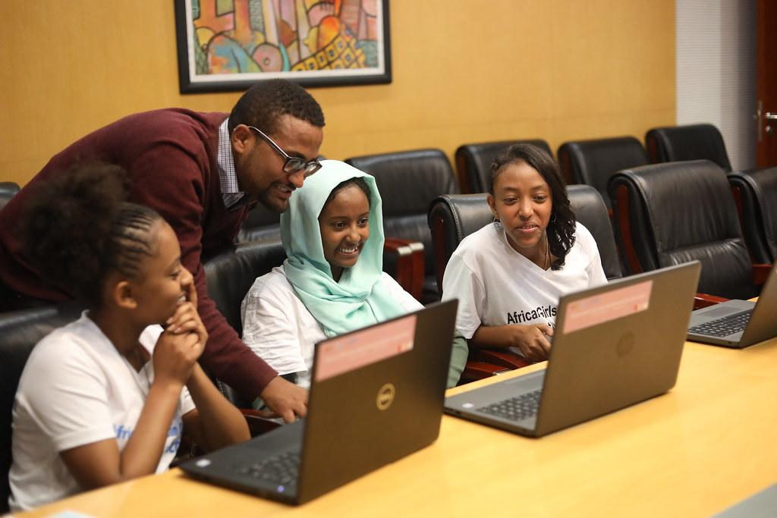
Developing public policy solutions
Federal, state and local institutions are taking steps to promote STEM female role models, extracurricular enrichment and provide clear progressive laws on gender equality. https://sciencepolicyreview.org/2020/08/reducing-gender-bias-in-stem/
Having extracurricular activities in NYC High Schools that promote STEM activities for females. Ex: Black Girls Code is a program that specifically teaches females how to code and how to create web programs. https://www.wearebgc.org/
https://sciencepolicyreview.org/2020/08/reducing-gender-bias-in-stem/

Slide 8
Selecting the best public policy solution

