Slide 1
Student Homelessness in NYC Public Schools
Renee Jones
Notes:
Changed title

Slide 2
Six steps of the PPA
Define the social problem.
Gathering evidence of the problem
Identifying causes of the problem
Evaluating existing public policies
Developing public policy solutions
Selecting the best public policy solution
Notes:
Have no idea what you mean by linking worksheets.

Slide 3
Defining the social problem
There is negative performance of students who are at risk of homelessness. As a child, it is very important to have a stable living environment. Student homelessness is on the rise in NYC.
There were more than 220,000 NYC Public School Students that have experienced homelessness since 2010. The numbers have grown since the Covid 19 Pandemic.
Notes:
Student homelessness is the problem

Slide 4
Gathering evidence about student homelessness in NYC
Nearly 1 in 10 students in New York City public schools were homeless last school year. https://ny.chalkbeat.org/2022/10/26/23423652/nyc-homeless-students-pandemic-shelter-transportation-bus
An annual report from Advocates for Children New York showed in an annual report that a total of 104,383 children lacked permanent housing last school year. This was in NYC public schools as well as charter schools.
District 9 in the Bronx has the highest percentage of student homelessness in the city.
While graduation data for last school year is not yet available, in the 2020-21 school year, just 70% of students who were homeless graduated, compared with 81% of all students. Twelve percent of those students dropped out, compared with 5% of all children.
Notes:
Gave evidence about poor student performance in NYC public schools

Slide 5
Identifying the causes of student homelessness
One of the main reasons that student homelessness has grown is because of the Covid 19 pandemic that occurred in 2020. Many parents lost their jobs and once the city opened back up, they were faced with widespread poverty and evictions.
https://www.nytimes.com/interactive/2020/09/09/magazine/homeless-students.html
Homeless students miss a lot of school because their parents are overwhelmed by the burden of getting the kids to school or they are not picked up by a bus route because of no address.l

Slide 6
Evaluating Existing Public Policies
No young person should experience homelessness, but each year there is an estimated 4.2 million youth and young adults that experience homelessness.
The National Network for youth is a policy under the Biden-Harris administration that was created to ensure that youth and young adults experiencing homelessness are at the forefront to receive efforts from all possible outlets.https://nn4youth.org/policy/federal-policy-on-youth-homelessness/
The National Network for Youth has various recommendations to help homeless youth. Some of these include: https://nn4youth.org/presidentialagenda2020/
Issue an Executive Order to address systemic barriers youth encounter across multiple federal programs, including access to a valid government ID and other vital documents, and make it easier for young people to access health care and public benefits.
Federal programs should capture similar outcome data, collect data on racial and LGBTQ+ identities, improve data sharing across systems, and analyze data to identify any disparities inequitable access and treatment.
Significantly increase investment in preventing homelessness experience and expand housing and service options explicitly targeted to youth and young adults.
Pass key legislation to advance the solutions and resources needed to end YYA homelessness.
Improve the administration of the Runaway and Homeless Youth Act (RHYA) program at HHS.
Create an office at HHS for children, youth, and families experiencing homelessness to administer a new program to prevent and respond to child, youth, and family homelessness.
Invest in learning and innovation through targeted HHS demonstration grants that focus on: (1) community-wide prevention strategies; (2) building anti-racist institutions; and (3) creating trauma-informed systems.
Provide and require training and technical assistance to RHYA grantees on serving LGBTQIA and BIPOC young people in culturally competent ways.
HUD should launch an “on-demand” voucher program for youth experiencing any form of homelessness.
Improve education supports for students experiencing homelessness in K-12 and higher education institutions.
Improve pathways to college and access to youth employment and career program opportunities.
Develop and implement a strategic plan focused exclusively on YYA experiencing homelessness.

Slide 7
Evaluating Existing Public Policy Cont
On a local level in NYC there is the New York State Technical and Educational Assistance Center for Homeless Students (NYS-TEACHS). This is an important policy because it gives school districts, social service providers, and other professionals free information and trainings about the rights for the students who are experiencing homelessness.https://www.nysteachs.org/
One advantage to the National Network for Youth is that it touches the aspects of helping all students who experience homelessness on a National level. It helps on a Legislative level to get resources needed to assist youth.
One disadvantage of NNY is there is a lot of red tape and bureaucracy. A lot of the agencies that are needed to help ( HUD and DOE) do not receive a lot of funding to help homeless students.
One advantage to NYS-TEACHS is that homeless students actually receive a mentor to help them navigate through the process of getting resources for school and helping their families with steps on temporary housing.
One Disadvantage to NYS-TEACHS is there are not enough mentors and resources to help all students who are homeless.

Slide 8
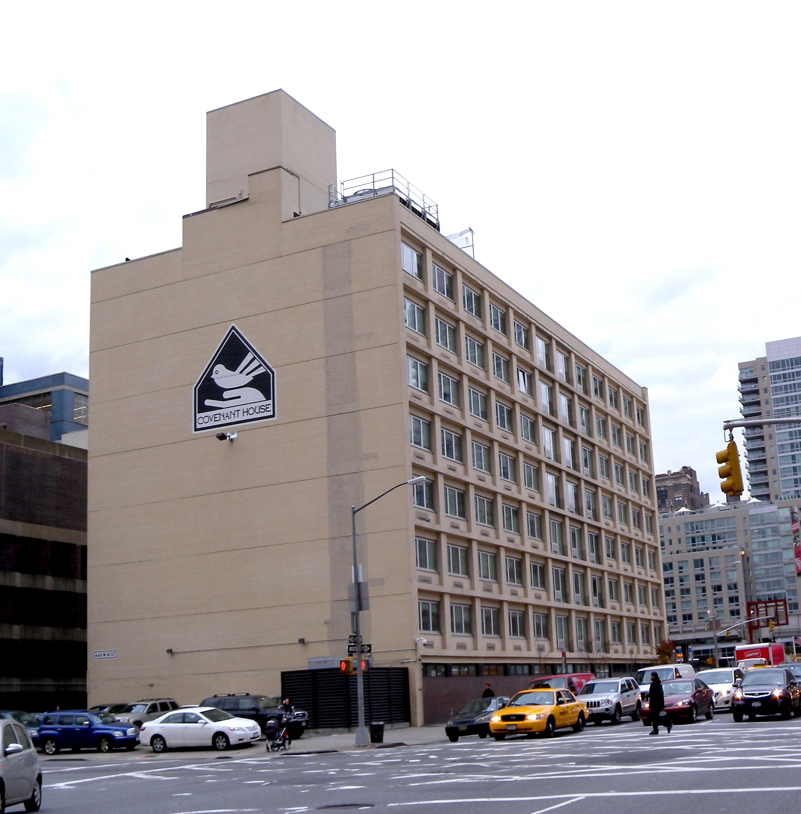
Developing Public Policy Solutions
Many agencies are trying their best to help beat the fight with student homelessness. Some solutions that will help this fight are:
Providing more funds to the NYS-TEACHS program. This would greatly benefit NYS students. Students would be able to have a mentor and an advocate to help them go through the tough steps of navigating the school system while being homeless. This can also help the student’s parents as well.
Providing more low income housing so that families can afford to live anywhere in the United States.
Creating more policies on a National level to make student homelessness more aware to politicians.
Notes:
My three solutions were providing more funds to NYS-TEACHS program, Providing more low income housing and Creating more policies on a national level

Slide 9
Selecting the best public policy solution
The policy or agency that works the best for homeless students and youth is NYS-TEACHS.
Through this program, students are protected under the McKinney -Vento Act. This states that students have the right to attend the same school they were in before they became homeless. They also have the right to free transportation. They also receive a liaison to protect them and let them know their rights as they navigate being in the homeless community.
Notes:
From the grid, I figured that the agency NYS-TEACHS is feasible and most effective.

