Slide 1
Define the problem:
Students in MS 324’s class 802 are experiencing and participating in cyberbullying on Facebook Live and other forms of social media.
Cherise James
MS 324
james@ms324.org

Slide 2
Public Policy Analyst Steps
Define the problem: Students in 802 are experiencing and participating in cyberbullying.
Gather Evidence: The Dean has contacted teachers
about bullying issues in this class.
Causes: Why are students engaging in cyberbullying?
Possible Solutions: How have other students tried to put an end to cyberbullying?
Best Solution: Determine the best solution for our class 802.

Slide 3
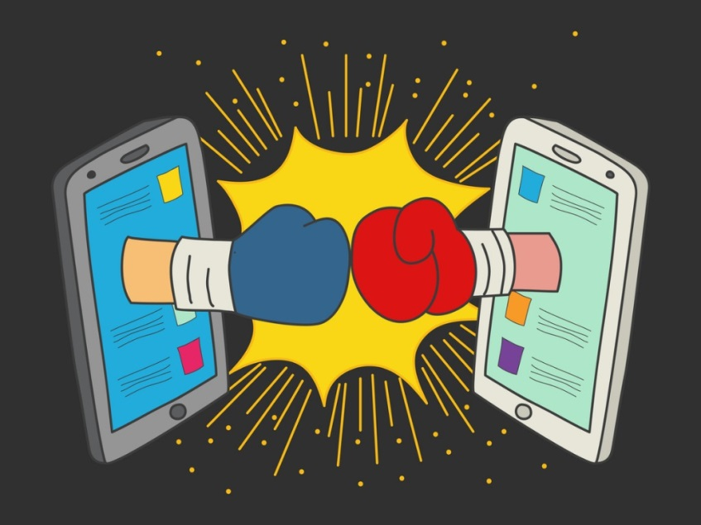
What is cyberbullying?
Turn and Talk to your neighbor
Share out
Let’s watch a short video that discusses cyberbullying
https://www.consumer.ftc.gov/media/video-0005-net-cetera-stand-cyberbullying
Step 1 of the PPA: Define the Problem

Slide 4
Is cyberbullying a real issue for teenagers?
What are the facts?
  According to the Department of Health and Human Services, about 20% of teens in the U.S. experienced bullying in 2017.
  Cyberbullying has replaced bullying as the common type of harassment that teens experience.
Step 2 of the PPA:
Gather the Evidence

Slide 5
Is cyberbullying a real issue for teenagers?
What is the frequency?
  The 2017 School Crime Supplement indicates that 15% of students ages 12-18 reported being bullied online or by text.
  The 2017 Youth Risk Behavior Surveillance System indicates that an estimated 14.9% of high school students were electronically bullied in the 12 months prior to the survey.
Step 2 of the PPA:
Gather the Evidence

Slide 6

Is cyberbullying an issue at MS 324?
Our Dean Mr. Downs has shared that students in our class are being bullied and are bullying others on Facebook Live and Social Media!

Slide 7
Cyberbullying causes
Turn and talk to your neighbor: What are three reasons why students choose to cyberbully?
Article study: “What really causes cyberbullying?”
https://www.heraldmailmedia.com/life/what-really-causes-cyberbullying/article_9ff3c3ed-b55c-5b89-9e04-a8c8dcbb9137.html
Step 3 of the PPA:
Identify the Causes

Slide 8
What is our school’s policy?
We are a Respect-for-All school within the New York City Department of Education and we will review together the guidelines for cyberbullying.
Resource: https://www.schools.nyc.gov/school-life/school-environment/respect-for-all
Step 4 of the PPA:
Examine Existing Policy

Slide 9

What has been done to put an end to cyberbullying?
Watch how students take on cyberbullying at Facing History High School in New York City
https://www.teachertube.com/videos/249685

Slide 10
What can WE do to put an end to cyberbullying?
In groups of 4 discuss the following:
  What are 3 new policies our class could develop to stop or lesson cyberbullying in our class 802?
Step 5 of the PPA:
Develop New Solutions

Slide 11

Best solution: Feasible and effective
For each of the 3 policies our class developed, discuss in your groups how feasible each one is (the likelihood it can be put into practice) and how effective each will be (the likelihood that each would be able to stop or lessen cyberbullying in our class
Step 6 of the PPA:
Evaluate Solutions

