Slide 1

Many Baychester students are not eating a healthy breakfast each morning.
8th Grade ELA- Baychester Middle School
Ms. Sharra Jackson
sjackson@baychesterwaves.org

Slide 2
Public Policy Analyst Steps
1. Define the Problem
2. Gather the Evidence
3. Identify the Causes
4. Evaluate an Existing Policy
5. Develop Solutions
6. Select the Best Solution (Feasibility vs. Effectiveness)

Slide 3
Step 1: Define the Problem
Many Baychester students are not eating a healthy breakfast each morning.
Breakfast is an important Meal of the Day!

Slide 4
Stop and Jot:
Do you eat breakfast? If so, what do you eat? (list as many items as you can)
If not, why don’t you eat? (list as many reasons as you can)

Slide 5
What is happening with breakfast?!
Look at the chart below. Turn and talk about where you fall on this chart. Share out.
Yes, I eat: | No, I don’t eat, because...

Slide 6

Step 2: Gather the Evidence
*We are going to read an article and watch some video clips:
"The importance of breakfast for kids"

Slide 7

Video Clips
-Why is a Healthy Breakfast the Most Important Meal of the Day?

Slide 8
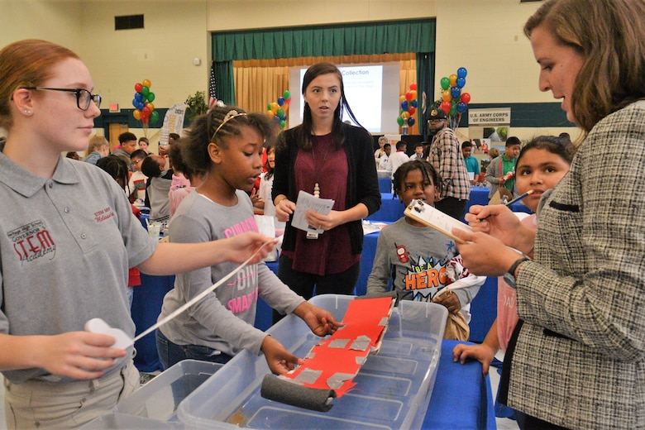
Step 3: Causes:
Think- Pair- Share

Slide 9
Step 4: Evaluate policies in place
Free Breakfast for all at 7:55am
Time set aside before classes to eat
8th grade can “grab and go” a breakfast and eat in classroom

Slide 10

Step 5: Possible Solutions
Take 3 minutes to brainstorm on your paper that you can think of to solve this issue. How can we get students to eat a HEALTHY BREAKFAST each day?

Slide 11

Share Out Solutions
We will share out our ideas and generate a class list of possible solutions

Slide 12
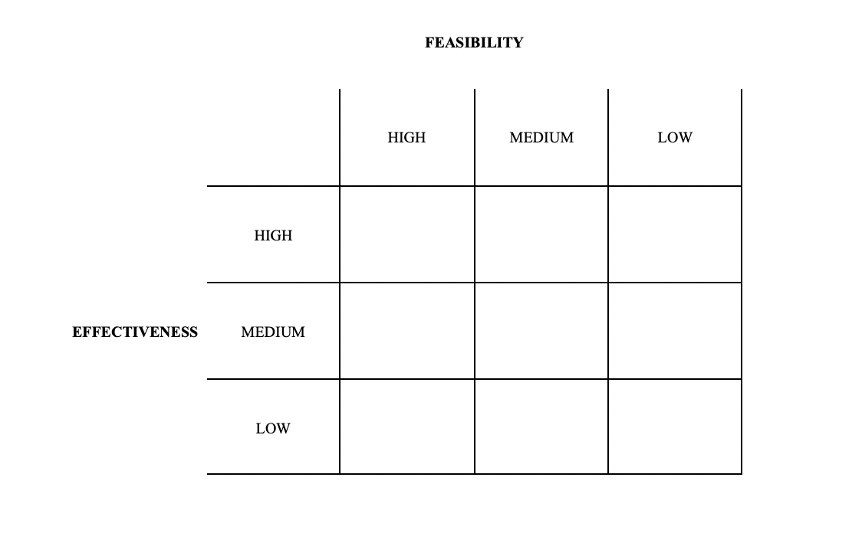
Step 6: Select the Best Solution

