Slide 1
The Problem
As you walk around the neighborhoods in Upper Manhattan, there is trash all over the streets and you need to watch out that you don’t step on trash and there are no trash cans to throw your trash.
Trash all over

Slide 2
How can we solve the problem of Trash in the Streets in Washington Heights?
By
Ms. J. Hunt
MS324

Slide 3
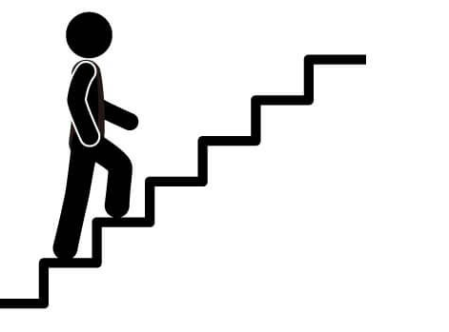
Use the Public Policy Analyst (PPA) steps to understand and address the problem.
6. What is the best policy to correct the problem?
5. What policies can you create to correct the problem?
4. What is the existing policy?
3. What are the causes?
2. Where is the evidence?
1. What is the problem?
Image from http://clipart-library.com/clipart/382081.htm

Slide 4
The Evidence
The streets and sidewalks have trash. Everywhere you walk, there is trash on the ground and not enough trashcans
Students sometimes come in to class with the smell of feces because they step in it on the sidewalks outside of the school.

Slide 5
What Are the Main Causes?
The city took away 222 trashcans in Harlem in 2018.
Residents have parties on the street and don’t pick up their trash.
People don’t dispose of trash in trashcans.
Dog owners don’t pick up after their dogs and stray dogs don’t pick up after themselves

Slide 6
Article on: Why this is an issue in our community
The New York City Sanitation Department has taken away the litter baskets from Harlem primarily because it says that while the baskets are intended only for litter from pedestrians, most had been crammed full of trash bags and debris from homes and businesses.

Slide 7
More evidence: Why this is an issue in our community
UPPER MANHATTAN - Crushed soda cans. Busted beer bottles. Leftover chicken bones and rice.
For some, these are the remnants of a good summertime picnic. For others, they are part of the all too common mess left strewn about the streets of Washington Heights and Inwood, where residents say a lax attitude toward street cleanliness has made sidewalks, stoops and streets unbearable.

Slide 8
What is the existing policy?
Here is a link to the NYC Department of Sanitation and Regulation Handbook to research what is being done now.
https://www1.nyc.gov/assets/dsny/downloads/pdf/about/laws/DSNY_rules_regs_2015.pdf
Here is a link to the environmental report card for upper Manhattan to help you understand more of what is being done in our area: https://www.weact.org/wp-content/uploads/2016/10/FINAL_WE-ACT_NM_EH_ReportCard.pdf
Requests for syringe disposal have increased 300 percent across New York City since 2014, city officials said. The department's Environmental Police Unit has conducted 200 cleanups since July 1 year, disposing of about 8,800 syringes. In areas of the city hit hard by the opioid epidemic, there is a greater need for syringe disposal.
Communities can get involved in cleaning up their own trash programs.

Slide 9
What can you do to correct the problem?
Get into small groups and research what solutions you can do as a group to clean up our community streets.
Find three solutions to the problem and make a list of the pros and cons for each solution.
Image from https://premiumbpthemes.com/clipart/get

Slide 10
What can you do to correct the problem? (possible solutions)
Never leave trash on the streets, always find a trash can.
Research community organizations that support clean streets and see if you can get involved.
Make a class group to pick up trash around the school.
Image from https://premiumbpthemes.com/clipart/get

Slide 11
What can the community and our class do to correct the problem?
In your small groups, you will propose one change from the list of three solutions you came up with earlier to reduce trash on our streets and sidewalks. This is a new proposed policy.
Propose your policy to the other groups. Make sure it is supported by your research and will address one of the causes of the problem.
Make a plan to put your policy into effect.

