Slide 1
Remote Learning
Stephanie Harvey
PS/MS 149
Grades 6-8

Slide 2
Learning Targets
Students will be able to identify the six steps of the public policy analyst
Students will be able to apply the model of the steps of PPA FOR a social problem of their own

Slide 3

What are the Six Steps to PPA?
1. Define the problem
2. Gather the evidence
3. Identify the cause
4. Evaluate an existing policy
5. Develop solutions
6. Select the best solution (feasibility & effectiveness)

Slide 4
Jigsaw (10 mins)
Directions:
Each table will be assigned a step
Each table will discuss the step that they have been given with their table mates
Each table will synthesize what each step means in their own words and share out with the whole class
Step Assignments:
Table 1: Step 1 4. Table 4: Step 4
Table 2: Step 2 5. Table 5: Step 5
Table 3: Step 3 6. Table 6: Step 6

Slide 5
Model Responses: Six Steps to the PPA
Define the problem: describe what the problem is at hand
Gather the evidence: what proof is there that the problem exist
Identify the causes: determine what caused the identified problem
Evaluate an existing policy: what solution is already in place to deal with said problem
Develop solutions: outside of the existing policy, determine a few more solutions
Select the best solution: based on the developed solutions, picked the one that is feasible (easy to implement) and effective (high probability of being successful)

Slide 6

Model: Step 1: Define the Problem
Remote Learning
Many middle school students from MS 149, Sojourner Truth School, aren’t present online

Slide 7
Model: Step 2: Gather the Evidence (10 mins)
https://www.edweek.org/ew/articles/2020/07/14/tracking-student-attendance-under-remote-learning-is.html
https://edsource.org/2020/teachers-grapple-with-how-to-keep-track-of-students-during-distance-learning/631189
https://www.chalkbeat.org/2020/4/12/21225479/present-or-absent-with-schools-closed-some-districts-stop-tracking-attendance-while-others-redefine
Choose one article from above and with a partner, define the problem and identify evidence of it using the link below:
https://www.surveymonkey.com/r/FB7BH9W

Slide 8
Turn and Talk (5 mins)
With your partner, answer the following question: what are some reasons that students are incapable of signing in online to participate in remote learning?

Slide 9

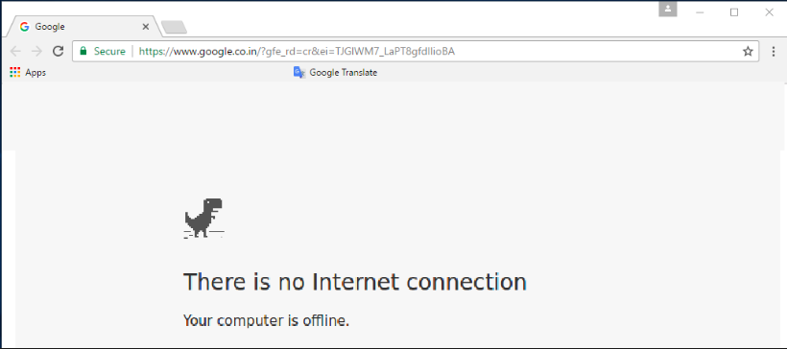


Exemplar Responses:
Step 3: Identify the Causes
Students do not have access to wifi or technology
Students do not know how to operate technology or remote platform
Students have faulty technology
Students are asleep during the time attendance is being recorded
Students aren’t encouraged by guardians to login online
Students have issues logging in
Students do not have or remember their login information
Students are sharing technology with siblings

Slide 10

Model: Step 4: Evaluating Existing School Policy
Support staff make calls to those students that have been identified as absent and/or not logging in
This Photo by Unknown Author is licensed under CC BY-SA-NC

Slide 11
Model: Step 5: Develop Solutions
Teachers call parents of absent students
Office send out notices to all parents encouraging online attendance
Teachers send out progress reports that details not only grades but attendance
Robo calls to parents reminding them to remind their children to login
Incentive programs for students who are present daily
Coffee time with principal every Wednesday

Slide 12
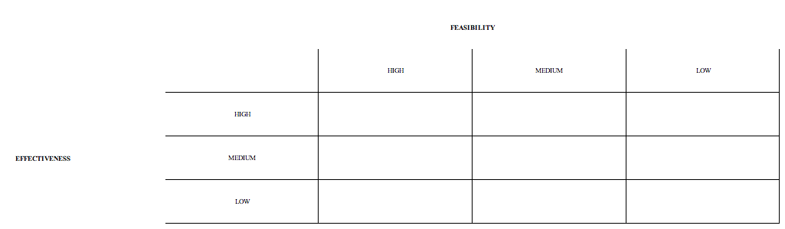
Model: Step 6: Select the Best Solution
Robo-calls
Progress Reports
Incentive program
Coffee-Time with Principal
Calling parents
Send out notices

Slide 13


Model Exemplar: The Best Solution
Incentive Program

Slide 14
Exit Ticket
(5 mins)
What social problem will you use the PPA steps for?

