Slide 1
Tardiness at PS 149
Jess Hanson
PS 149
Jhanson6@schools.nyc.gov

Slide 2
PPA Steps
1. Define the problem
2. Gather the Evidence
3. Identify the Causes
4. Evaluate an Existing Policy
5. Develop Solutions
6. Select the Best Solution (feasibility vs. effectiveness)

Slide 3
Step 1: Define the Problem http://flippedtips.com/plegal/tips/select.html
Students are excessively tardy at PS 149.
Activity:
Click this link and create a flipgrid video!
FlipGrid Video Response!

Slide 4
Step 2: Gather the Evidence http://flippedtips.com/plegal/tips/gather.html
Statistics:
Data to look at
Activity:
Spend some time looking the above website. Look at the data for our school; then respond to the prompt on FlipGrid.
Flipgrid Prompt: What is one thing you noticed after looking at the data? Why do you think the data are put into different categories such as “ethnicity, gender, and poverty.”
FlipGrid Response

Slide 5
Step 3: Identify the Causes http://flippedtips.com/plegal/tips/identify.html
Long commute
Bullying
Little siblings to care for at home
School Anxiety
Lack of motivation
Lack of morning routine
Turn and Talk (Step 1): Why might you or a friend be late to school? Record your response here.
Step 2: Respond to a classmates flipgrid under “Why might you be late” by clicking here.. and

Slide 6
Step 4: Evaluate an Existing Policy http://flippedtips.com/plegal/tips/existing.html
Incentives (Prizes)
Elective first period (Art, PE, French, Music, Band)
Positive phone call home
Wake-Up call/buddy walks
Respond to the following prompt in this form: Click here!
Prompt: Which of the above policies is most likely to get you to come to school on time? Which works best for you? Explain why.

Slide 7
Step 5: Develop Solutions http://flippedtips.com/plegal/tips/solutions.html
We need your help!
“What are some new ideas that could help get you and your classmates to school on time?”
Click here!

Slide 8
Step 6: Select the Best Solution http://flippedtips.com/plegal/tips/bestsol.html
Proposed Alternative Solutions: (collect from students)
-
Turn and Talk: Can we improve any of these proposed solutions? Let’s chart them together!

Slide 9
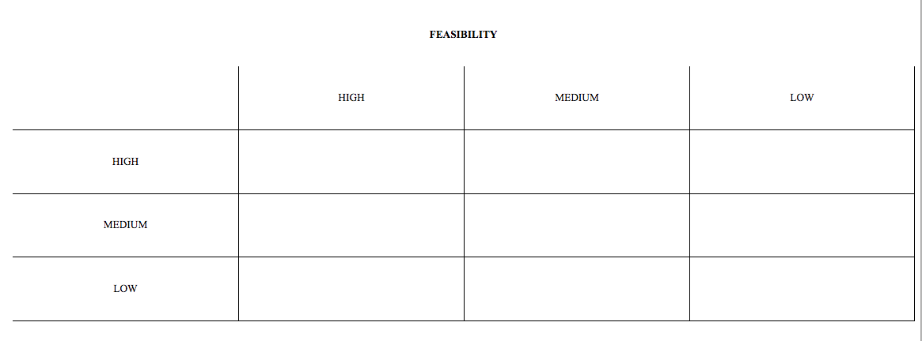
Feasibility vs. Effectiveness
Work with a partner to put our proposed solutions in the feasibility vs. effectiveness table.

Slide 10
Best Proposed Solution
Click the following link and respond to our PPA survey!
Click here!

