Slide 1
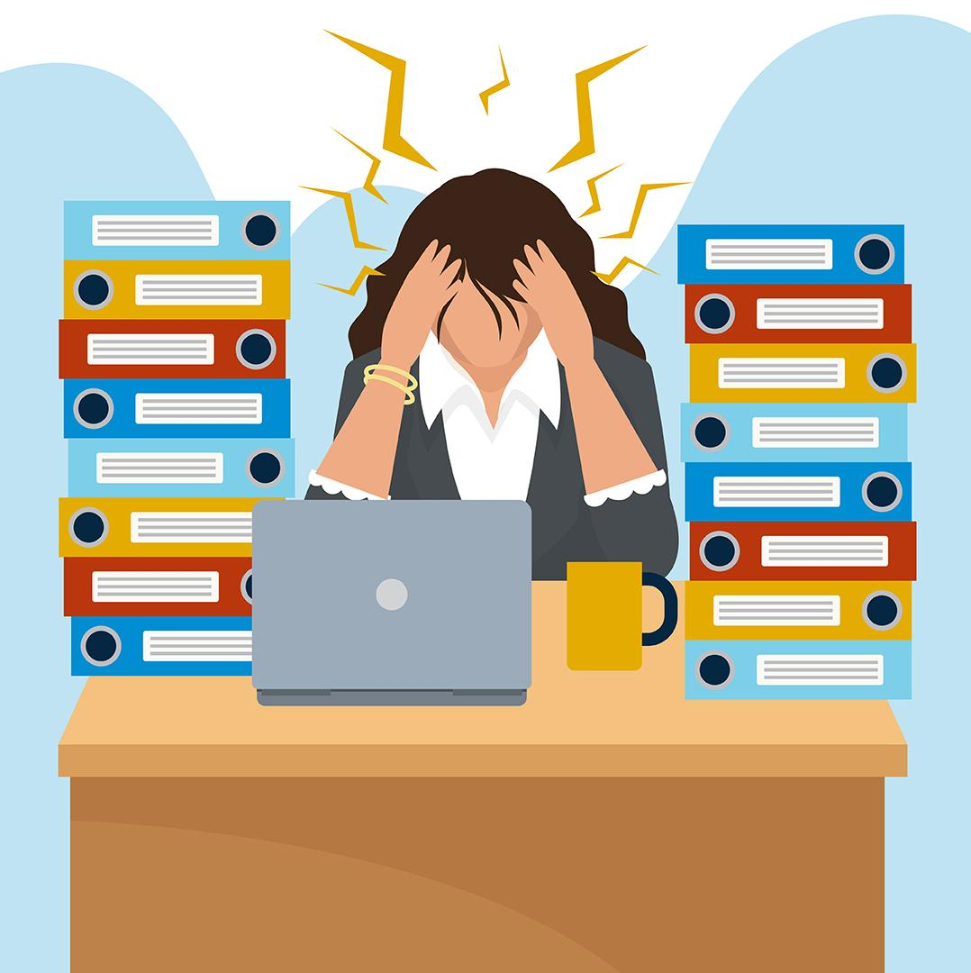
“STRESS” in FDA1 Students
By : Tihira Haffoney
Frederick Douglass Academy 1
Target Grades 6th - 12th Grades

Slide 2
Do Now : Watch video, and discuss some questions.
Question: Do you feel like this sometimes?
( Answer in your Journal )

Slide 3
STRESSED STUDENTS IN SCHOOLS
We will use the 6 Steps in Public Policy Analyst (PPA) in this week’s lesson.
REFRESH YOUR MEMORY CLICK STEPS BELOW :
1. Define the Problem
2. Gather the Evidence
3. Identify the Causes
4. Evaluate an Existing Policy
5. Develop Solutions
6. Select the Best Solution (Feasibility vs. Effectiveness)

Slide 4
Problem: Stress in FDA1’s Students
What can your group do about it? Read the Problems :
Teenagers, like adults, may experience stress every day and can benefit from learning stress management skills. Most teens experience more stress when they perceive a situation as dangerous, difficult, or painful and they do not have the resources to cope.
Some teens become overloaded with stress. When this happens, it can lead to anxiety, withdrawal, aggression, physical illness, or poor coping skills such as drug and/or alcohol use.
When we perceive a situation as difficult or painful, changes occur in our minds and bodies to prepare us to respond to danger. This “fight, flight, or freeze” response includes faster heart and breathing rate, increased blood to muscles of arms and legs, cold or clammy hands and feet, upset stomach and/or a sense of dread.

Slide 5
Gathering Evidence :
Is School Stress Normal?
Stress is a normal part of everyday life, both in and outside of school. Some stress is good — it motivates us to do our best and meet the challenges ahead. However, negative stress — known scientifically as distress — is usually felt when it feels like we don’t have the means or abilities to face a conflict. This feeling can be overwhelming and hard to work through.
School stress is normal and experienced by many students. According to a study by NYU, 49% of students experience stress caused by school on a daily basis.
Below are some of the most common stressors in school:
Navigating social lives
Adjusting to routine changes and transitions
Pressure to be successful
Finding or identifying support systems
Time management
Click Article : https://thriveworks.com/help-with/stress/why-is-school-so-stressful/#:~:text=One%20study%20found%20that%20low,esteem%2C%20another%20gateway%20to%20depression.

Slide 6
Identifying the causes :
School also presents a variety of demands that can feel difficult to meet. Some possible stress-causing demands are:
Preparing for quizzes and upcoming tests
Forming relationships
Adhering to schedules
Complying to the requests of teachers
Completing homework assignments
Getting good grades
Students completed daily surveys asking about the stress they experienced, and daily saliva samples were collected to measure their cortisol levels. A majority of these students—68 percent—experienced a drop in grades in the first semester and reported feeling stressed as a result.

Slide 7
Evaluating an Existing Policy : Click bold link for laws ( Your group can read then have accountable talk, and recorder write down key facts )
https://www.today.com/health/today-analysis-more-states-requiring-mental-health-education-law-t162822
https://www.ncsl.org/state-legislatures-news/details/student-mental-health-emerges-as-focus-of-education-bills-in-2022

Slide 8
Developing Solutions:
Feasibility :HIGH -Take care of yourself: Prioritize sleep. Eat nutritious food each day. Get some exercise. Improving these health habits alone can go a long way to mitigating your stress.
MEDIUM: Connect with others: Those with strong social support networks (friends, family, teammates, etc.) report less stress and overall higher levels of mental health and well-being.
Effectiveness:
LOW:
Refuse to play the stress game: Remember that stress carried for too long diminishes your quality of life, so aspire to be organized and include breaks for fun and connection in your time management plan.

Slide 9
Develop New Solutions
New Policy 1: Take care of yourself: Prioritize sleep. Eat nutritious food each day. Get some exercise. Improving these health habits alone can go a long way to mitigating your stress. (SELF CARE)
New Policy 2: Connect with others: Those with strong social support networks (friends, family, teammates, etc.) report less stress and overall higher levels of mental health and well-being. (CONNECT)
New Policy 3: Refuse to play the stress game: Remember that stress carried for too long diminishes your quality of life, so aspire to be organized and include breaks for fun and connection in your time management plan. (POSITIVE OUTLOOK)

Slide 10
“STRESS “ in FDA Students |  | FEASIBILITY
 |  | HIGH | MEDIUM | LOW
EFFECTIVENESS | HIGH | Self- Care
 | MEDIUM |  | Connect with others
 | LOW |  |  | POSITIVE OUTLOOK)

Slide 11
Exit Ticket: We have to learn how to manage our stress in school…..
Watch the video and make a managing stress checklist ( on separate piece of paper ) on how you can save energy in your home with all your new data and facts.
https://youtu.be/h2zWopNUUJE

Slide 12
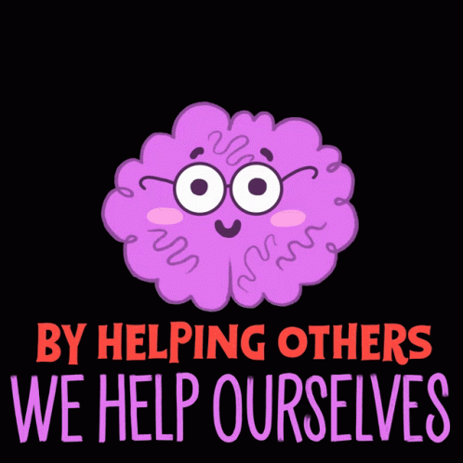
Remember: Learn how to manage your school stress:
Videos: https://www.youtube.com/watch?v=3Nf2Pzcketg
https://www.youtube.com/watch?v=3Nf2Pzcketg
Articles :
https://thriveworks.com/help-with/stress/why-is-school-so-stressful/#:~:text=One%20study%20found%20that%20low,esteem%2C%20another%20gateway%20to%20depression.
https://www.ncbi.nlm.nih.gov/pmc/articles/PMC8619610/

