Slide 1
Energy Wasted in US Homes Over the Years……….
Tihira Haffoney
Frederick Douglass Academy 1

Slide 2
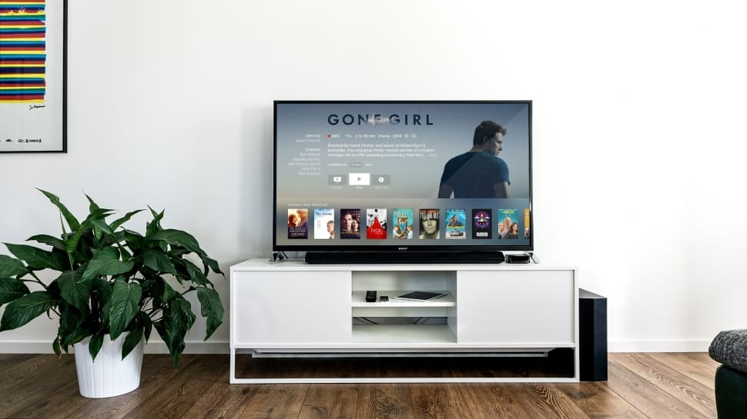
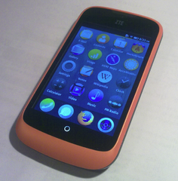
LET’S THINK : Wasted Energy Check -List
DID YOU TURN OFF THE…..
LIGHTS?
COMPUTER?
T.V.?
DO YOU KEEP YOUR PHONE CHARGING ALL NIGHT?
S

Slide 3
Do Now: Click Link ,Watch Video, and Then answer this Question: How much energy do you waste?
( Answer in your Journal )
https://youtu.be/Kc7dRXkuXWA
Leaving lights on when you not using them. WASTE!!!!!
People in households do this for years.
You too have to turn off the lights!!!

Slide 4
ENERGY WASTED IN US HOMES OVER THE YEARS:
We will use the 6 Steps in Public Policy Analyst (PPA) in this week’s lesson.
REFRESH YOUR MEMORY CLICK STEPS BELOW :
1. Define the Problem
2. Gather the Evidence
3. Identify the Causes
4. Evaluate an Existing Policy
5. Develop Solutions
6. Select the Best Solution (Feasibility vs. Effectiveness)

Slide 5
Problem: Energy Wasted in US Homes Over the Years
What can your group do about it? Read the Problems :
The U.S. economy wastes 61 to 86 percent of the energy that flows through it Lawrence Livermore National found in its 2012 annual report on national energy waste that the U.S. economy is 39 percent efficient, less efficient than ever before. The study factors in energy wasted in everything fro electricity plants and cars to home appliances and furnaces. The U.S. gets a failing grade for efficiency.
Americans spend $130 billion a year on wasted energy A 2009 McKinsey & Company study found that American homes and businesses collectively pay for $130 billion worth of energy that powers standby appliances and heat that warms the air on the other side of the cracks in their walls.
The percentage of household income spent on utilities has climbed 70 to 119 percent since 2001. Average Americans making more than $50,000 a year spent 9 percent of their income on utilities in 2012, up from 5 percent in 2001. Families making less than $10,000 a year spend 78 percent of their income on utilities, up from 36 percent in 2001, according to data from the American Coalition for Clean Coal Electricity.
https://www.constellation.com/energy-101/energy-choice/energy-activities-for-kids.html -Click here for more facts!!!

Slide 6
Gathering Evidence
The U.S. is estimated to have consumed 97.5 quads of energy in 2015
What’s a quad? It’s equal to a quadrillion BTUs.
The BTU is often used to describe the heat value of fuels, or the heating and cooling power of a system (such as a barbecue grill). One BTU is approximately:
What is a quadrillion BTUs?
It's about equal to the amount of energy in 45 million tons of coal, or 1 trillion cubic feet of natural gas, or 170 million barrels of crude oil.
It’s estimated that 59.1 quads (60.6% of all energy) is “rejected energy”, a fancy term for energy that is produced but not used in an effective way.Data states that 67% of all energy going to generate electricity is wasted.
Click link to see diagram:
Group Discussion ( Accountable Talk)
https://www.weforum.org/agenda/2018/05/visualizing-u-s-energy-consumption-in-one-chart

Slide 7
Identifying the causes :
5 Biggest Causes of Wasted Energy :
Old Inefficient Equipment , HVAC mishaps, Inefficient lighting practices, running electronics in an empty office, and not having an energy management system
The amount of energy wasted by 75,000 average American homes in a single year is equal to the waste that occurred in the 2010 BP Oil Spill It would cost $1 billion to retrofit all the homes in a small city and save the same amount of energy that would have been generated with the roughly 50 million gallons of oil that leaked into the Gulf of Mexico, according to a study from Energy Savvy.
**The energy we rely on every day comes from one of these sources above in the animation , and while some may be better than others, it is always best to avoid unnecessary use by us humans.
retrofit add (a component or accessory) to something that did not have it when manufactured.
"drivers who retrofit catalysts to older cars"

Slide 8
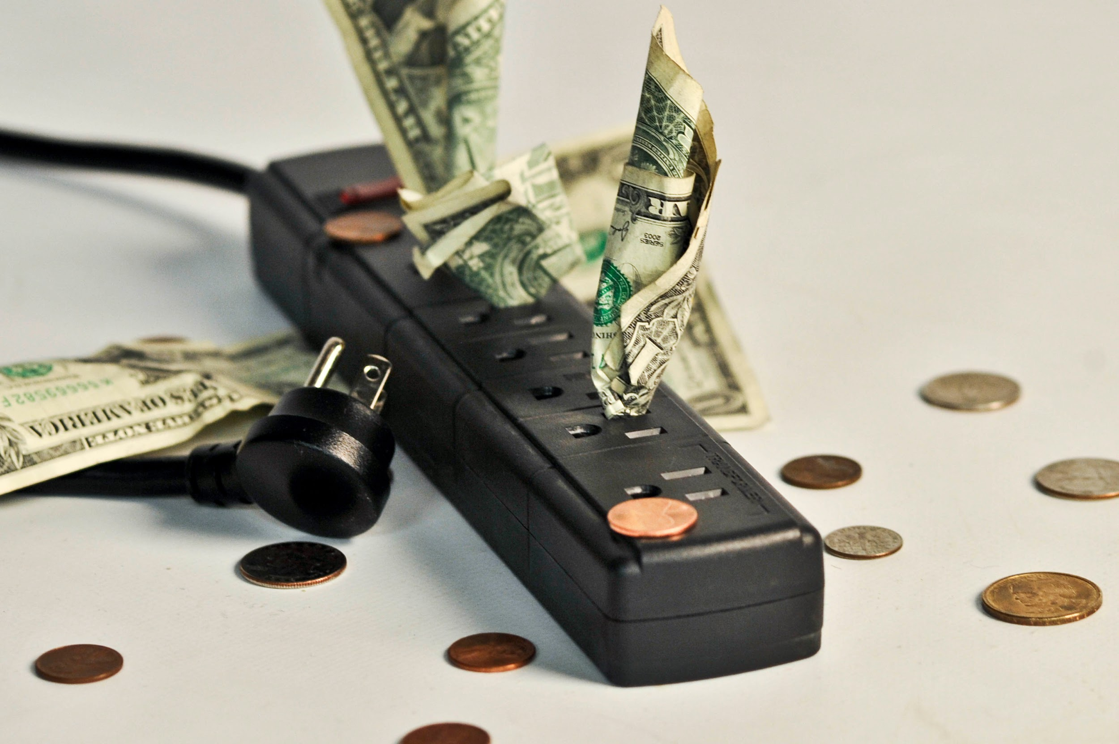
Evaluating an Existing Policy : Click black link for laws ( Your group can read then have accountable talk, and recorder write down key facts )
https://www.epa.gov/energy/national-action-plan-energy-efficiency
Next Steps We Can Do…………
“

Slide 9
DEVELOP SOLUTIONS:
How can we in U.S. homes save energy ?
5: Main Causes: Old Inefficient Equipment , HVAC mishaps, Inefficient lighting practices, running electronics in an empty office, and not having an energy management system
Task : Your group needs to read article ( link below) /watch video and write down which are the top six ( 6) ways to save energy in homes. ( Think about what you have or haven’t been doing not to waste energy )
Article: https://www.energysage.com/energy-efficiency/101/ways-to-save-energy/
Video : https://youtu.be/bVYNmc_Q8Bc

Slide 10
PLEASE SELECT THE BEST SOLUTION FOR NOT TO WASTE ENERGY IN US HOMES……… Feasibility vs. Effectiveness (Vocabulary Check)
Feasibility: capable of being done or carried out a feasible plan, reasonable ,suitable or being used or dealing with success.
Effectiveness: is the capability of producing a desired result or the ability to produce desired output.
NEXT STEP CREATE A CHART

Slide 11
Solutions Not To Waste Energy in US Homes
Feasibility
High -
Adjust your day-to-day behaviors
Medium Replace your light bulbs
Effectiveness
LOW: Dress appropriately for the weather inside and outside

Slide 12
Exit Ticket: If in U.S. Homes we keep wasting energy ……….
Watch the video and make a energy saving checklist ( on separate piece of paper ) on how you can save energy in your home with all your new data and facts.
https://youtu.be/QsAgaD7IeuA

Slide 13
REMEMBER NOT TO WASTE ENERGY IN YOUR HOME:
LINKS TO ARTICLES and VIDEOS :
Policy Energy Action Plan- https://www.epa.gov/energy/national-action-plan-energy-efficiency
Article: https://www.energysage.com/energy-efficiency/101/ways-to-save-energy/
Video : https://youtu.be/bVYNmc_Q8Bc -How To Save Energy
https://youtu.be/QsAgaD7IeuA -Surprising Places We Waste Energy
LOOK AT THE ICONS TO HELP SAVE ENERGY ………..NEXT PAGE>>>>

Slide 14
ICONS: RENEWABLE ENERGY |

