Slide 1
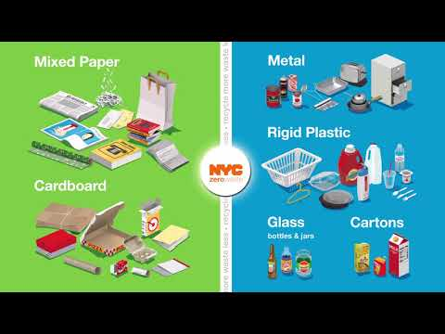


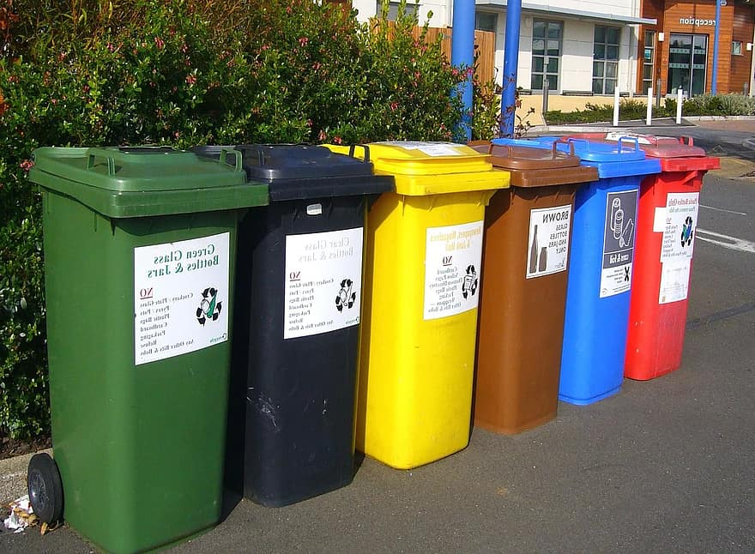
Recycling in NYC!
Tihira Haffoney
thaffoney@schools.nyc.gov
Frederick Douglass Academy 1 Manhattan
Target Class: 8th Grade Living Environment

Slide 2
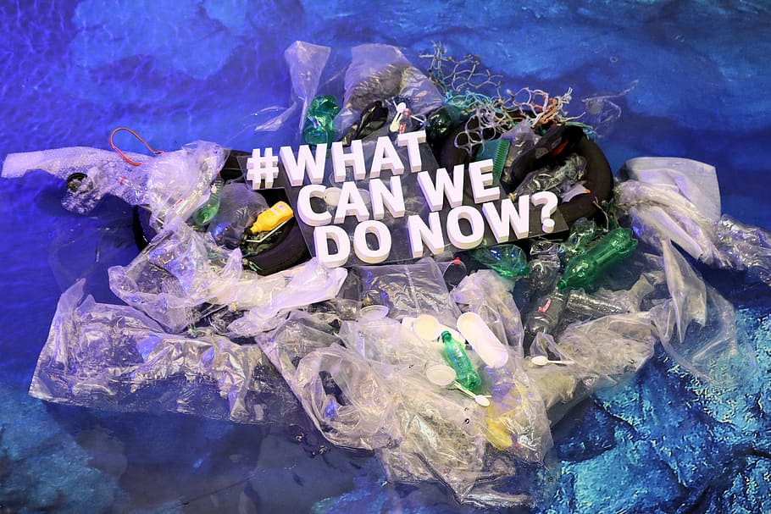
https://www.flocabulary.com/unit/reduce-re-use-recycle/
Do Now : Watch video, and discuss some questions.

Slide 3
Recycling in NYC following Public Policy Analyst:
What is a public policy ? Public Policy is the set of policies ( laws, plans, actions, behaviors that the” government chooses to do or not to do.”
The 6 Steps of the Public Policy Analyst (PPA):
CLICK A STEP TO LEARN IT :
1. Define the Problem
2. Gather the Evidence
3. Identify the Causes
4. Evaluate an Existing Policy
5. Develop Solutions
6. Select the Best Solution (Feasibility vs. Effectiveness)

Slide 4
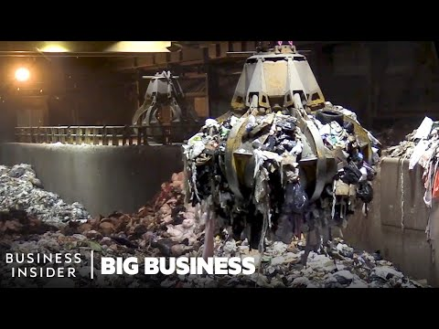
Problem : Not enough recycling of trash in NYC
Only 30% of trash in NYC is recycled turns into energy to be reused
Expensive to export the trash out of state it costs 429 million dollars
NYC creates 300- 600 tons of garbage a day
CLICK THE VIDEO TO SEE >>>>>>>>>>>PROBLEMS

Slide 5

Gathering Evidence :
There are Seven ( 7) Reasons Recycling Isn’t Working in New York City:
Click the recycling of numbers and letters below to find out the evidence :
Article: https://nam10.safelinks.protection.outlook.com/?url=https%3A%2F%2Fwww.nytimes.com%2F2020%2F01%2F29%2Fnyregion%2Fnyc-recycling.html&data=04%7C01%7Cthaffoney%40schools.nyc.gov%7Caf2d93e93db347036c2408d96e2c9571%7C18492cb7ef45456185710c42e5f7ac07%7C0%7C0%7C637661960031028435%7CUnknown%7CTWFpbGZsb3d8eyJWIjoiMC4wLjAwMDAiLCJQIjoiV2luMzIiLCJBTiI6Ik1haWwiLCJXVCI6Mn0%3D%7C2000&sdata=IUsALIBvwZLBe2VI1EDmJsw5rFePUSJHtbCCglFrdzc%3D&reserved=0
Choose a section that stuck with you from the article then ,”Turn and Talk “ : Discuss any other evidence you can think of why recycling isn’t working in your community or school with a classmate :

Slide 6
Identifying the causes:
New York City causes :
Not enough recycling in city housing ,city schools, businesses and residential areas
Not knowing how serious to decrease solid waste management for NYC
Not enough of recycling bins in cities
Click link below to learn some vocabulary words , with an activity :
https://www.flocabulary.com/unit/reduce-re-use-recycle/vocab-cards/

Slide 7
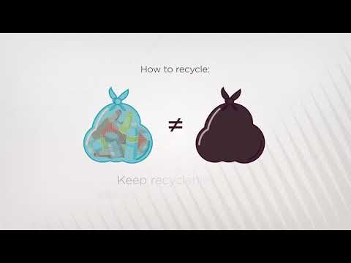
Evaluating an Existing policy : Click blue link for laws and arrow for video on laws . READ OR WATCH ( You choose)
https://www1.nyc.gov/assets/dsny/site/resources/recycling-and-garbage-laws/recycling-laws-for-residents
NEXT STEPS WE CAN DO…………………..

Slide 8
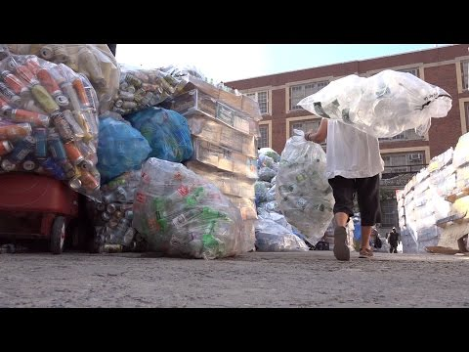
Develop Solutions :What can NYC do to Recycle better?
*More Recycling Education in NYC:
(Businesses, Communities Schools, Flyers, Billboard, Posters, Games)
*Governor /Mayor/Scientists and Environmentalists input : Speaking on TV Commercials daily about Recycling
* Distributing more recycling bins in all parts of NYC : Schools, City Housing , Businesses and Residential areas
After watching this video below : Give one more solutions to recycle better

Slide 9
Select the Best Solution for Recycling :
Feasibility vs. Effectiveness
Effectiveness :
Effectiveness is the capability of producing a desired result or the ability to produce desired output.
Feasibility : capable of being done or carried out a feasible plan. 2 : capable of being used or dealt with successfully : suitable. 3 : reasonable
LETS MAKE A CHART >>>>>>>>>>>>>>>>>>>>>>.......................

Slide 10
RECYCLING HIGH , MEDIUM or LOW :
 |  | FEASIBILITY
 |  | HIGH | MEDIUM | LOW
EFFECTIVENESS | HIGH | Distributing more recycling bins in all parts of NYC
 | MEDIUM |  | NY Governor/Mayor/ Scientists/ Environmentalists/ Input Daily
 | LOW |  |  | More Recycling Education

Slide 11

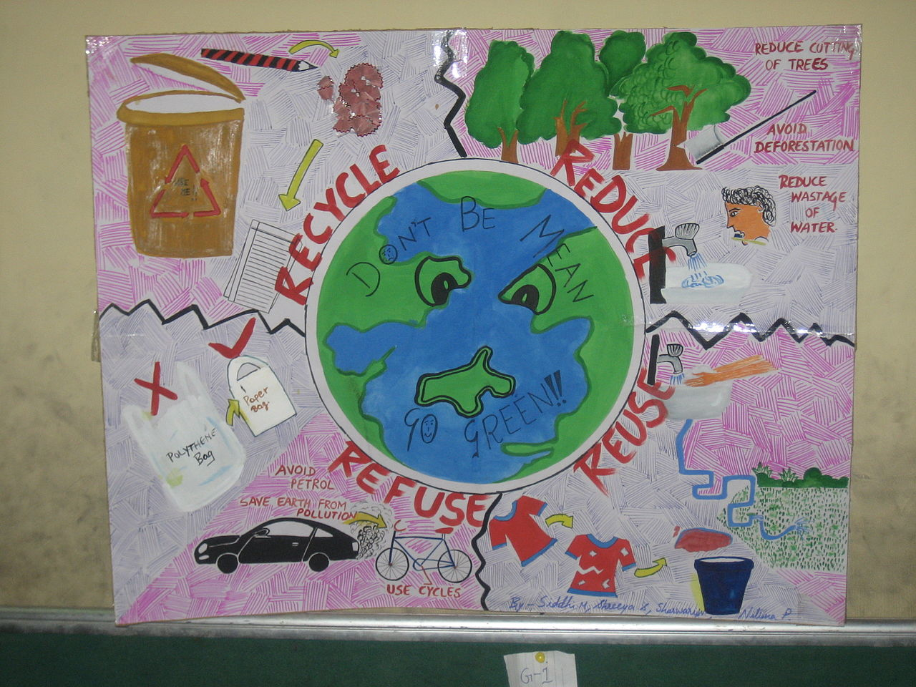
EXIT TICKET :IF WE DON’T RECYCLE OUR EARTH WILL:
WATCH THE VIDEO and WRITE DOWN TWO (2) MAIN RESPONSIBILITIES as NEW YORKERS WHY WE NEED TO RECYCLE?
https://www.flocabulary.com/unit/environmental-change/video

Slide 12
Thank you for the Information:
Links from Flocabulary Website :
https://www.flocabulary.com/unit/environmental-change/video
https://www.flocabulary.com/unit/reduce-re-use-recycle/
NYC RECYCLING LAWS :
https://www1.nyc.gov/assets/dsny/site/resources/recycling-and-garbage-laws/recycling-laws-for-residents
NEW YORK TIMES ARTICLE:
https://nam10.safelinks.protection.outlook.com/?url=https%3A%2F%2Fwww.nytimes.com%2F2020%2F01%2F29%2Fnyregion%2Fnyc-recycling.html&data=04%7C01%7Cthaffoney%40schools.nyc.gov%7Caf2d93e93db347036c2408d96e2c9571%7C18492cb7ef45456185710c42e5f7ac07%7C0%7C0%7C637661960031028435%7CUnknown%7CTWFpbGZsb3d8eyJWIjoiMC4wLjAwMDAiLCJQIjoiV2luMzIiLCJBTiI6Ik1haWwiLCJXVCI6Mn0%3D%7C2000&sdata=IUsALIBvwZLBe2VI1EDmJsw5rFePUSJHtbCCglFrdzc%3D&reserved=0

