Slide 1
Academic gap in students living in temporary housing
Shavon Glover
Urban Assembly Academy for Future Leaders (05M286)
Physical Education & Health, Computer Science

Slide 2
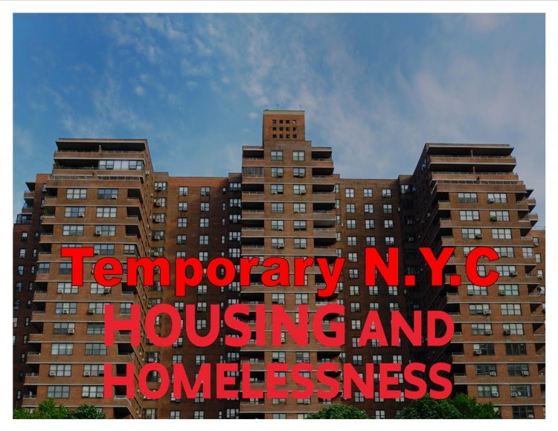

Slide 3
In this project, students will engage in the research of a public problem, applying the public policy analyst (PPA) to solve the identified societal problem.
TASK

Slide 4
A public policy is a government action intended to deal with a social problem. Every day policies are enacted in schools, cities, states and countries throughout the world that will affect our daily living. Policy decisions play a very large part in shaping our global history. it is essential to have the skills related to analyzing historical and current public policy issues. The six (6) steps of the Public Policy Analyst (PPA) will guide you through the problem solving skills necessary to study historical and current American and global public policy issues.
What is the Public Policy Analyst?

Slide 5
The six (6) steps of the Public Policy Analyst (PPA) will guide us through the problem solving skills necessary to study historical and current American and global public policy issues.

Slide 6
A social problem is a condition that at least some people in a community view as being undesirable. As a public policy analyst, you will first need to select A TOPIC aND specifically define a social problem.
PUBLIC POLICY ANALYST STEP #1: DEFINING A PROBLEM

Slide 7

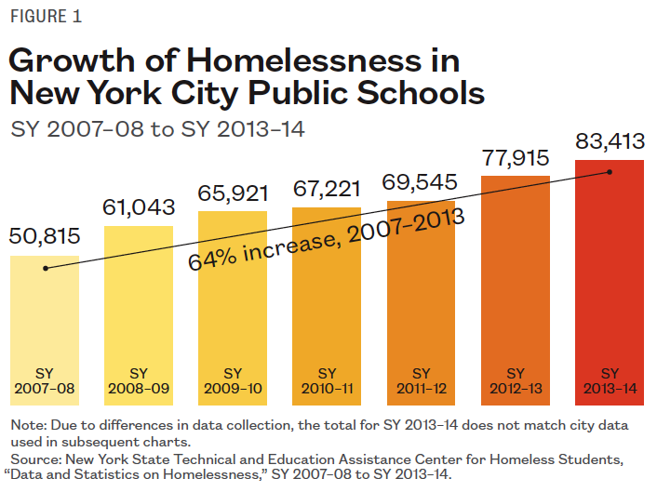

Slide 8
The goal of THIS STEP is to develop problem solving skills through using the Internet TO CONDUCT RESEARCH. Therefore, this step requires you to use the Internet to locate at least three (3) different types of evidence to support the existence of your problem.
PUBLIC POLICY ANALYST STEP #2: GATHER THE EVIDENCE

Slide 9

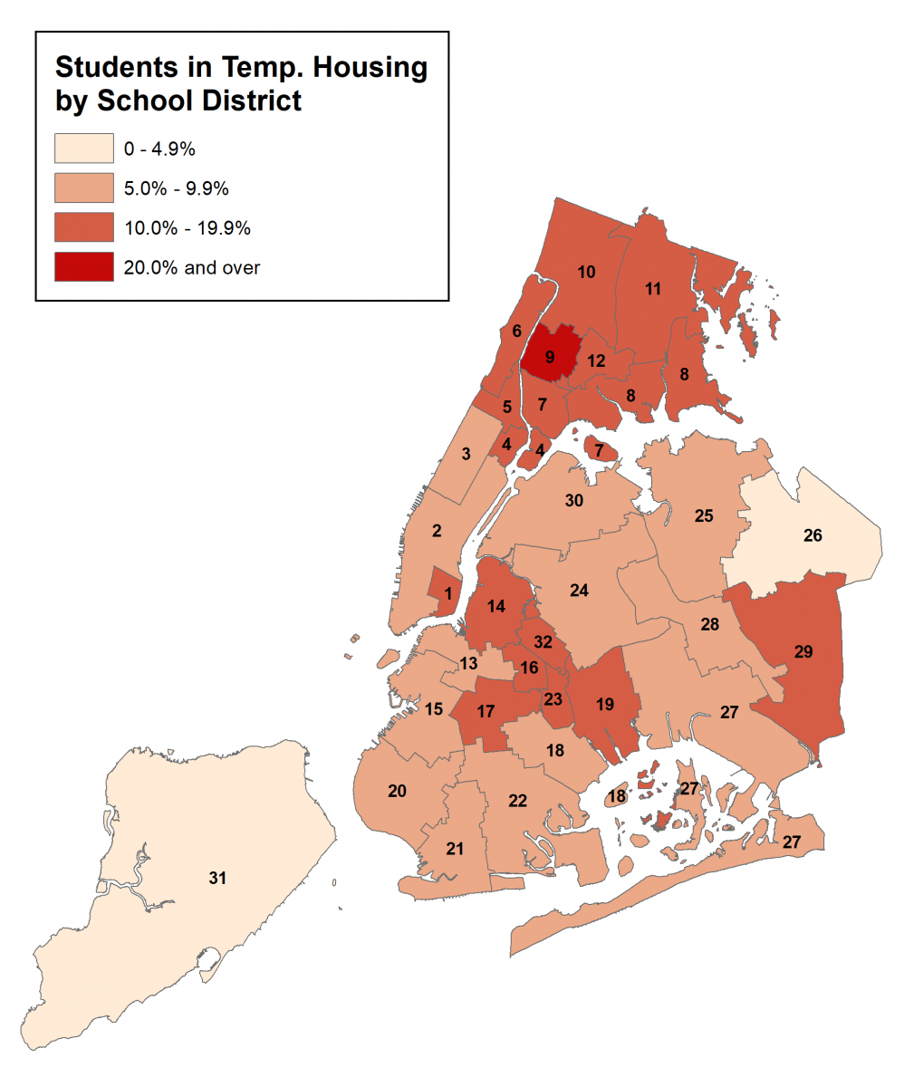
The law requires that students living in temporary housing have the same public education and the same educational services as permanently housed students. Complete the Housing Questionnaire to help determine services a student may be eligible to receive. www.schools.nyc.gov › school-life › special-situations

Slide 10
In this step you will research and articles and brainstorm the causes and factors that contribute to your social problem.
EXAMPLE:
In June 2020, there were 58,736 homeless people, including 13,275 homeless families with 19,626 homeless children, sleeping each night in the New York City municipal shelter system. Families make up two-thirds of the homeless shelter population.
Source: https://www.cccnewyork.org/datsa-and-report/publications
PUBLIC POLICY ANALYST STEP #3: IDENTIFYING THE CAUSES

Slide 11
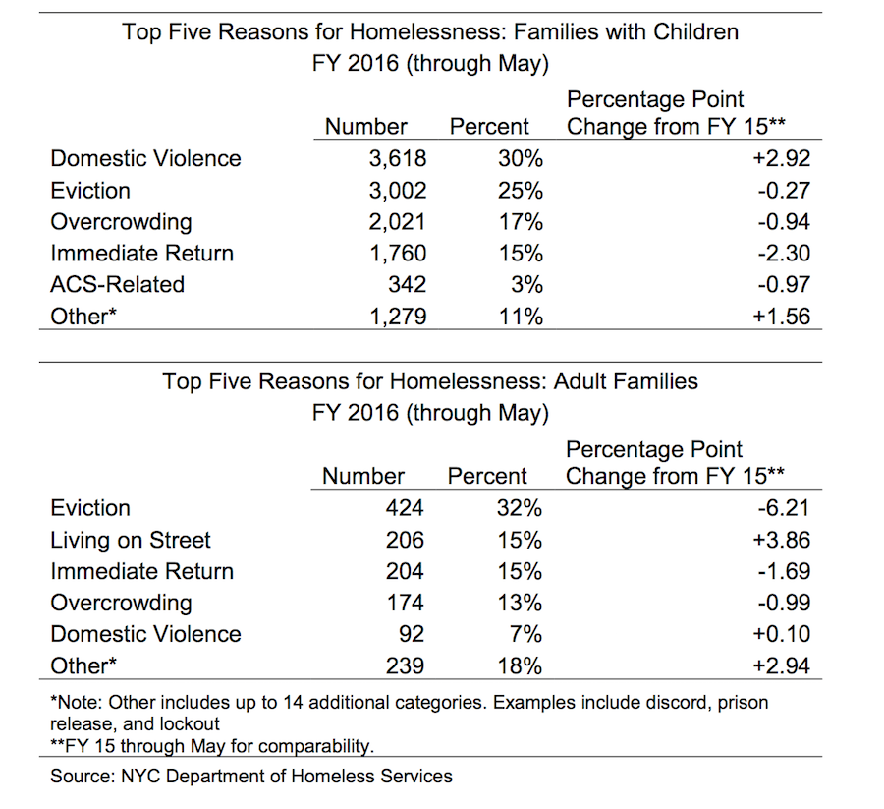
Causes:
Of Homelessness

Slide 12
Evaluating the main existing policy or policies to deal with a social problem is an important step in the PPA process. Analyzing both the advantages and disadvantages of existing policies can suggest what parts of the current policy should be kept or strengthened, and what parts should be changed. If the existing policy seems to be totally ineffective, then perhaps, it needs to be replaced.
PUBLIC POLICY ANALYST STEP #4: EVALUATE EXISTING POLICY

Slide 13
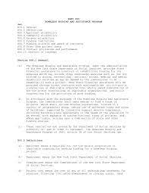
Part 800 Homeless Housing and Assistance Program
(HHAP)

Slide 14
One way to solve a problem is to eliminate or lessen the causes or contributory factors. Another source for developing public policy alternatives is the current policy. Perhaps you think that the current policy fails to even deal with the problem and should be totally replaced. Perhaps the current policy simply needs to be strengthened or improved. YOU WILL develop THREE (3) new/original public policy alternatives, A public policy must include a specific type of government action to reach the public policy goal.
PUBLIC POLICY ANALYST STEP #5: DEVELOPING PUBLIC POLICY SOLUTIONS

Slide 15

https://regs.health.ny.gov/volume-c-title-18/281489017/part-800-homeless-housing-and-assistance-program

Slide 16
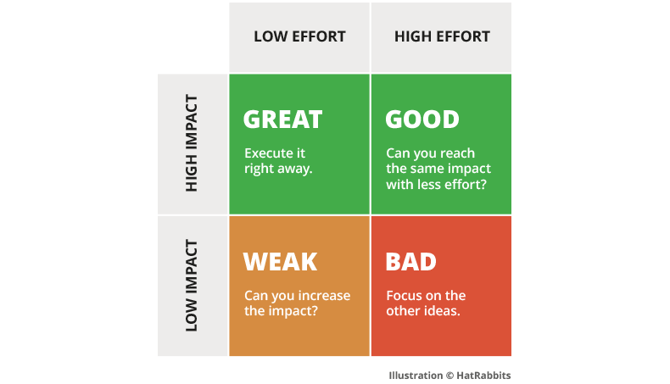
Feasibility refers to the likelihood that your policy would be enacted by the government or government agency.
EFFECTIVENESS REFERS TO THE LIKELIHOOD THAT A CURRENT POLICY WILL PRODUCE RESULTS THAT LESSEN THE SOCIAL PROBLEM.
PUBLIC POLICY ANALYST STEP #6:
SELECT THE BEST SOLUTION: FEASIBILITY vs. EFFECTIVENESS

Slide 17
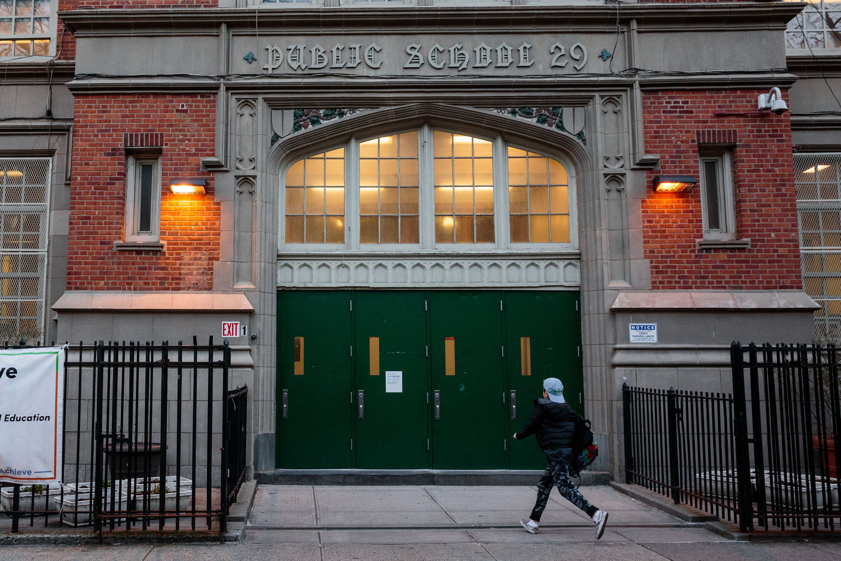


I didn’t ask for this!
I really loved school.
I loved school more when I saw this.
Then I fell into this!

