Slide 1
Michigan Water Issues
The Issue with Water Pollution in Flint, Michigan
By Ms. Francis
PS/MS 129, John H. Finley School

Slide 2
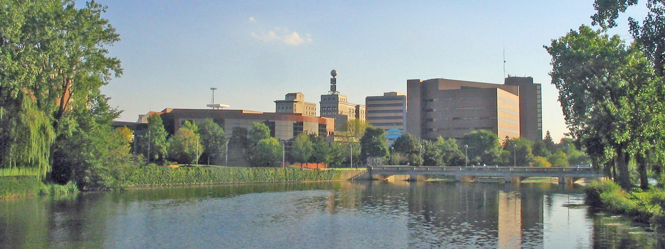
Step #1: Defining the Social Problem
What is the nature of water pollution?
What is the specific community location of this social problem?
Water pollution occurs when harmful substances—often chemicals or microorganisms—contaminate a stream, river, lake, ocean, aquifer, or other body of water, degrading water quality and rendering it toxic to humans or the environment
Governmental Authority Involved: (Community-level Social Problem) City Council
Location: Flint, Michigan

Slide 3
Step #1: Defining the Social Problem
Three undesirable social conditions that result from (Flint) water pollution:
Exposure to lead can increase risk for high blood pressure, heart disease, kidney disease, and reduced fertility… Adversely affects all lifeforms that directly or indirectly depend on this source
Steep decreases in economy
Environmental racism
Water Pollution in Flint, Michigan

Slide 4

Step #2: Gathering Evidence of the Problem:
One specific policy: The Federal Safe Drinking Water Act’s Lead and Copper Rule. The LCR provides two important sets of criteria: water quality standards and treatment/testing protocols for lead and copper in drinking water systems.
The law requires that local water utilities monitor and test their water supplies and report their results to the state government, which in turn reports all data to the U.S. Environmental Protection Agency. The EPA is ultimately responsible for ensuring compliance.
Policy Evaluation:The law requires that local water utilities monitor and test their water supplies and report their results to the state government, which in turn reports all data to the U.S. Environmental Protection Agency. The EPA is ultimately responsible for ensuring compliance.
When Flint switched its drinking water source to the Flint River in April 2014, the state environmental quality department failed to require the city to treat the water for corrosion, as would be necessary to meet federal Safe Drinking Water Act (SDWA) standards.
Notes:
https://news.umich.edu/simultaneous-reinforcing-policy-failures-led-to-flint-water-crisis-providing-lessons-during-pandemic/

Slide 5
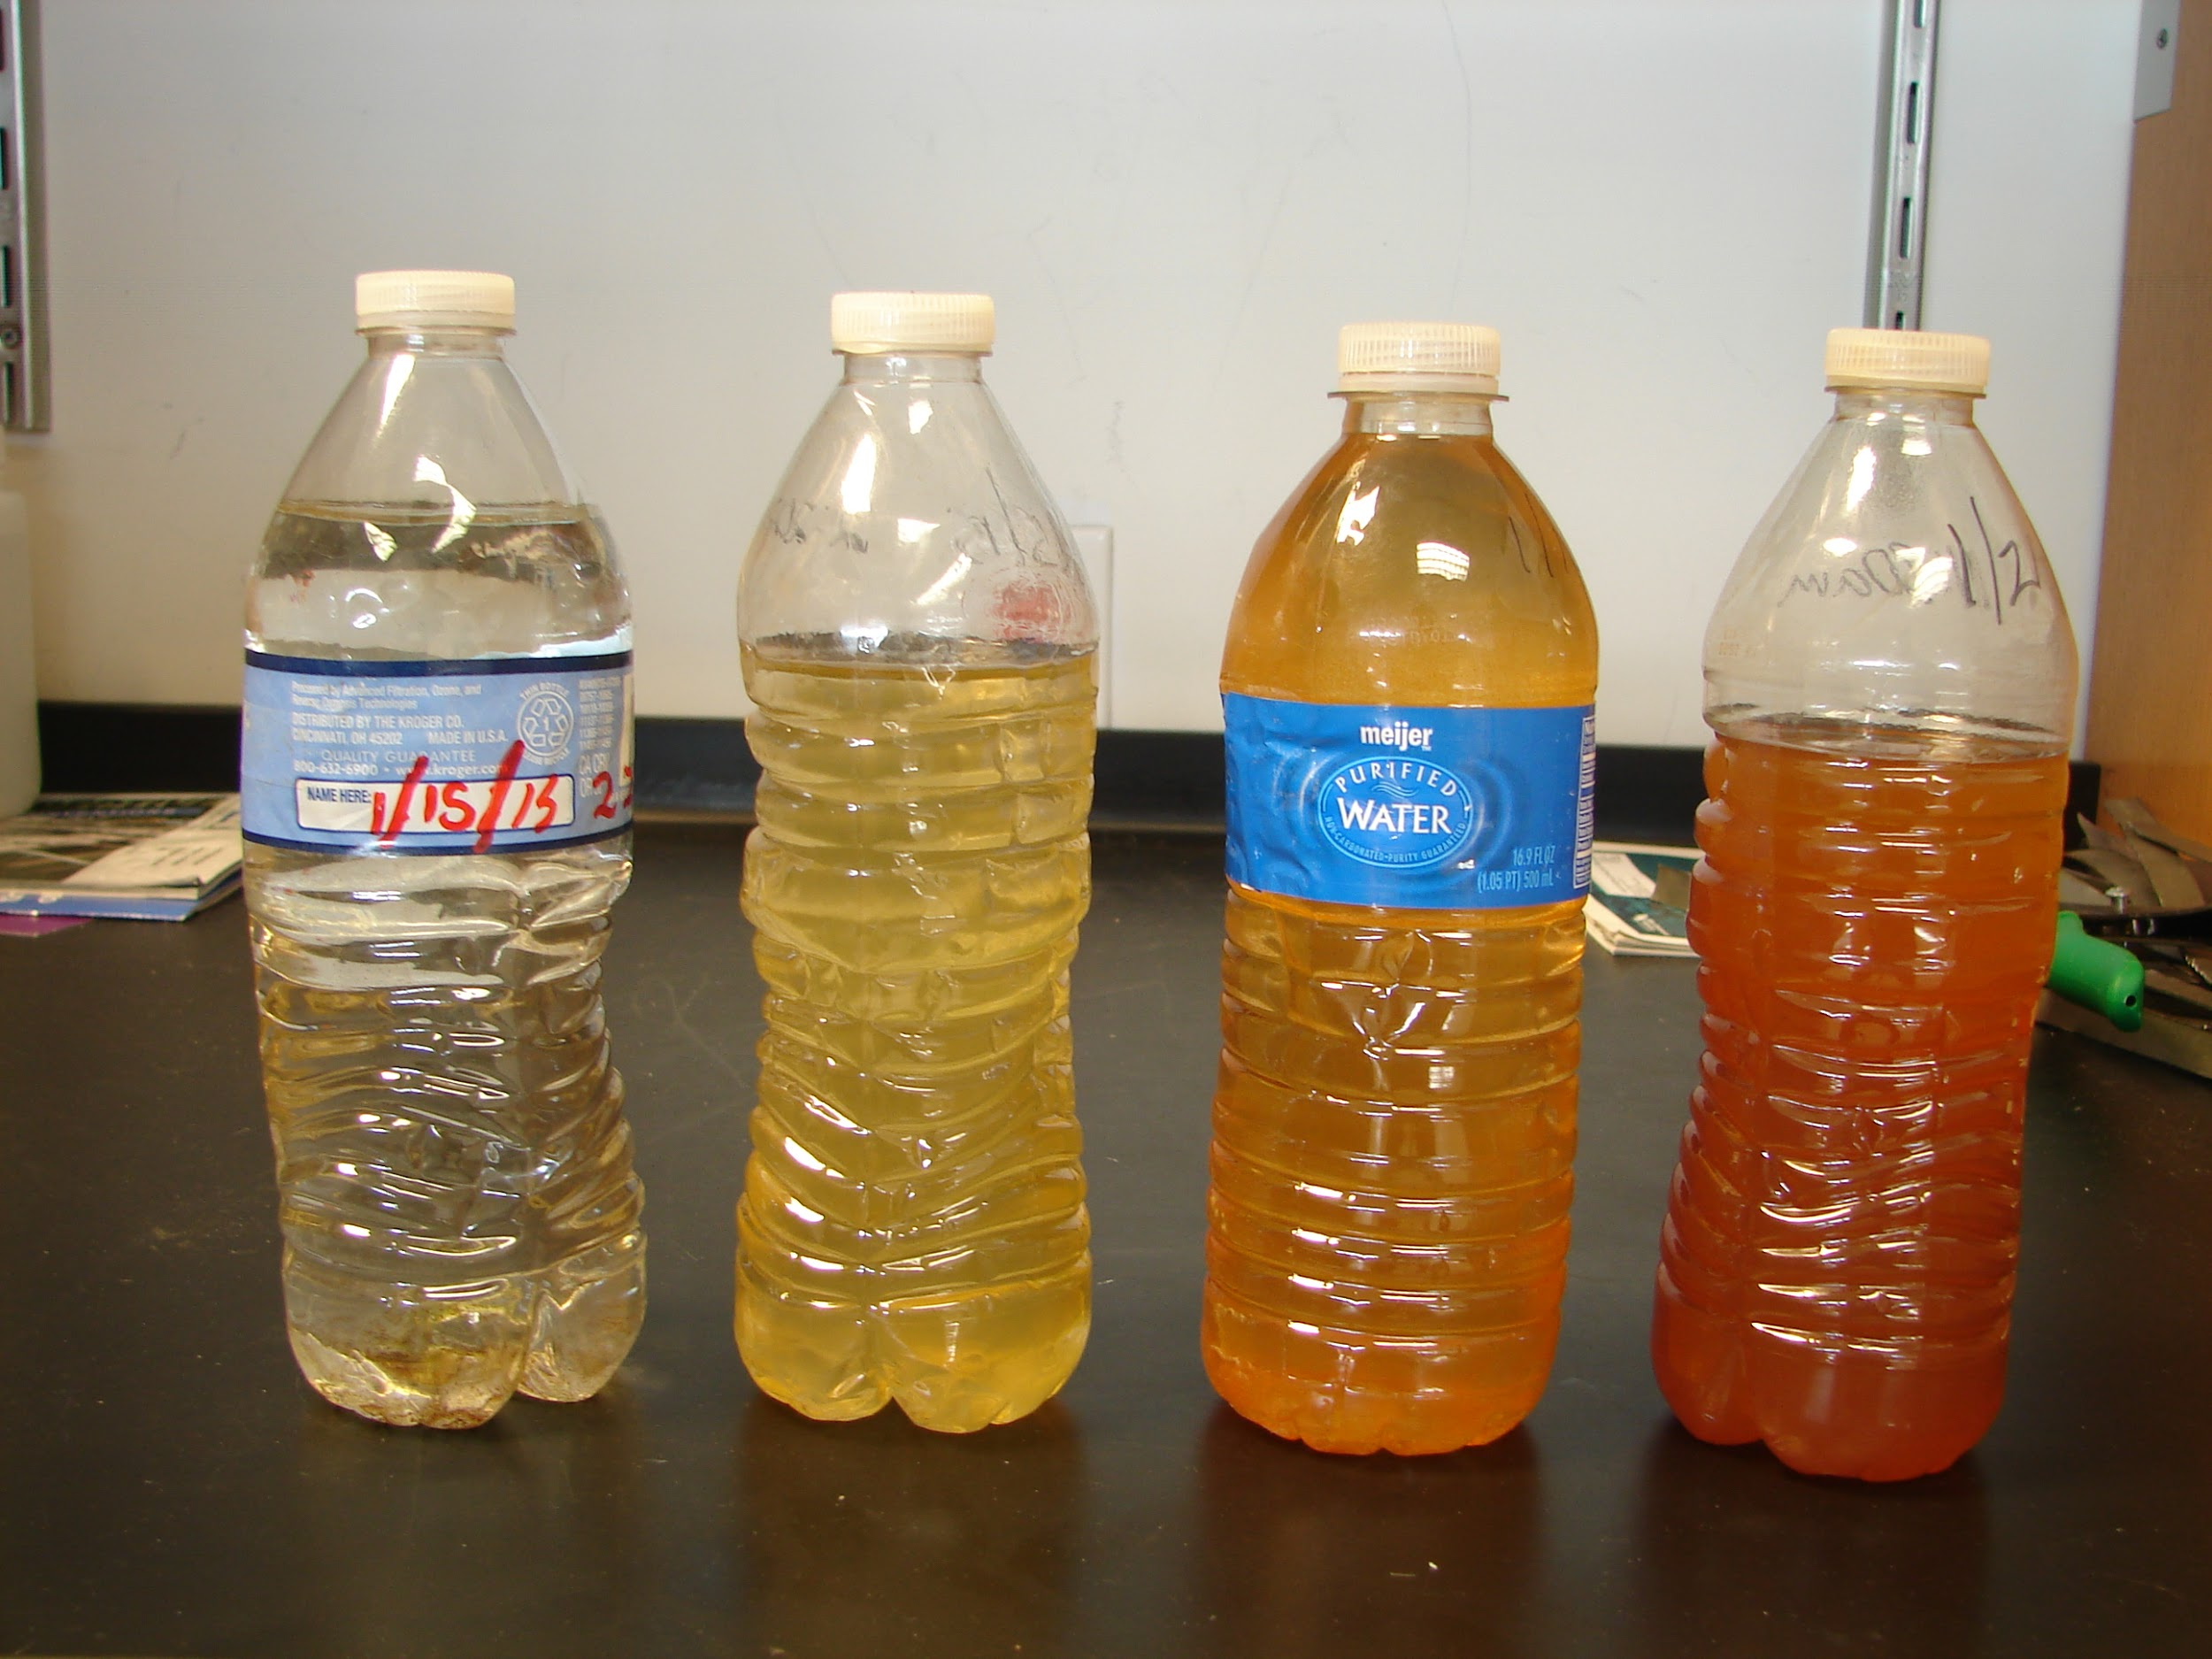
Step #3: Identifying the Causes of the Problem
Water is uniquely vulnerable to pollution. Known as a “universal solvent,” water is able to dissolve more substances than any other liquid on earth. It’s the reason we have Kool-Aid and brilliant blue waterfalls. It’s also why water is so easily polluted. Toxic substances from farms, towns, and factories readily dissolve into and mix with it, causing water pollution (nrdc).
Notes:
https://www.nrdc.org/stories/water-pollution-everything-you-need-know#whatis

Slide 6
Step #3: Identifying the Causes of the Problem
Officials failed to apply corrosion inhibitors to the water. As a result, lead from aging pipes leached into the water supply, leading to extremely elevated levels of the heavy metal neurotoxin and exposing over 100,000 residents to elevated lead levels.
Officials didn't use a corrosion-control treatment to maintain the stability of rust layers (containing lead) inside service lines. Within a month of the switch, residents started to report smell and color changes to their water.
Notes:
https://www.nrdc.org/stories/water-pollution-everything-you-need-know#whatis

Slide 7
Step #3: Identifying the Causes of the Problem
In the middle of the 20th century, Flint was a small but thriving city, a hub of manufacturing where solid, middle-class jobs at General Motors were plentiful. When the automotive industry faltered, so did Flint.
After thousands of factory jobs left Flint, so did many of its residents, and neighborhoods throughout the city are still marked by blight and abandoned houses, often vandalized or taken over by squatters.
With a declining tax base, the city’s fiscal condition slid, too. Ultimately, Flint’s finances were so perilous that the state sent in emergency managers to oversee city operations,
Notes:
https://www.nrdc.org/stories/water-pollution-everything-you-need-know#whatis

Slide 8
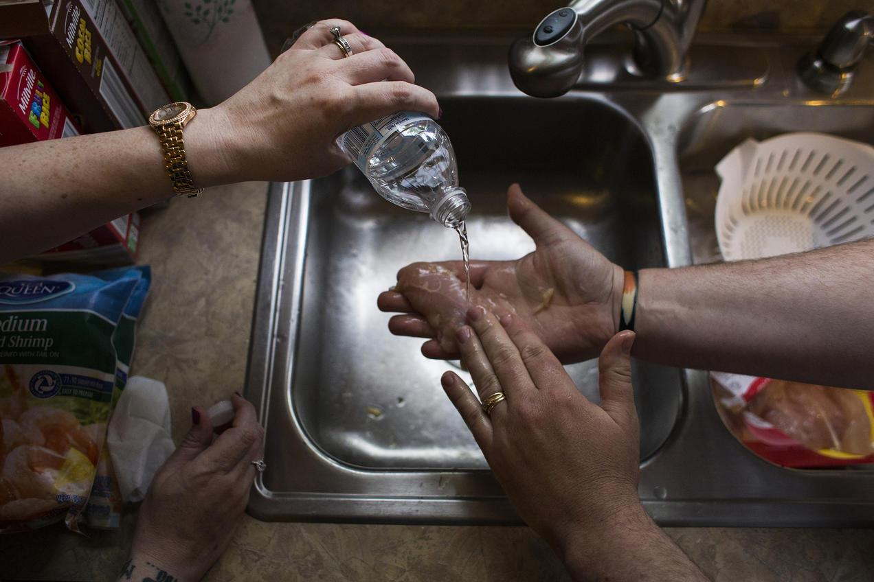
Step #4: Evaluating Existing Public Policies
A story of environmental injustice and bad decision making, the water crisis in Flint, Michigan, began in 2014, when the city switched its drinking water supply from Detroit’s system to the Flint River in a cost-saving move.
Inadequate treatment and testing of the water resulted in a series of major water quality and health issues for Flint residents—issues that were chronically ignored, overlooked, and discounted by government officials even as complaints mounted that the foul-smelling, discolored, and off-tasting water piped into Flint homes for 18 months was causing skin rashes, hair loss, and itchy skin.

Slide 9
Step #4: Evaluating Existing Public Policies
15 people who worked in state and local government roles have been charged with crimes in Flint’s crisis.
The charges have reached high levels of Michigan’s government, and suggested that officials had failed to warn residents of known risks and allowed their desire to save money in financially strapped Flint to come before the safety of water.

Slide 10
Step #4: Evaluating Existing Public Policies
EPA has awarded a $100 million grant to MDEQ to fund drinking water infrastructure upgrades in Flint. The funding, provided by the Water Infrastructure Improvements for the Nation (WIIN) Act of 2016, enables Flint to accelerate and expand its work to replace lead service lines and make other critical infrastructure improvements.

Slide 11
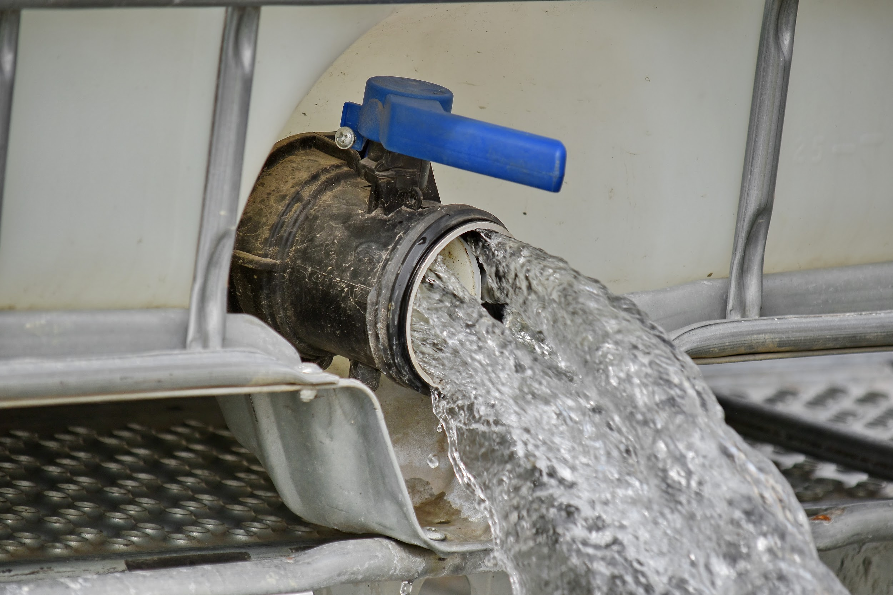
Develop 3 policies based of the Flint Water Crisis
Propose at least three new/original public policy alternatives.
Be sure that all of your public policy alternatives are at the same geopolitical level as your social problem.
Each alternative must specify the actual government or government agency that will carry out the proposed action.
List the proposal that your group considers the most promising first.

Slide 12
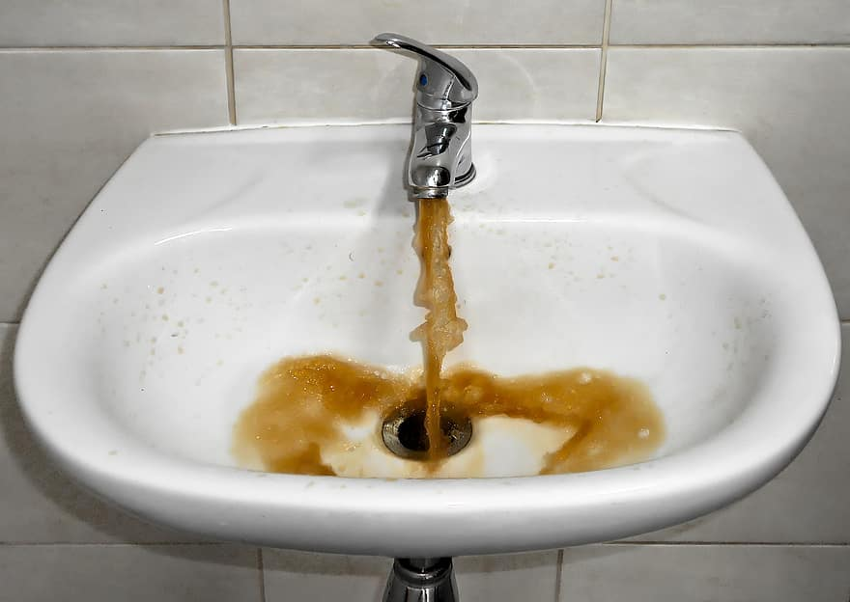
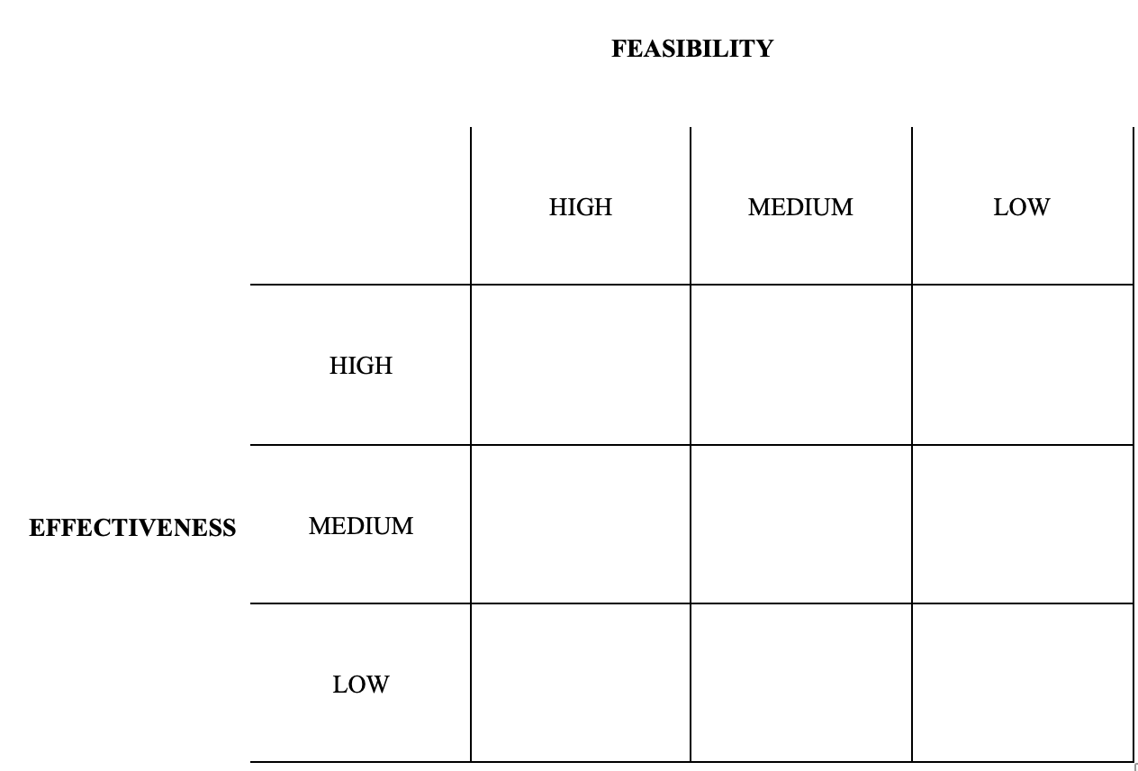
Based on the 3 previous policies, use the matrix to select the best solution.
Step #6: Selecting the Best Public Policy Solution

Slide 13
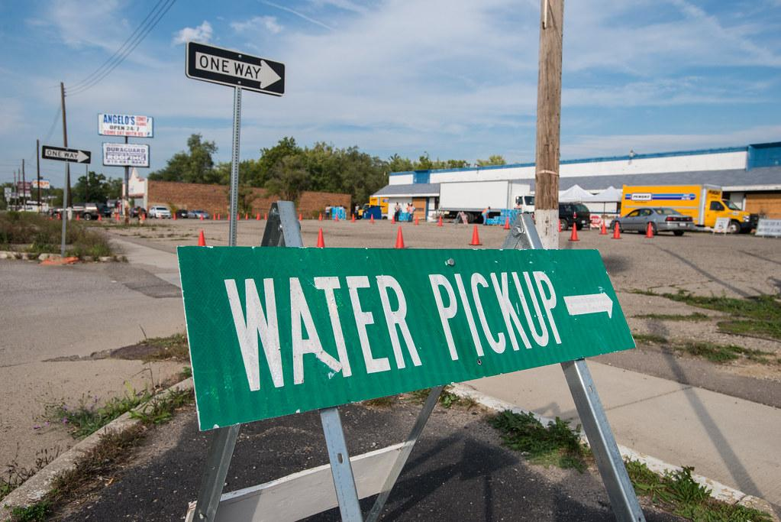
Thank you
Ms. Francis

