Slide 1

Bilingual Special Ed: Help Wanted
Mr. Samuel Ducoff
High School for Law and Public Service
SDucoff@nyc.schools.gov

Slide 2

Today’s Agenda: Be a Public Policy Analyst

Slide 3

The Roadmap to Success
Define the Problem
Gather the Evidence
Identify the Causes
Evaluate an Existing Policy
Develop Solutions
Select the Best Solution
To be a PPA, you must follow the 6 steps to success!

Slide 4

Step #1: Define the Problem
What’s the problem?
There is a lack of certified Bilingual Special Education teachers in NYC

Slide 5

Turn and Talk for 3 minutes
How would you feel if your teacher couldn’t communicate with you during class?

Slide 6

Step #2: Gather the Evidence
Many of NYC’s bilingual special education students don’t get the right services. Remote learning has made it even harder.
Special Ed and Bilingual Teacher Shortages
Bilingual Teachers Are in Short Supply. How Can Schools Cultivate Their Own
As PPA experts, we must investigate and find data to help us with our investigation!

Slide 7
The Facts
“As of November 2019, about 3,800 students legally entitled to be in small, bilingual special education classes didn’t receive the accommodation, according to education officials” (Chalkbeat)
“There are currently 500 certified bilingual special education teachers in the city, according to officials, with another 500 special education teachers who have a bilingual extension” (Chalkbeat)
“People who want to become certified in both bilingual and special education must pursue about 18 to 24 more credit hours of coursework than a general education teacher” (UFT)
Currently there are a total of 275 bilingual special education classes across all grades in New York City, while recruiting enough qualified teachers is a huge challenge in opening new bilingual special education programs. (DOE)

Slide 8

Turn and Talk for 3 minutes
Which piece of evidence surprised you the most and why?

Slide 9
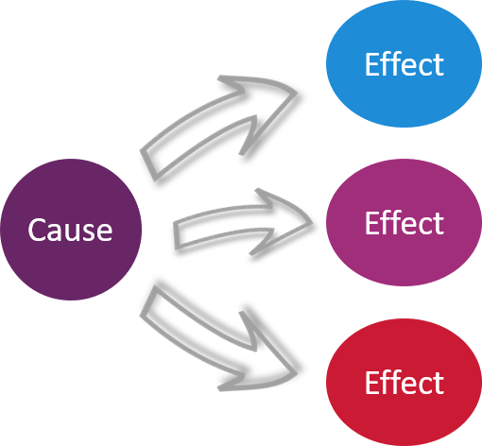
Step 3: Identify the Causes
Normally a problem doesn’t arise from thin air. There must be at least one cause for this problem! As PPA’s, we must identify them.
The Causes
High needs schools and districts, which tend to have the most bilingual students, have trouble recruiting and keeping bilingual teachers
Many students speak less common languages, making it more difficult to find bilingual teachers
The road to bilingual certification is time consuming, requiring more coursework and extra tuition costs for perspective bilingual teachers

Slide 10
Step 4: Evaluate an Existing Policy
Now let’s evaluate a current NYSED policy regarding bilingual teachers!
According to the New York State Education Department, “To address the critical issue of the shortage of qualified staff, NYSED has developed a number of programs to recruit, evaluate, and develop Bilingual teachers throughout the state.”

Slide 11


Step 4: Evaluate an Existing Policy (Cont’d)
Some of these programs include:
  the Clinically Rich Intensive Teacher Institute which provides tuition assistance for Bilingual courses that lead to a teaching license (NYSED).
  Alternative education degree programs such as NYCTF and NYCTC that offer subsidized tuition for teachers going for Bilingual Education

Slide 12


Step 5: Develop Solutions
Solution 1-Incentivize current special education teachers to get bilingual certification through higher tuition subsidies, loan repayment programs, and salary increases
Solution 2-Improve partnerships with university education programs and develop a more comprehensive recruiting strategy for potential bilingual sped teachers
Solution 3-Allow for current sped teachers that happen to already be bilingual but lack certification to teach in bilingual sped classes while they obtain their official certification

Slide 13
Step 6: Select the Best Solution(s)
Feasibility
 | High | Medium | Low
High |  | Solution #3
Medium | Solution #2 | Solution #1
Low
Effectiveness

Slide 14

Which solution(s) is/are best?
Exit Ticket: Write a paragraph explaining the best solution

Slide 15
Sources:
https://ny.chalkbeat.org/2020/4/30/21242991/many-of-nycs-bilingual-special-education-students-dont-get-the-right-services
https://www.citeonline.com/special-ed-and-bilingual-teacher-shortages/
https://blogs.edweek.org/edweek/learning-the-language/2019/03/bilingual_teachers_shortage.html#:~:text=The%20bilingual%20teacher%20shortage%20is,language%20classrooms%2C%20federal%20data%20indicate.

