Slide 1
Introduction to the Public Policy Analyst (PPA)
Learn How to Become a Public Policy Analyst
A Large Number of Teens Drive Drunk in the United States

Slide 2
WHAT IS THE PUBLIC POLICY ANALYST?
The Public Policy Analyst (PPA) is designed to help students to maximize their participation in government as responsible citizens. As a public policy analyst, you and your class will develop the following policy skills, learning how to:
Identify the nature of a social problem
Gather evidence to support the existence of the problem
Determine the causes and factors contributing to the problem
Evaluate the existing policy
Develop public policy alternatives
Determine the best public policy solution to the problem

Slide 3

What is Public Policy?
Public policy as a system of principles, rules, and guidelines concerning a given topic promulgated by a governmental entity or its representatives to reach its long-term goals for the greater public good.

Slide 4

Step 1 - Define the Problem
As a public policy analyst, your group will need to identify the social problem we want to study and the location in which the problem is occurring:
Example: Too many teenagers drive drunk in the U.S.

Slide 5

Step 2: Gather Evidence
As a Public Policy Analyst, we conduct research to find evidence that shows that this problem exists.
The three types of evidence we will search for to support the existence of the problem we are studying are:
Statistics
Expert Articles
Case Studies
Example:
Since 2015, young drivers involved in fatal crashes rose by 3.6% (source)

Slide 6
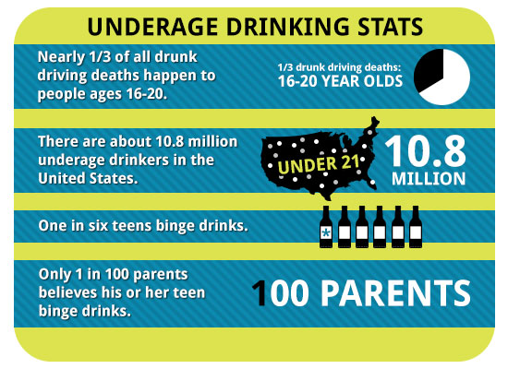
Statistics
Statistics refers to numerical facts or data. Usually statistics are organized and tabulated to present significant information. Statistical data are essential to demonstrate the existence of a social problem. Statistics regarding specific social conditions can be compared among different locations or over a period of time to demonstrate that an undesirable social condition is worse in one community or has increased over a number of years.

Slide 7

Expert Articles
Like case studies, articles by experts are generally less persuasive as evidence in doing PPA than statistics. First, for the article to have any value, the author has to be a recognized expert in the field that he or she is writing about. For example, during the middle of the twentieth century, Dr. Benjamin Spock was one of the country’s most well known experts on baby and child care. His books and articles on the subject influenced policies used by other doctors and hospitals.

Slide 8

Case Studies
A case study is a description of a particular type of social condition, organization, group, or individual. Generally, statistical data provides stronger evidence than individual case studies. For example, to demonstrate the problem of unemployment in your city, one would want to know the statistical rate of unemployment provided by the US Department of Labor. However, a case study might shed some additional insights into the actual effects of unemployment on a typical family. Therefore, never use case study data as a sole source of evidence in doing PPA. If you use them at all, include a reference to a case study to supplement statistical data.

Slide 9
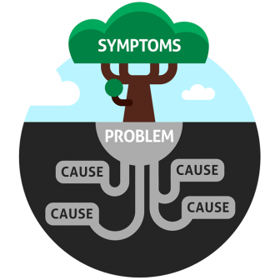
Step 3: Identify the Cause
As a Public Policy Analyst, we continue our research to identify the causes or factors that contribute to the social problem that we are studying, then we can try to eliminate or lessen those causes or factors
Example:
Why do teenagers drink and drive? Create a survey using Google forms.

Slide 10

Step 4: Evaluate an Existing Public Policy
As Public Policy Analysts we conduct further research into the policies that already exist regarding the social problem we are studying. We ask:
Through our evaluation of those policies, we identify their advantages and disadvantages and determine if they should be replaced, strengthened, or improved. What do these policies say? Who do they benefit? Do they address the issue of teen drunk driving? Do these policies need to be changes?
Example:
What is the current policy to reduce teenage drunk driving deaths?

Slide 11
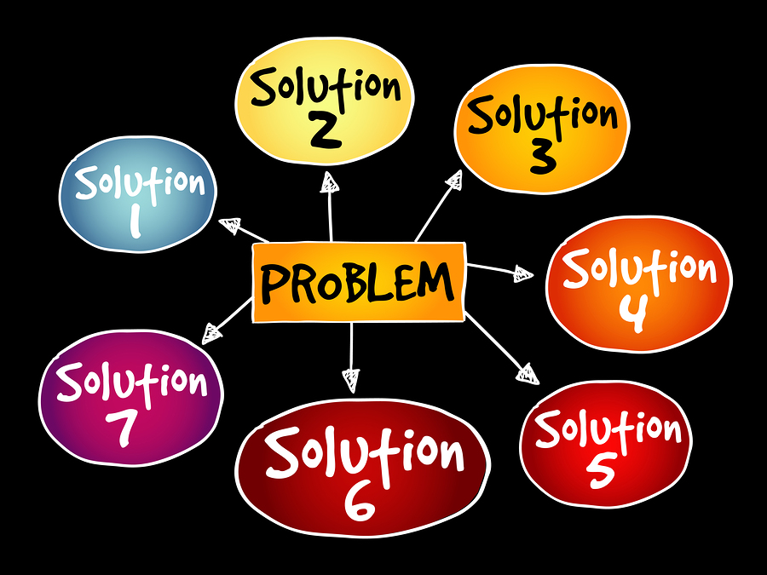
Step 5: Develop Solutions
As a Public Policy Analyst, we develop three (3) potential solutions to the problem we are studying in one of two way:
We can either eliminate or lessen the causes or contributory factors through a new public policy, or we can strengthen or improve the current public policy in place to address this solution (e.g. tougher penalties, more public education, additional regulations, clearer guidelines)
Example:
Develop solutions to prevent teenage drunk driving deaths.

Slide 12

Step 6: Select the Best Solution
As a Public Policy Analyst, you will now evaluate the three (3) potential solutions identified in step 5 and select your preferred policy.
Two criteria that will assist in determining the best policy are feasibility and effectiveness . Your best policy should rate highly in both, if possible.
Example:
Using the solutions you came up with in the previous step, which one do you think will be the best?

Slide 13
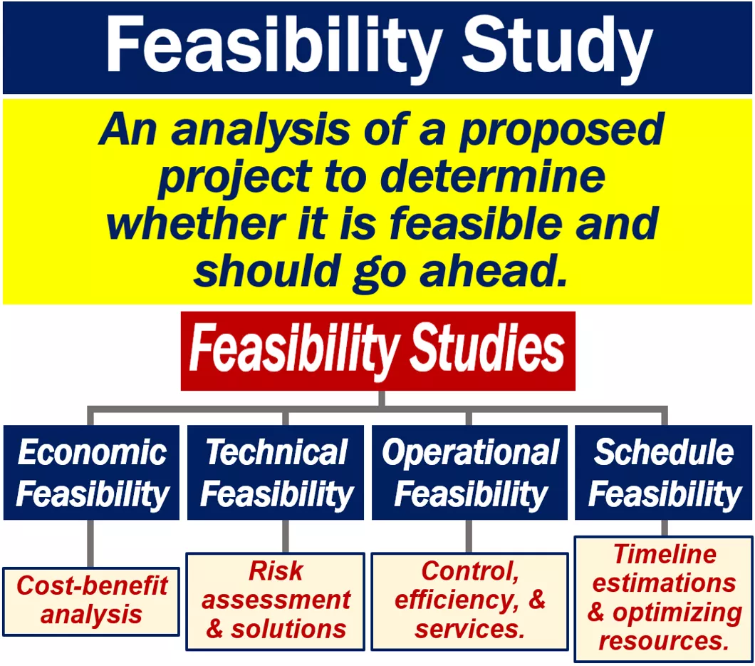
Feasibility
Feasibility refers to the likelihood that your policy would be enacted by the government or government agency. Feasibility can be affected by factors such as cultural acceptance and the anticipated costs in comparison to the benefits.
As a Public Policy Analyst in order to select the best public policy solution for your problem feasibility must be considered.

Slide 14
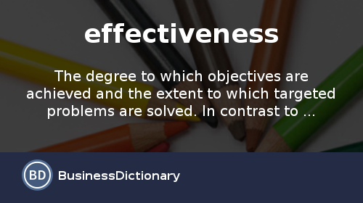
Effectiveness
Effectiveness refers to the likelihood that your policy will produce results that lessen the social problem. To be able to anticipate the effectiveness, it is essential that your problem in step 1 is narrowly and specifically stated.
As a Public Policy Analyst in order to select the best public policy solution for your problem effectiveness must also be considered.

Slide 15
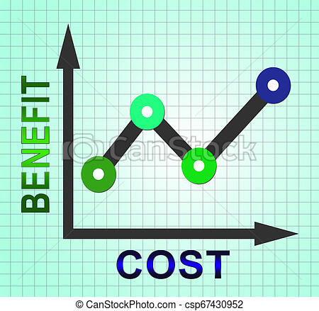
Evaluating Costs and Benefits
Now it is time to examine effectiveness more closely. You probably selected your policy because you believe it will bring about good or desirable consequences. These future good consequences are called benefits. Your policy may also bring about some bad or undesirable consequences. These are called costs. The process of studying the benefits and costs of a public policy is called evaluation.

Slide 16

STUDENT APPLICATION
As Public Policy Analysts you will now work in your groups to apply your new found knowledge to find a solution to a social issue that has be plaguing the Senior Class at Urban Assembly Academy for Future Leaders since the beginning of the 2019-2020 School Year.
Problem: Chronic Lateness

