Slide 1
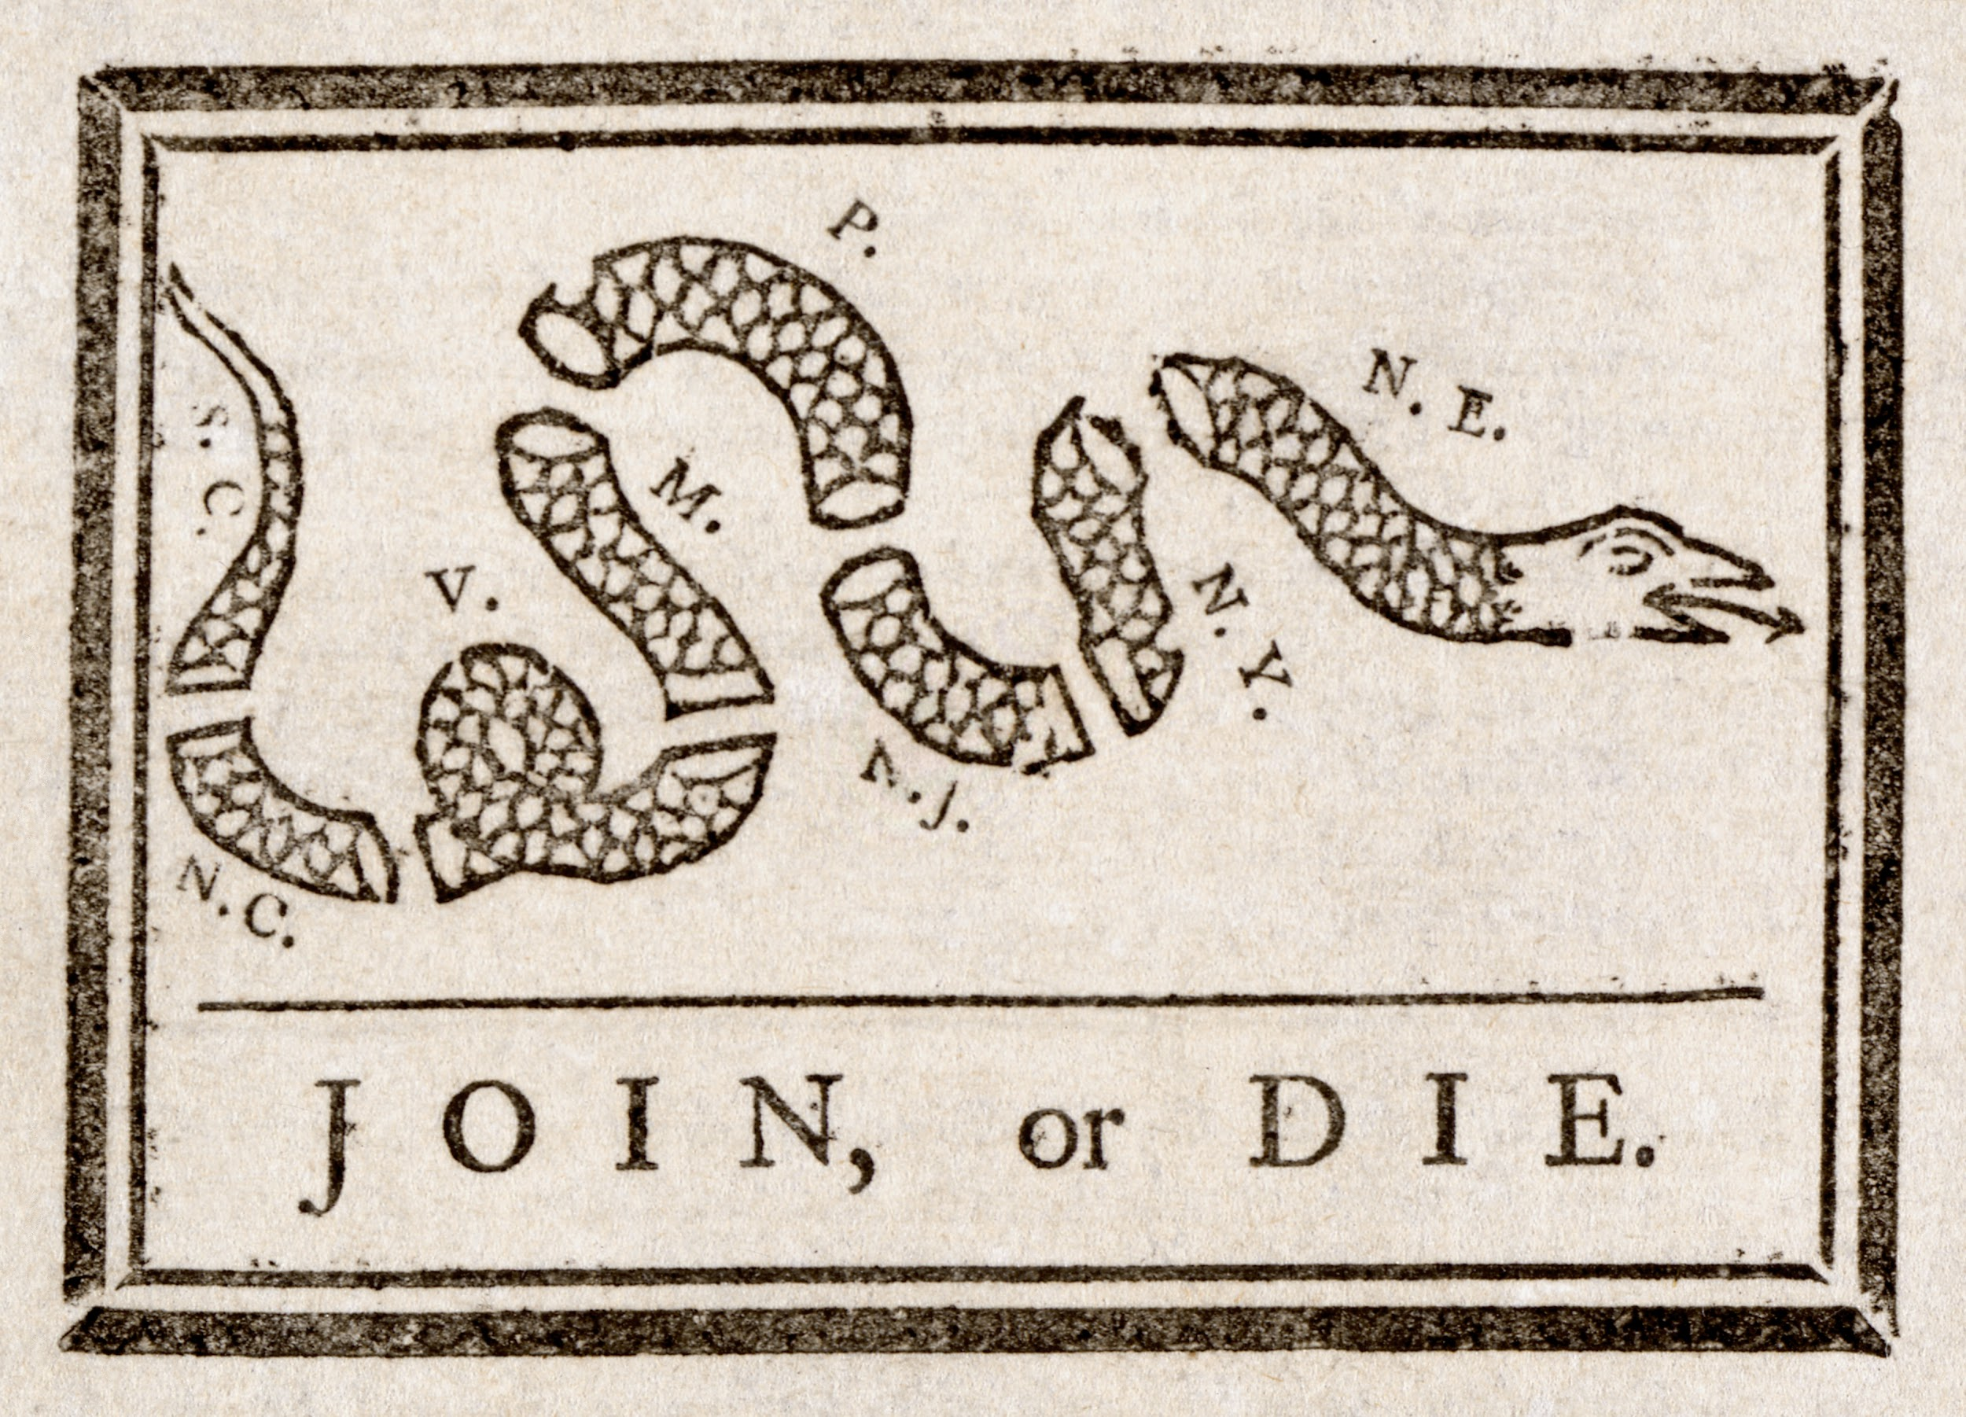
American Revolution(Beginning)
FDA -Neville David -Grade 8th
U.S. History
Negative impact of British rule on the 13 colonies

Slide 2
Steps of the PPA
Define the Problem
Gather the Evidence
Identify the Causes
Evaluate the Policy

Slide 3
1.Define the Problem
British rule of the 13 colonies led to oppression
Do Now: Identify the word oppression
Please review the following DBQ
(You will use the documents in slides ( 9-12)

Slide 4
The American Revolution
1775-1783
The revolutionary war in America is also known as the American revolution. was fought between great Britain and the thirteen colonies. The result was the formation of a new nation-the United States of America.

Slide 5
2. Gathering the evidences
To investigate and gather evidence of social bullying and oppression. Please review each document 1 and 2) from slides 9 and 10) and notes to t to gather evidence
-Sugar Act-1764
-Stamp Act -1765
-Boston Massacre

Slide 6
The Stamp Act of 1765 – required colonist to pay for tax stamps on newspapers, and various legal documents. Parliament abolished the Act in 1766.
4. The Townshend Acts of 1767 placed a duty on imported goods including glass, lead, paint, and paper. Americans responded by not buying British goods.

Slide 7
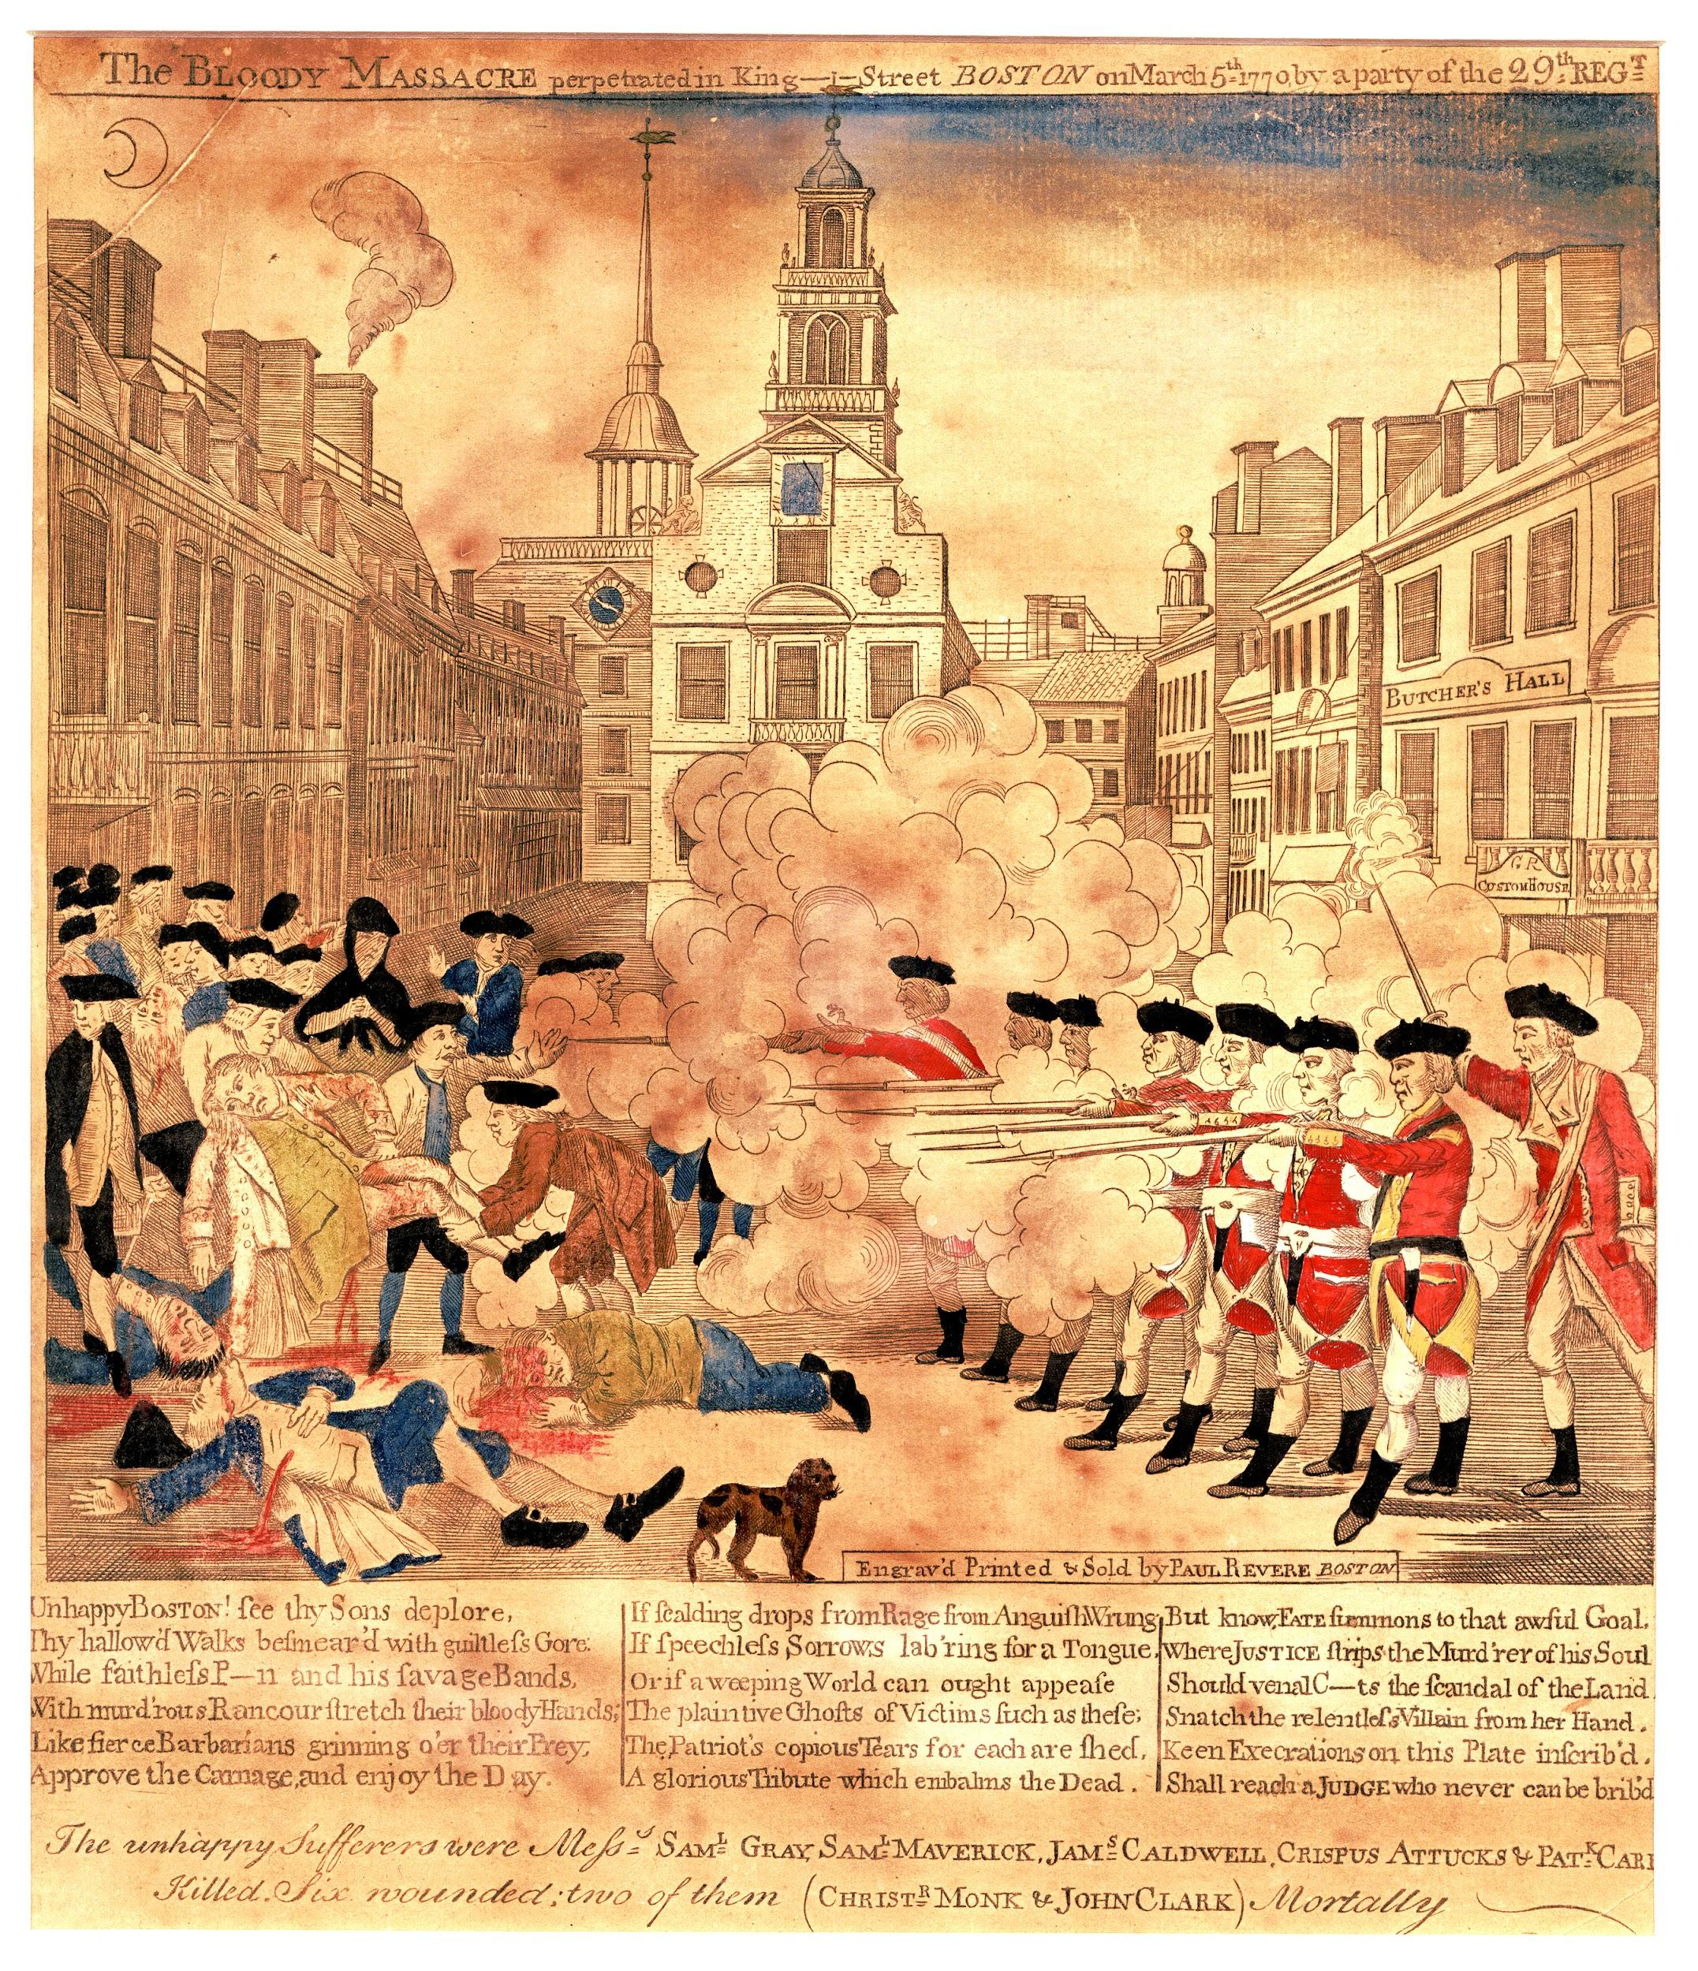
Boston Massacre-1770
Angered by the presence of troops and Britain's colonial policy, a crowd began harassing a group of soldiers guarding the customs house; a soldier was knocked down by a snowball and discharged his musket, sparking a volley into the crowd which kills five civilians.

Slide 8
3-Identify the causes
Please review the following document or pages to identify why historian would argue that stamp act,, sugar act, or Boston Massacre would be considered a cause leading the American Revolution . Feel free to add outside document not mentioned(Intolerable Act, Common Sense, Patrick Henry) -)(Students will be provided with a DBQ document source from textbook to analyze why these events contributing the causes. ( Doc 1-4 from slides 9-12)

Slide 9
Doc #1 excerpts are from Letters from a Farmer in Pennsylvania by John Dickinson. Dickinson was a Pennsylvania political leader who served in the Stamp Act Congress of 1765. Later in his career, he served in the Continental Congress, and later still, in the Constitutional Convention. In the following statement, Dickinson condemned some of the new taxes being imposed by Parliament.
Doc !TDBQ# here is another late act of parliament, which appears to me to be unconstitutional, and ... destructive to the liberty of these colonies.... The parliament unquestionably possesses a legal authority to regulate the trade of Great Britain, and all her colonies. I have looked over every statute [law] relating to these colonies, from their first settlement to this time; and I find every one of them founded on this principle, till the Stamp Act administration.... All before, are calculated to regulate trade.... The raising of revenue ... was never intended.... Never did the British parliament, [until the passage of the Stamp Act] think of imposing duties in America for the purpose of raising revenue. [The Townshend Acts claim the authority] to impose duties on these colonies, not for the regulation of trade ... but for the single purpose of levying money upon us.
According to Dickinson, what taxes was Parliament justified in imposing on the colonies?
Why did he object to the Stamp Act and the Townshend Acts?

Slide 10
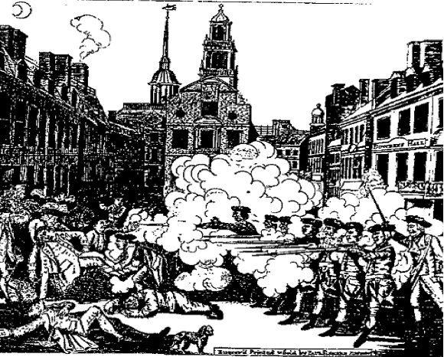
Doc #2 On March 5, 1770, a crowd of Boston boys and men surrounded a number of British soldiers and began taunting and cursing them while they pelted them with snowballs. Order quickly broke down, and the frightened soldiers fired into the crowd. When the shooting ended, several people were dead and more were wounded. This engraving by Paul Revere, a leader of the Boston Sons of Liberty, was sent throughout the Colonies in the following weeks to arouse anti-British feelings.
How does the engraving tell a different story from the above description of the Boston Massacre?
Where do you suppose the term "massacre" came from that describes this event?

Slide 11
Document -3
These excerpts are from Thomas Paine's Common Sense, published in January 1776. This popular pamphlet helped to convince many Americans that the conflict with England was beyond peaceful settlement and that independence was America's only course.
D
Men of passive tempers look somewhat lightly over the offenses of Great Britain, and, still hoping for the best, are apt to call out, COME, COME, WE SHALL BE FRIENDS AGAIN FOR ALL THIS. But ... then tell me whether you can hereafter love, honour, and faithfully serve the power that hath carried fire and sword into your land? ... No man was a warmer wisher for a [peaceful settlement] than myself, before the fatal nineteenth of April, 1775 [the battles at Lexington and Concord, Massachusetts, occurred on this day], but the moment the event of that day was made known, I rejected the hardened, sullen-tempered [King of England] forever.
1-Why was Paine unwilling to be reconciled with Britain?
2-Was Paine an objective and unbiased reporter? Explain.

Slide 12
Quartering Act (1764, 1775)
His majesty hereby requires the people to house and quarter his soldiers and officers in barrackers provided by the colonies; and if there shall not be sufficient room in these barracks, then in such a case the soldiers must be housed in the quartered in the homes of the people in the colony. They are also required to do the following:
Provide food for the troops
Provide beer and wine for troops
Provide bedding, utensils, candles and firewood for troops
Explain how Quartering Act beneficial to the British and harmful the colonies?

Slide 13
4-Evaluating the existing policies -Declaration of Indepence
Please identify the advantages of the Declaration of Independence
Advantages
Please review the stamps act or other documents to see how the the law was beneficial to the British
Disadvantages
Discuss how the law hurt the colonies

