Slide 1
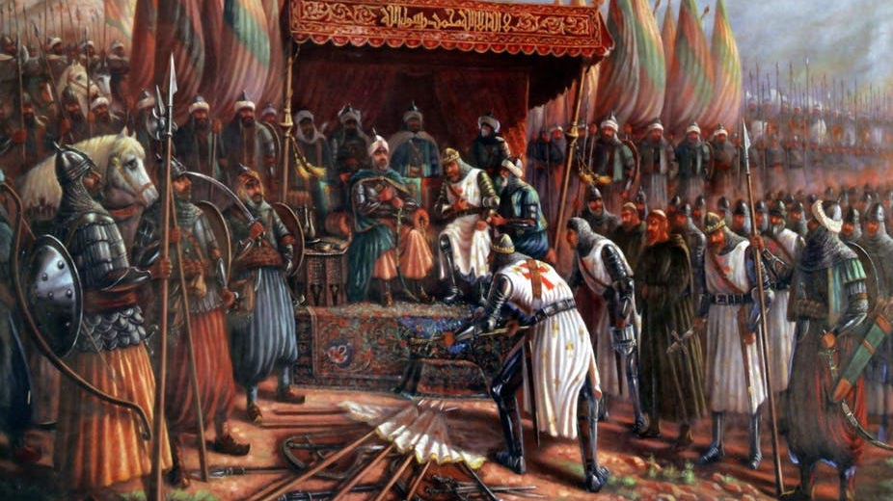
How has religion been used to justify war?
By
Algeri Cruz
High School for Media and Communication

Slide 2
WE will Use the 4-Step Public policy approach to analyze the situation
1. | Define the Problem
2. | Gather Evidence of the Problem
3. | Determine Causes of the Problem
4. | Evaluate the Policy
 | Worksheet3: "Identifying the Causes"(MSWORD) Worksheet3: "Identifying the Causes"(HTML)
 | Please use the document links above to respond to the question
For this presentation we will only
focus on steps 1 through 4

Slide 3
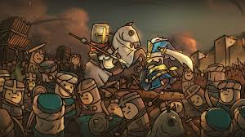
Identify the Problem can religion be used to justify war?
The Medieval Crusades were Wars that were fought in the name of God

Slide 4
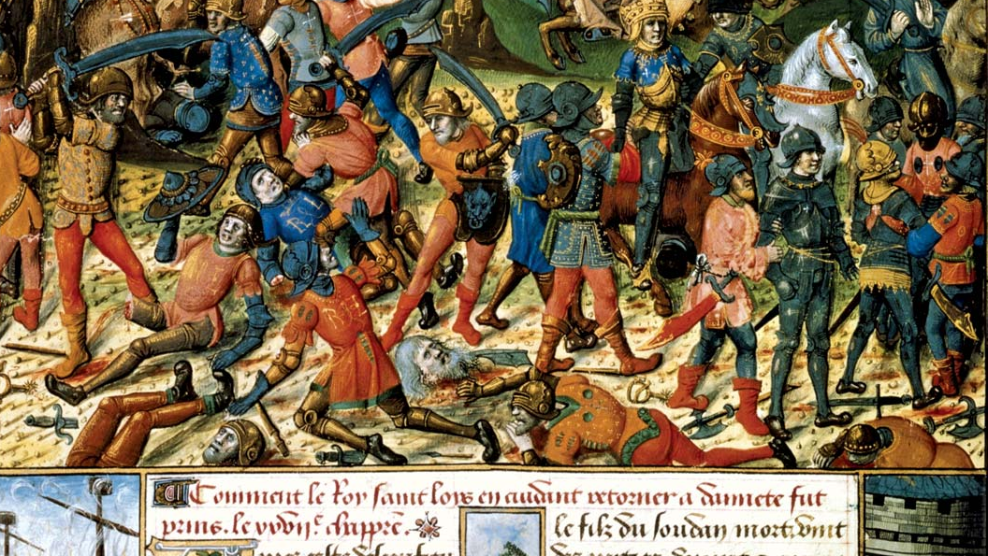
Gather Evidence of the Problem
Why Did the Christians go to War with the Muslims?

Slide 5
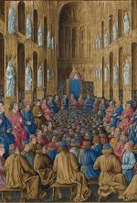
Gather Evidence of the Problem
Why did the Crusades Begin?
In response to the Muslims Invasion of Palestine Pope Urban II called to arms the French and German Bishops to retake the Holy land.
Any Christians who answered this call were known as Crusaders.

Slide 6
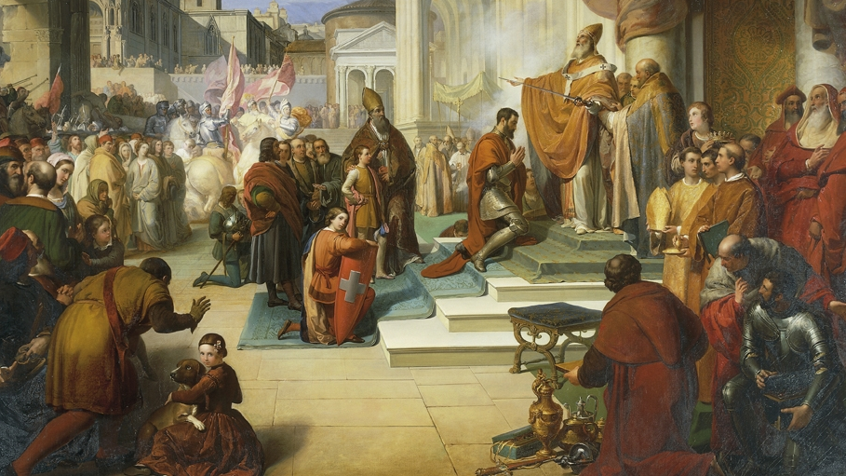
Determine causes of the problem
What Reasons did the Catholic Church use for fighting against the Muslims?

Slide 7

What do you think the word “CAUSE” means?
For example: If there is a house on fire, what do you think caused (started) it?

Slide 8
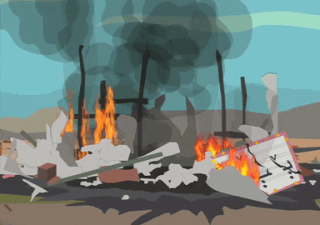
What do think the word “EFFECT” means?
For example: What is the effect (result) of the fire on the house?

Slide 9
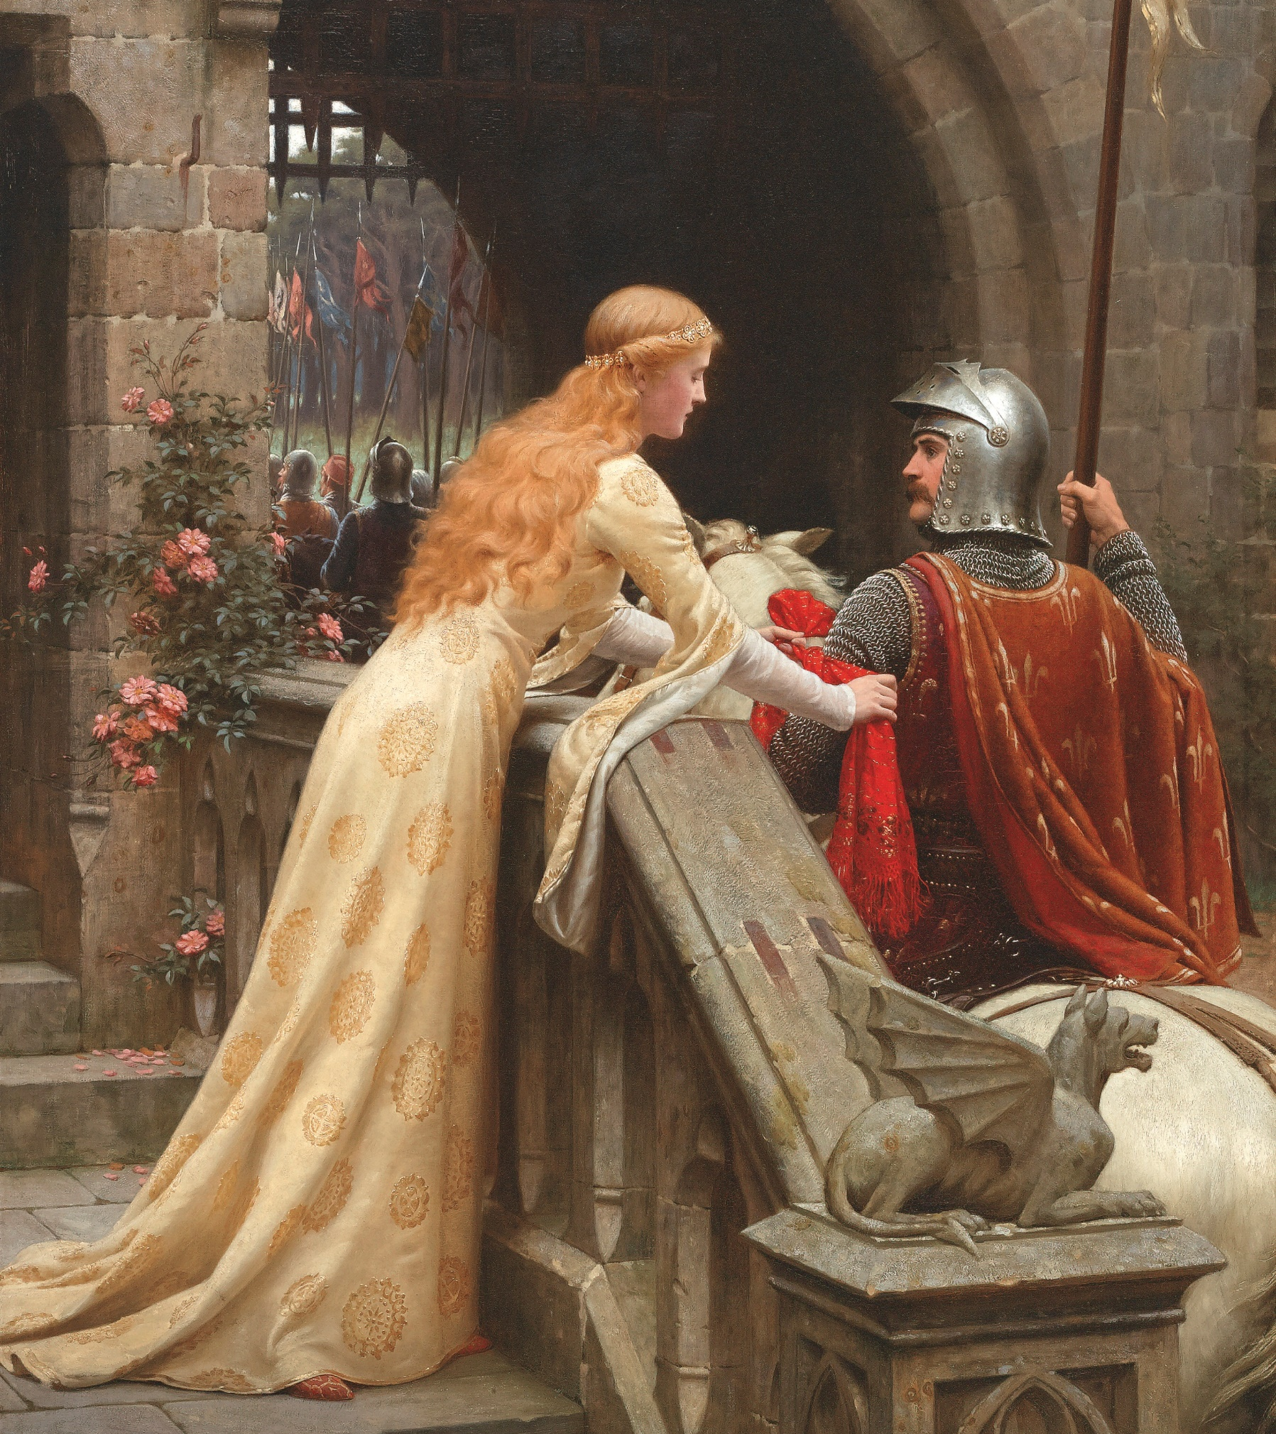
Determine Causes of the problem Christian Crusaders reason for fighting a holy war
Christians believed that fighting in the Crusades would wipe away their sins.
The Pope believed that the Church would gain power over Europe while also uniting Christians who where fighting amongst themselves.
He said those who fought and died in the Crusades would be promised a spot in Heaven with all sins forgiven.
about 30,000 men took up his offer and left Western Europe to fight in.

Slide 10
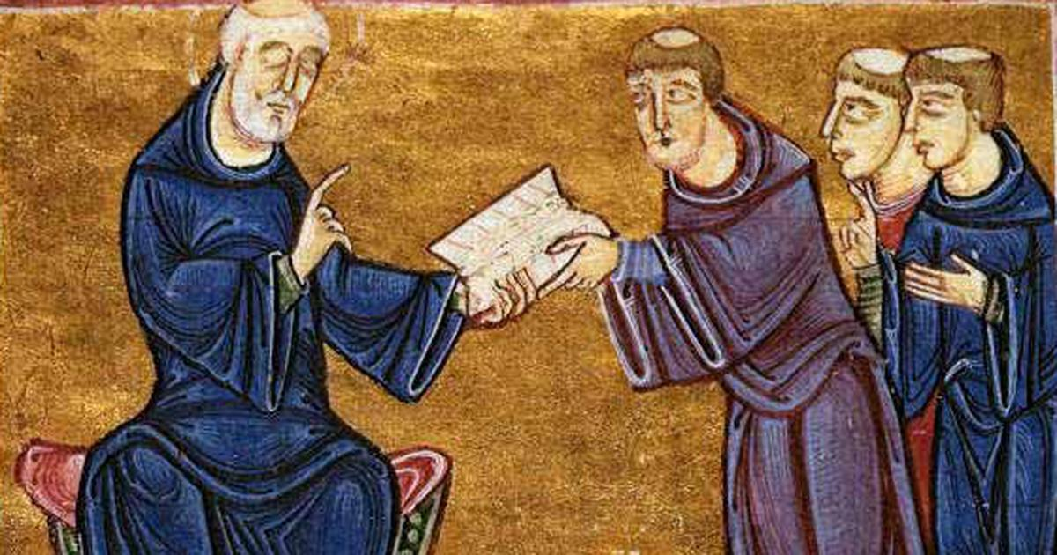
Evaluate the Policy
How effective was the Decision to fight a War in a Foreign land solely based on religion?
What were the short-term effects?
What are the Long-Term effects?

Slide 11
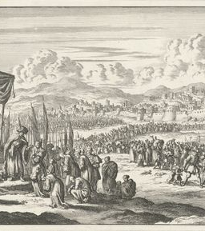
Evalute the policy
Short-term effects
Temporary gains in land
Showed power of the Church in convincing thousands to fight
Women gained more freedom
Inflation, peasants' riot for higher wages
Persecution of Jewish peoples in Europe and the Middle East
Muslims Reactions to the Crusades:
In the 1100’s Saladin unites the Muslim World. In 1291 the Muslims regain Jerusalem and avenged the attacks on Constantinople.

Slide 12
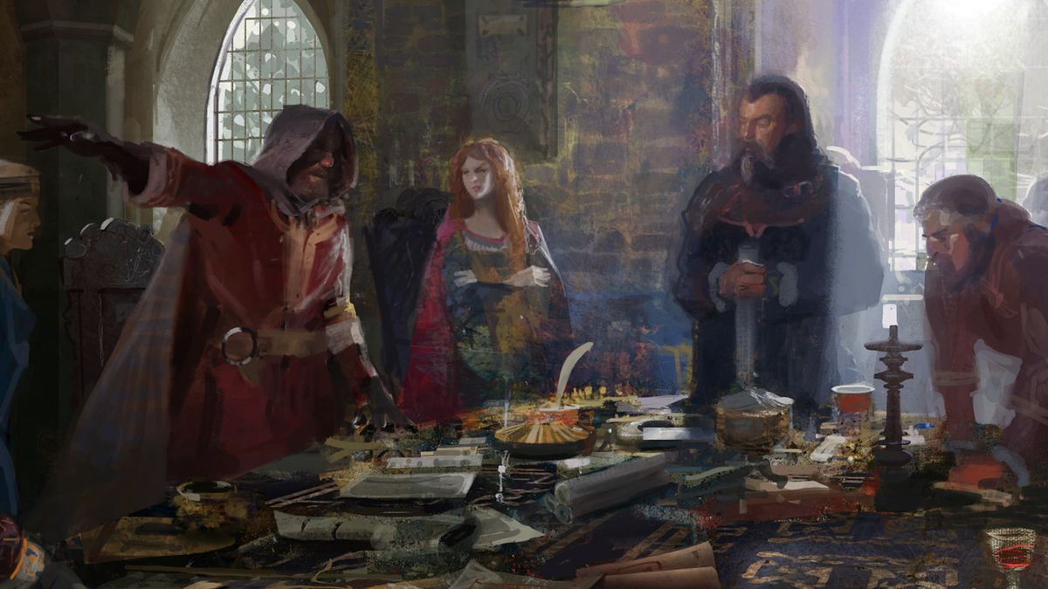
Long term effects
Failure of later Crusaders weakens the pope
Rise of Nations (Countries)
Strengthening of power of kings
End of Feudalism
Improved trade with East
Revival in learning and spread of knowledge
Intolerance and Brutality between both sides thus creating lasting hate

Slide 13

Resources
https://www.youtube.com/watch?v=X0zudTQelzI&t=218s
https://www.ancient.eu/article/1249/the-crusades-causes--goals/
https://www.youtube.com/watch?v=NGyCpI1zE6k
https://www.youtube.com/watch?v=bCiNvTNwAQk
https://www.youtube.com/watch?v=7LY2CMteGw8
Please use these resources to help you respond to the question “How has Religion been used to justify war?

