Slide 1
Bullying at P.S 129
Erica Cornett
P.S 129, John H. Finley Campus School

Slide 2
PPA: A public policy analyst is someone who works to make people aware of social issues in ther communitites.
The 6 Steps of the Public Policy Analyst (PPA)
1. Define the Problem
2. Gather the Evidence
3. Identify the Causes
4. Evaluate an Existing Policy
5. Develop Solutions
6. Select the Best Solution (Feasibility vs. Effectiveness)

Slide 3
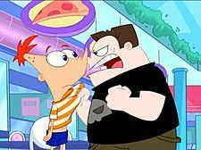
Step 1: Define the problem: A social issue is a problem that many people in a community face.
Turn and talk about what problem you think may be taking place in these images.

Slide 4
Step 2; Gather the evidence: This is the proof that a problem exists.
Let’s take a survey! Click the link to take the survey.
https://forms.gle/8z9xJxg3XXuXEC8A9
Notes:
https://forms.gle/8z9xJxg3XXuXEC8A9

Slide 5
Step 3: Identify the causes: These are the reasons why something happens.
Identify what causes the Recess
Queen to be a bully.
Think of other reasons why some
One might become a bully.

Slide 6
Step 4: Evaluate an Existing Policy: Take a closer look at rules on the books.
Anti-Bullying rules help to stop bullying. Here are some examples.
Parent outreach
Short term behavioral progress reports
Intervention by counseling staff
Talk to an adult you trust. Don’t keep your feelings inside. Telling someone can help you feel less alone. They can help you make a plan to stop the bullying.
Stay away from places where bullying happens.
Stay near adults and other kids. Most bullying happens when adults aren’t around.
What are some other things that kids could do to stop bullying?

Slide 7
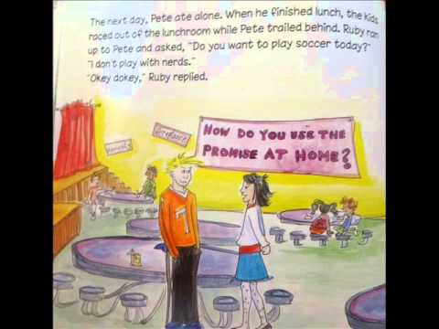
Step 4: Develop Solutions: Steps to get rid of the problem
In your groups discuss possible
solutions.

Slide 8
Step 6: Select the Best Solution: Which idea do you think will be the easiest to do and have the best results?
 | FEASIBILITY
EFFECTIVENESS |  | HIGH | MEDIUM | LOW
 | HIGH
 | MEDIUM
 | LOW

