Slide 1
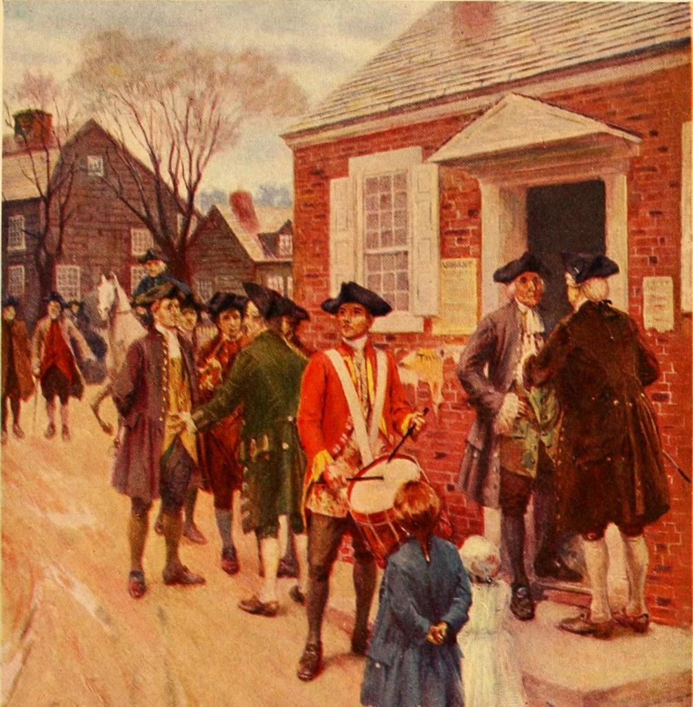
Taxation Without Representation is Tyranny!
By Marta T. Colomer
P. S. 129M

Slide 2
Analyze the reasons for the American colonists’ discontent towards the British using the American History Public Policy Analyst (AHPPA) format.
1. Define the Problem
2. Gather the Evidence
3. Identify the Causes
4. Evaluate the Policy

Slide 3
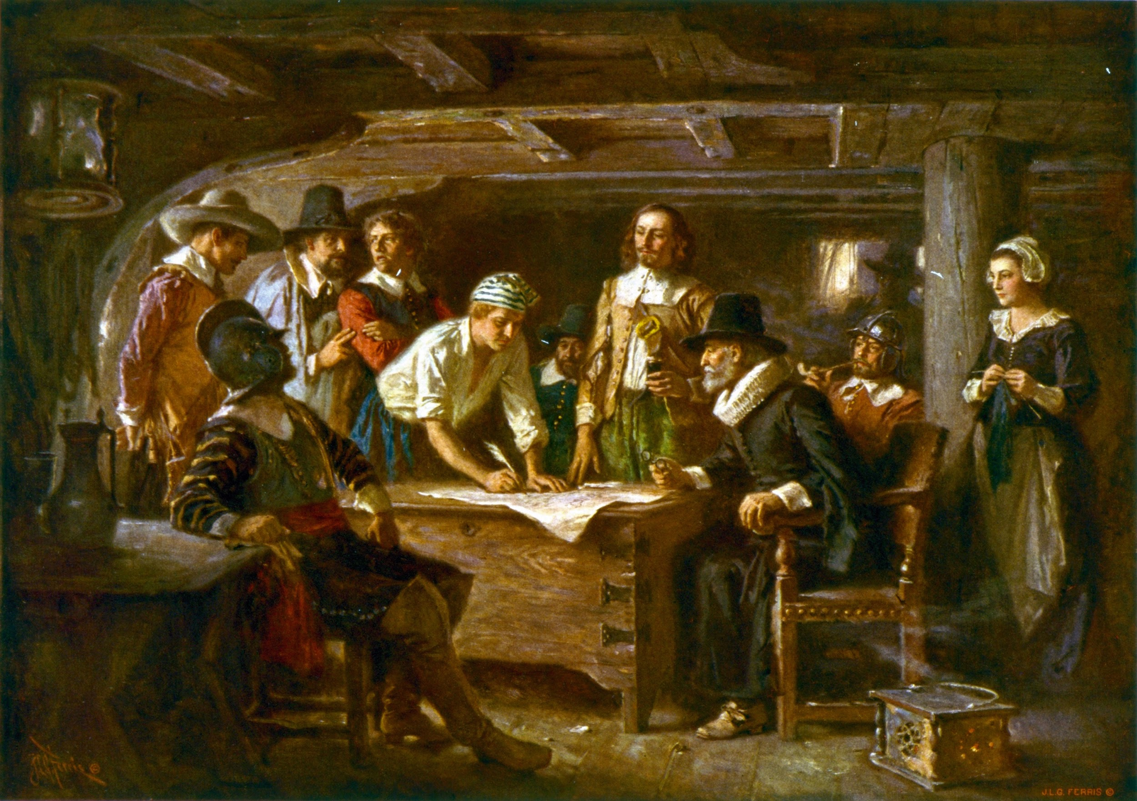
American Colonies Under British Rule
The American colonists worked hard.
They built towns and settlements.
They fought against Native American attacks.
They only export raw materials to England and only import finished goods from England
Step 1 of the AHPPA: Define the Problem:
The British government wants to make money from the American colonies so they impose various taxes on the colonies.

Slide 4
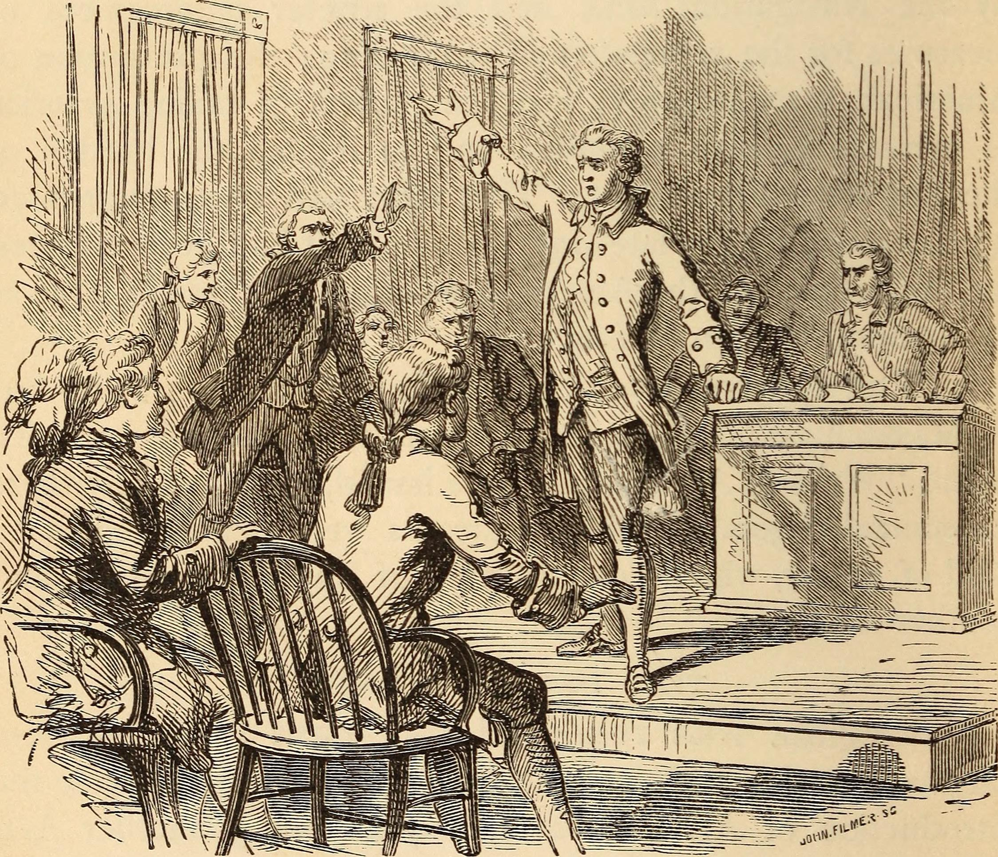
Step2 of the PPA: The Evidence
Rules and Taxes Imposed on the American Colonists:
Navigation Act
Sugar Act
Currency Act
Stamp Act
Currency Act
Define these terms by researching the following websites:
https://revolution.mrdonn.org/stampact.html
https://www.ducksters.com/history/american_revolution/the_stamp_act.php

Slide 5
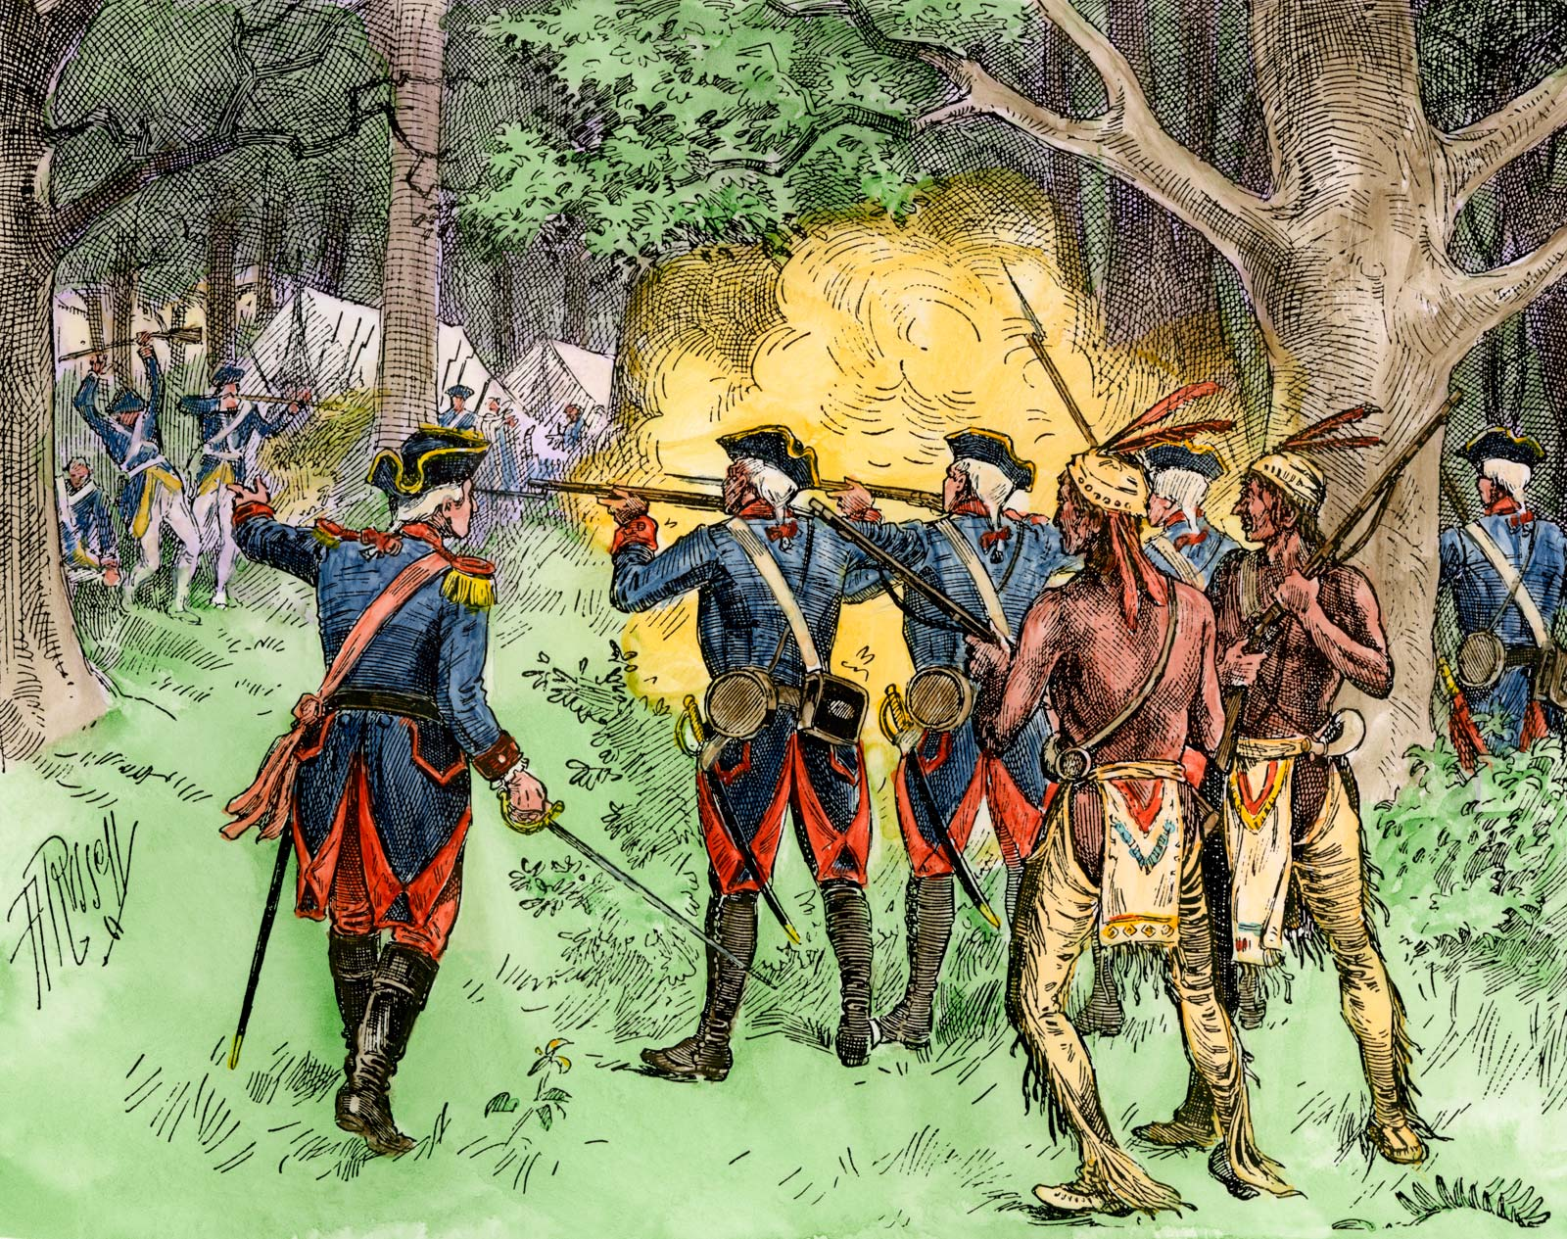
The French & Indian War
The policy of Mercantilism: Colonies were primarily to benefit/enrich the mother country. Colonies were only allowed to trade with the mother country.
The French Indian War was fought from 1754-1763 in North America between the French and their Indian allies on one side and the British and the American colonists on the other. The British and colonists were the victors, but the financial costs of the war were high
Step 3 of the AHPPA: Causes:
The British government believed that the American Colonies should bear the burden of the costs of the war because they benefited from the outcome.

Slide 6
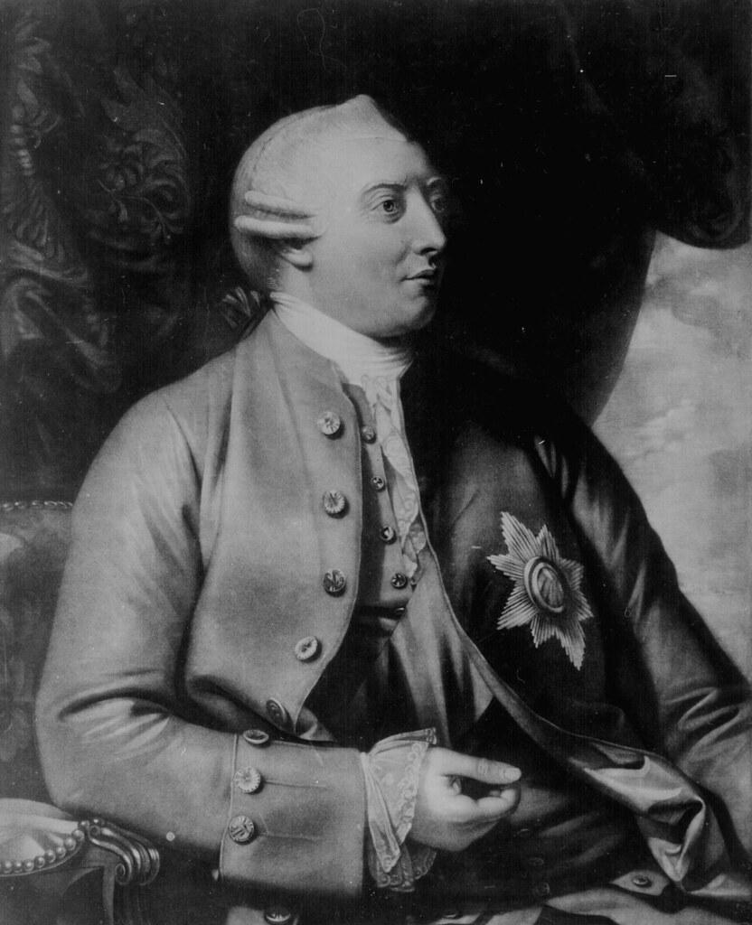
The American Colonist Disagree!
Why did King George III of Great Britain impose rules and taxes on the American Colonists?
Explain the meaning of “Taxation without Representation”for the American Colonists.
Step 4 of the AHPPA: Evaluate the Policy

Slide 7
Task - Choose One:
Based on your evidence, make believe that you are a colonist who disagrees about the Taxation without Representation imposed on the American colonist.. Write a letter to King George III of Great Britain explaining why his tax policy is unfair to the American colonists, giving him other suggestions on how to improve the situation.
Based on your evidence, make believe that you are a colonist who disagrees about the Taxation without Representation imposed on the American colonists. Compose and perform a protest song about this issue.
Based on your evidence, believe you are a colonist who disagrees about the Taxation without Representation imposed on the American colonists. Write a speech that you would deliver to your fellow American colonists under the Liberty Tree.

