Slide 1
Increased violence on NYC Subways
Ms. Christiansen
Mott Hall High School
mchristiansen2@schools.nyc.gov

Slide 2
The Public Policy Analyst

Slide 3
Define the Problem
Example Problem:
Subway ridership has decreased after the pandemic https://www.osc.state.ny.us/reports/osdc/impact-covid-19-pandemic-subway-ridership-new-york-city
However, there has been an increase in violent crime on the subway. This increase has been documented in local and national media. https://www.nytimes.com/2022/10/22/nyregion/nyc-subway-police-combat-crime.html
Problems exist everywhere. We see them in our school, in our neighborhoods and cities. We also see them in our nations and in the world.
We have problems in our city which attract national attention.
Think about your own neighborhood. Are there any problems that affect the people living there?

Slide 4
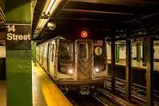
Gather the Evidence
Example Problem: Subway Crime
There are a few websites that gather information on crime statistics.
https://compstat.nypdonline.org/2e5c3f4b-85c1-4635-83c6-22b27fe7c75c/view/90
https://new.mta.info/document/95496
In addition multiple media outlets have covered this subject. Make sure you assess your medica sources, using the Fact vs. Fiction graphic organizer
Next, find sources of information about this problem.
Facts can be
Statistics
Photos
Interviews/Case studies
Experts
It is important to evaluate your resources. Use the internet source evaluation worksheet and the Fact vs. Fiction graphic organizer to evaluate sources.

Slide 5
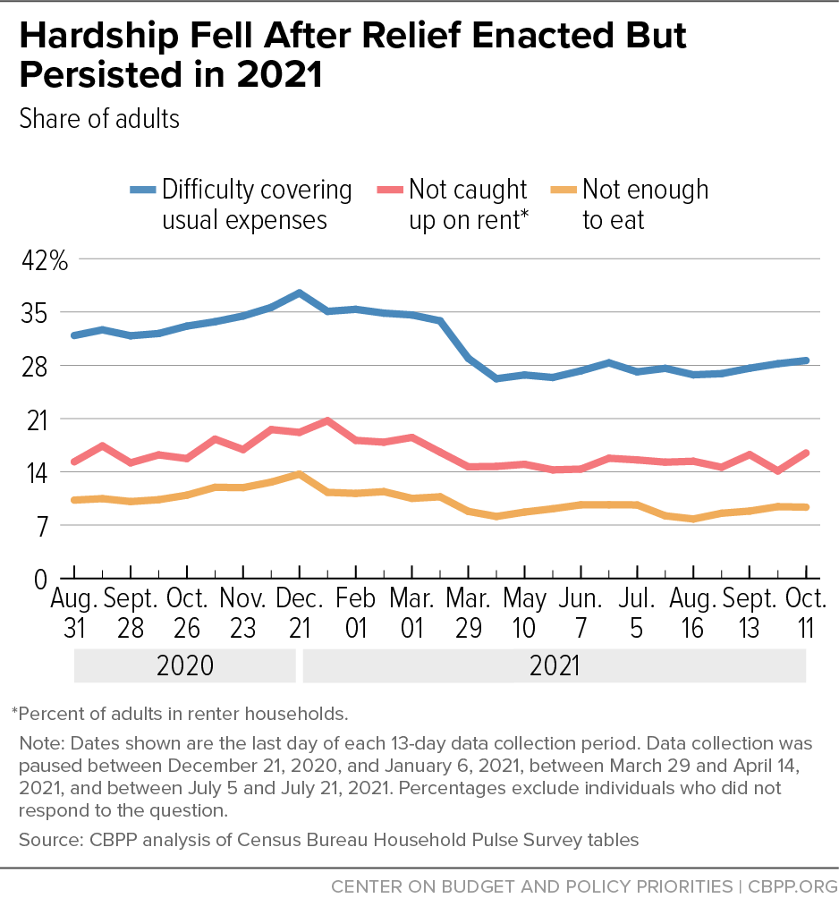
Identify the Causes
Example Problem: Crime in Subway
What events make this problem happen?
There are so many reasons for crime to occur. It could be a because of displacement, mental illness, and other social factors.
What motivates them?
Loss of jobs, mental stress, social problems
What steps or actions lead to the problem?
The various traumas of the pandemic have resulted in increased mental illness, insecurity and loss.
As we examine our sources, think about why this problem exists? Some guiding questions are:
What events make this problem occur?
What motivates the people involved in the problem?
What steps or actions lead to the problem?
Use your cause and effect graphic organizer . Enter your problem as the effect and use the sources to find causes of our effect/problem.

Slide 6
Examine & Evaluate Existing Policy
Example Problem: Subway crime
There is a police force specifically for the subway. There are laws against loitering, carrying weapons in the subway and crime in the subway.
Some suggested improvements are cameras in the subways, increased mental health services in the subways, increase police presence in the subways.
Are there policies in place to address this issue?
Policies can be rules and regulations, laws and directives that leaders use to guide the actions of individuals and organizations..

Slide 7
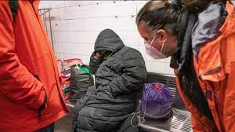
Develop Solutions
Example Problem Subway Crime
Possible solutions:
Increase the number of police officers present in the subway.
Install cameras to record any crime that occurs in the subway.
Increase the number of mental health providers in the subway system.
Guiding Questions?
What can we do to fix this problem?
Should we create rules?
Should we use incentives or rewards?
How can we change behavior?
How can we change minds?

Slide 8
The Public Policy Analyst Tool
Which solution is best?
Feasibility
 | High | Medium | Low
High |  | Increased Mental Health Supports | Increased Police Presence
Medium | Cameras
Low
Effectiveness

Slide 9
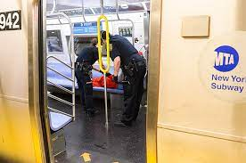
Select the Best Solution
What is Feasible?
What will be Effective?
Example:
The solution: Increased Mental Health Supports
Is this feasible?
How possible is it?
What will it take to get it done?
How effective is it?
How well do we think it will work?
What is Feasible?
Feasible means possible.
Which of these solutions is possible?
What is Effective?
Effective means it will work.
Which of these solutions is going to work?
Rate each solution on it’s feasibility and its effectiveness.

Slide 10
Your Voice
You will work in teams of 4 to address a problem using the Public Policy Analyst Tool.
We will choose a problem together and then use the graphic organizer to use each step of the Public Policy Tool to create new solutions.
We will then evaluate the solutions together as a group.

