Slide 1
Our Neighborhoods-
Gentrification in New York City
Ms. Christiansen
Mott Hall High School
mchristiansen2@schools.nyc.gov

Slide 2
The Public Policy Analyst

Slide 3
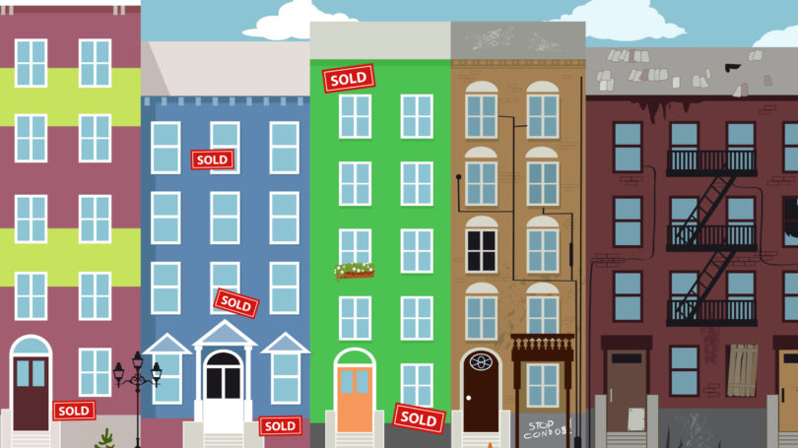
Define the Problem
Example Problem:
Gentrification
New people are moving into New York City neighborhoods and displacing the people who life there.
Problems exist everywhere. We see them in our school, in our neighborhoods and cities. We also see them in our nations and in the world.
In our novel The House on Mango Street we are learning about a family and a neighborhood. Think about your own neighborhood. Are there any problems the effect the people living there?

Slide 4
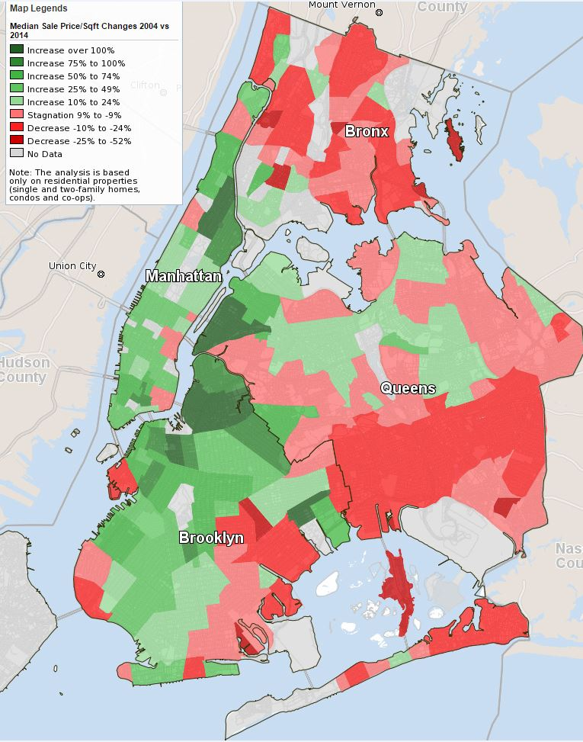
Gather the Evidence
Example Problem: Gentrification
This map is a good source of information. It shows us neighborhoods where housing prices have rapidly increased.
Another source for information about Gentrification is interviews with long time residents about changes they see in the neighborhood.
Next, find sources of information about this problem.
Facts can be
Statistics
Photos
Interviews/Case studies
Experts
It is important to evaluate your resources. Use the internet source evaluation worksheet and the Fact vs. Fiction graphic organizer to evaluate sources.

Slide 5
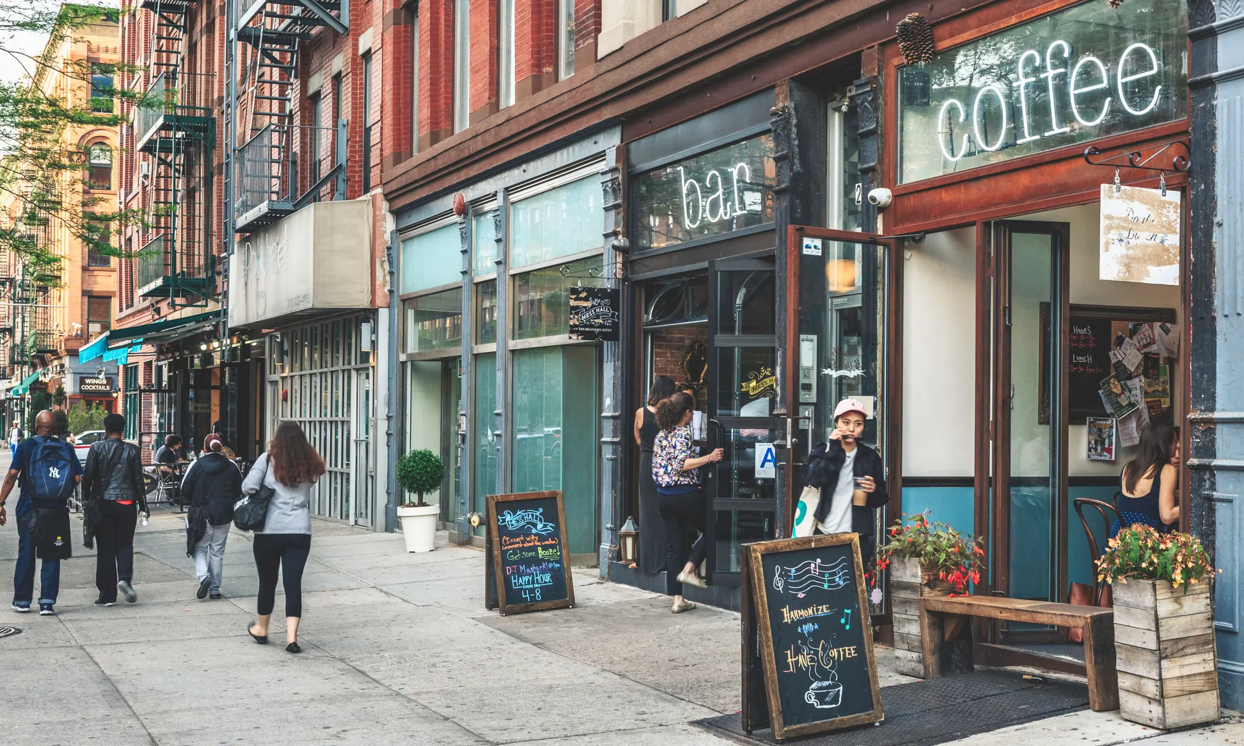
Case Study Harlem
125th a historic row of business owned and operated by community members was rezoned for commercial high rises.
This change changed the architecture of the street and the people working and patronizing the businesses on the street.
“When I was little it wasn’t the stores and the buildings but the vendors outside—people selling things, performing. That was Harlem. When Mayor Giuliani rezoned them to a parking lot in the nineties, we were worried that it would change the face of Harlem. Now, with the rezoning of 125th street it feels like history is just repeating itself. Those people have been there longer but now, they don’t fit into Harlem anymore with the new buildings and establishments.” Vance Rawles – a 24 year old student and Harlem native – expresses his concerns
How did zoning changes affect the building and use of a Harlem street?
To read the full report click below:
https://www.humanityinaction.org/knowledge_detail/gentrification-and-displacement-in-harlem-how-the-harlem-community-lost-its-voice-en-route-to-progress/

Slide 6

Identify the Causes
Example Problem: Gentrification
What events make this problem happen?
People move from one neighborhood to another.
What motivates them?
Changes in the cost of housing.
What steps or actions lead to the problem?
People in expensive neighborhoods want bigger spaces, they move into less expensive neighborhoods and drive up the cost of housing.
As we examine our sources, think about why this problem exists? Some guiding questions are:
What events make this problem occur?
What motivates the people involved in the problem?
What steps or actions lead to the problem?
Use your cause and effect graphic organizer . Enter your problem as the effect and use the sources to find causes of our effect/problem.

Slide 7
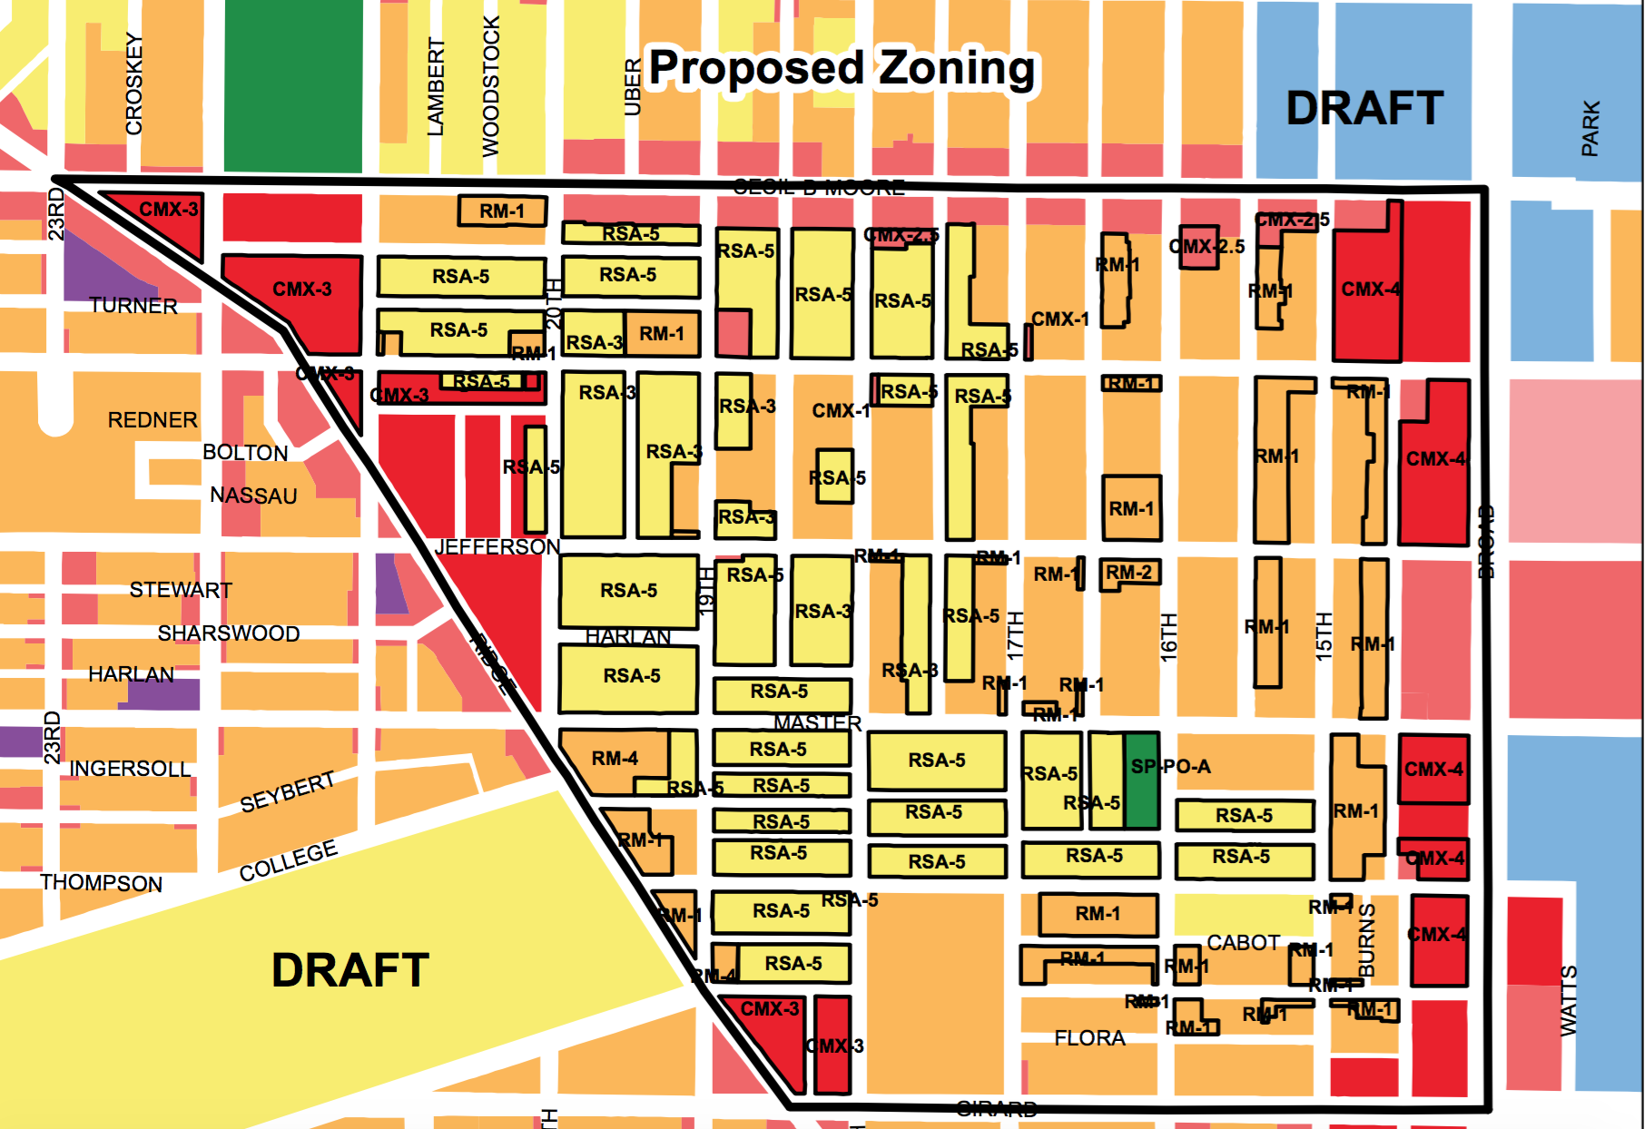
Examine & Evaluate Existing Policy
Example Problem: Gentrification
Existing policy to combat gentrification require builders to set aside apartments for lower income residents.
Builders are rewarded with lower property taxes and loan incentives.
Community Boards set zoning plans to ensure neighborhoods include essential services and balance residential, commercial and public spaces.
Are there policies in place to address this issue?
Policies can be rules and regulations, laws and directives that leaders use to guide the actions of individuals and organizations..
https://citylimits.org/2019/06/26/opinion-to-combat-gentrification-nyc-needs-simpler-speedier-policies/
http://www.centernyc.org/are-de-blasios-rezonings-a-trojan-horse-for-gentrification-probably-not

Slide 8
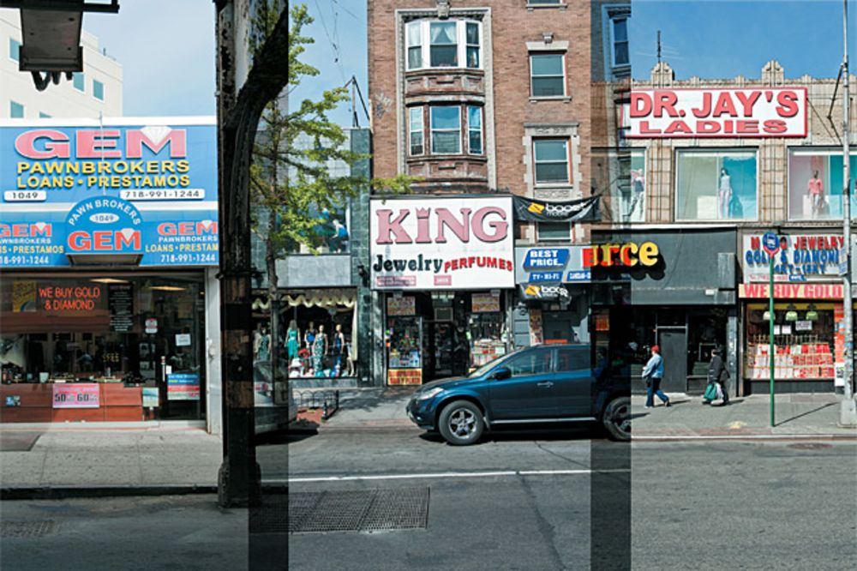
Develop Solutions
Example Problem Gentrification
Possible solutions:
Raise awareness among the new residents about what is changing in the neighborhood.
Give new residents incentives to support existing businesses.
Create new zoning laws to preserve cultural value in neighborhoods.
Guiding Questions?
What can we do to fix this problem?
Should we create rules?
Should we use incentives or rewards?
How can we change behavior?
How can we change minds?

Slide 9
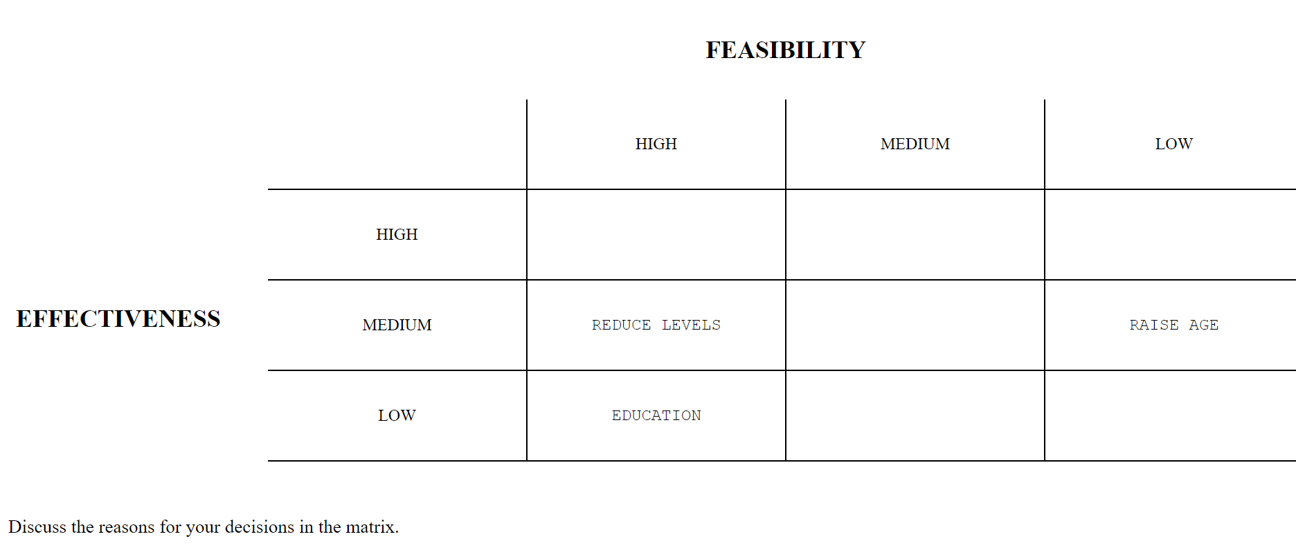
The Public Policy Analyst Tool
Which solution is best?

Slide 10
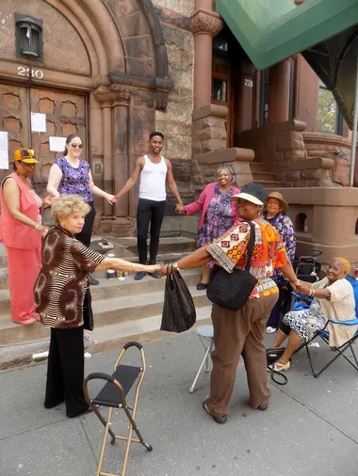

Select the Best Solution
What is Feasible?
What will be Effective?
Example:
The solution: Provide incentives for new residents to use established businesses.
Is this feasible? How possible is it? What will it take to get it done?
How effective is it? How well do we think it will work?
What is Feasible?
Feasible means possible.
Which of these solutions is possible?
What is Effective?
Effective means it will work.
Which of these solutions is going to work?
Rate each solution on it’s feasibility and its effectiveness.

Slide 11

Your Voice
You will work in teams of 4 to address a problem using the Public Policy Analyst Tool.
We will choose a problem together and then use the graphic organizer to use each step of the Public Policy Tool to create new solutions.
We will then evaluate the solutions together as a group.

