Slide 1
Students do not feel connected to their classmates at PS/MS 123
By Ivandy Castro-Astor
icastroastor@schols.nyc.gov

Slide 2
The Public Policy Analyst (PPA)
1. Define the Problem
2. Gather the Evidence
3. Identify the Causes
4. Evaluate an Existing Policy
5. Develop Solutions
6. Select the Best Solution

Slide 3
Step 1. Define the Problem
Students lack a sense of belonging in Class

Slide 4
Step 2. Gather de Evidence
According to New York City Public Schools Panorama Education Survey:
46% of classmates recognize that they understand each other as person.
51% feel connected to their teachers in class.

Slide 5
Step 2. Gather de Evidence
40% feel respected in the classroom by their classmates
43% feels that they matter to theirs classmates
57% feel that they belong to their class.

Slide 6
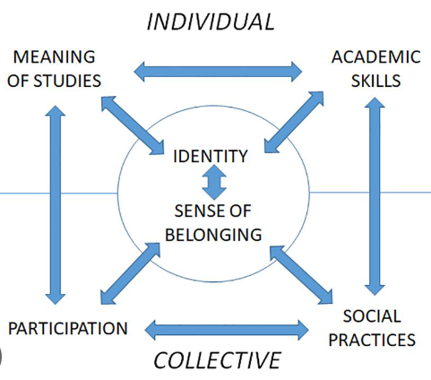
Step 2. Gather de Evidence
Research shows students’ sense of belonging in school is critical and it impacts their success in school
Source: Report by the Australian Council for Educational Research, based on 36 countries, including the United States

Slide 7
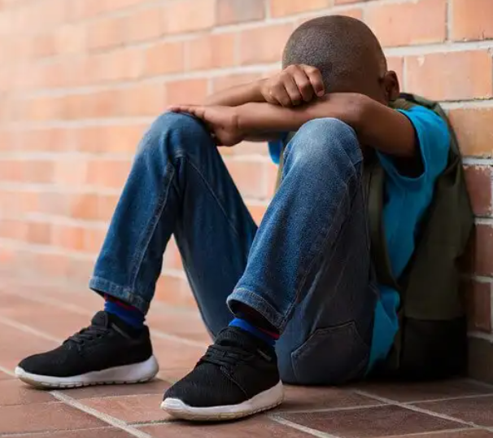
Step 3. Identify the Causes
Students living in shelters
Ongoing abuse or neglect.
Parental absence

Slide 8
Step 4. Evaluate an Existing Policy
SY 2023-24 Code of Conduct and District-Wide Safety Plan
Top priority: Ensure that every child learns in safe, supportive, and inclusive schools.

Slide 9
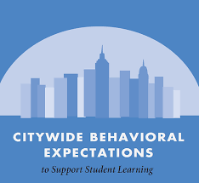
Step 4. Evaluate an Existing Policy
Citywide Behavioral Expectations to Support Student Learning Grades 6-12.
Schools are expected to take a proactive role in helping students develop life long skills, such as:
Recognizing and managing emotions;
Developing caring and concern for others;
Establishing positive relationships.

Slide 10
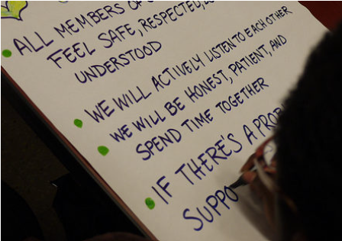
Step 5. Develop Solutions
RULER Charter: Building and Sustaining a Positive Emotional Climate.
RULER is an evidence-based approach to social and emotional learning (SEL) developed at the Yale Center for Emotional Intelligence.

Slide 11
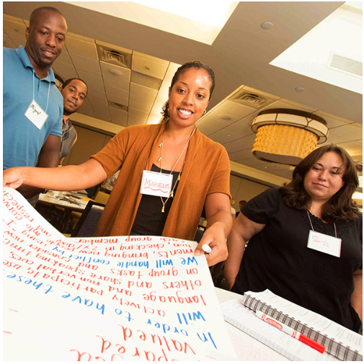
Step 5. Develop Solutions
Develop (survey) and display in a central location a RULER Charter by asking staff and students the following questions:
How do we want to feel?
How will we help each other to experience these feelings?

Slide 12
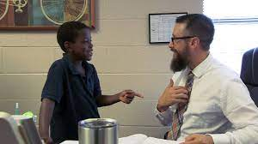
Step 5. Develop Solutions
Restorative Practices - Focus on resolving conflict, repaired harm, and healing relationship.
Positive Relationship: Check-In/Check-Out - Daily Support System for Students. One adult meet with student every single day.

Slide 13
Step 6. Select the best solution
Feasibility
 | High | Medium | Low
High
Medium
Low
Effectiveness

