Slide 1
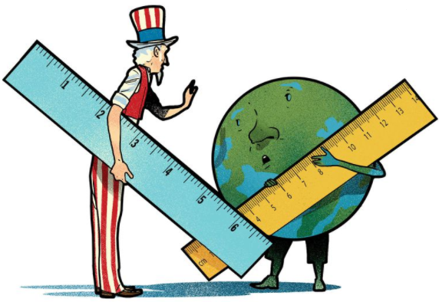
The U.S. and The Metric System
By Ivandy Castro-Astor

Slide 2

The Public Policy Analyst (PPA)
1. Define the Problem
2. Gather the Evidence
3. Identify the Causes
4. Evaluate an Existing Policy
5. Develop Solutions
6. Select the Best Solution

Slide 3

Step 1. Define the Problem
The U.S. loses money and time for not using the metric system.

Slide 4
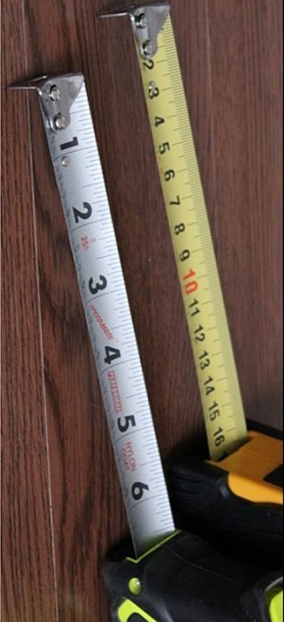
- Step 2: Gather the evidence
Metric system allows easier conversion.
The metric system is easier to comprehend.
Conversion mistakes unlikely to occur.
The U.S. lost $125 million satellite (NASA's Mars Climate Orbiter) due to conversion.

Slide 5

After metrification (1970), General Motors increased their profit.
Science, medicine and commerce use metric system.
It Makes the medical industry safer.
International trade becomes an obstacle due to unit conversions.

Slide 6
- Step 3: Identify the causes
In 1790 the U.S. adopted the British Imperial System of measurement.
Factories and equipment were built using the Imperial System of measurement.

Slide 7
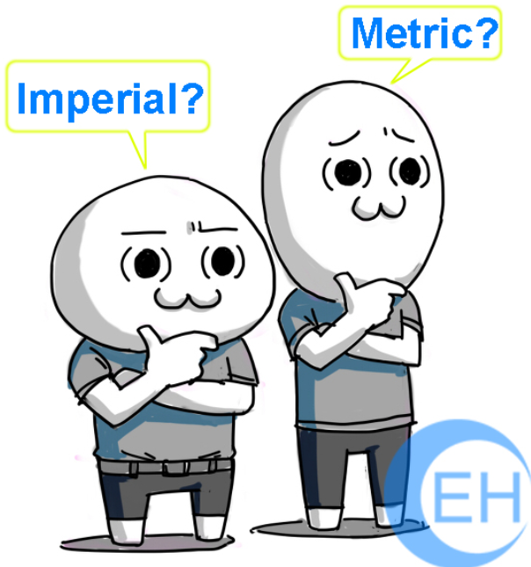
-
Big businesses and American citizens blocked the adoption of the metric system in Congress in the late 19th century and 20th century.
The efforts of the Metric Board were largely ignored by the American public.

Slide 8
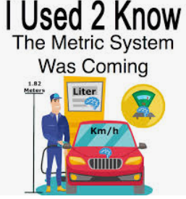
Step 4: Evaluate the existing policy
The U.S. is the only industrialized country that has not adopted the metric system
In 1866, Congress authorized the use of the metric system
In 1875, the United States solidified its commitment to metric system.

Slide 9
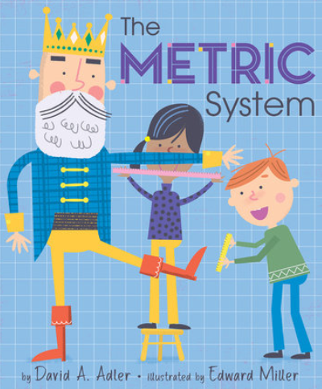
In 1968 a study, authorized by the Congress, recommended the metric system.
Congress passed the Metric Conversion Act of 1975.
In 1988 Congress, recognizes the necessity of using the metric system.
Federal agencies were required to use the metric system.

Slide 10

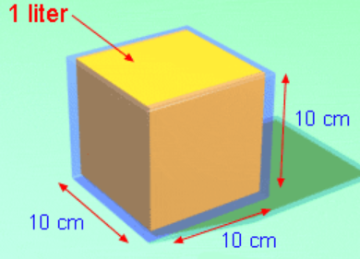
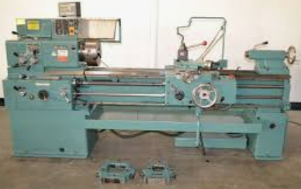
Step 5: Develop solutions
Strict laws and policies and a solid timeline to switch over, followed by strong messages through a media campaign
Gave manufacturers the option to use only metric on product packaging.
New machines or part must be designed using the metric system

Slide 11
Step 6: Select the best solution
Feasibility
 | High | Medium | Low
High
Medium
Low
Effectiveness

