Slide 1
Lack of Ethnic Studies Classes at West Side High School
Brandon Camacho
Special Education Teacher
Edward A. Reynolds West Side High School
bcamacho3@schools.nyc.gov | brandon@earwshs.net

Slide 2
Table of Contents
1: Title Page 9: Step 4 - Evaluating Existing Public Policies
2: Table of Contents 10: Step 5 - Developing Public Policy Solutions
3-5: What is a PPA? 11-12: Step 6 - Selecting the Best Public Policy Solution
6: Step 1 - Defining the Social Problem 13: Sources
7: Step 2 - Gathering Evidence of the Problem
8: Step 3 - Identifying the Causes of the Problem

Slide 3

PLEASE STOP WHAT YOU ARE DOING...
...and PUT ON YOUR PUBLIC POLICY ANALYST HAT !!

Slide 4
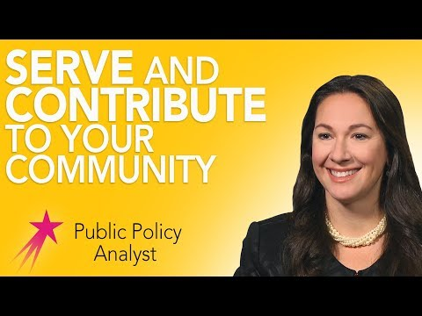
What is a Public Policy Analyst (PPA)?

Slide 5
What is a Public Policy Analyst (PPA)?
A PPA is a person who::
examines the efficacy of existing public policies;
lays the groundwork for new programs and legislation;
reviews and amends policy drafts by proposing suggestions to improve the effects of existing policies;
works closely with stakeholders to determine the goals and objectives of policies;
depending on the industry, a policy analyst may progress into a directorial or executive role.
(https://www.glassdoor.com/Job-Descriptions/Policy-Analyst.htm)

Slide 6


Step 1: Defining the Social Problem
What is a social problem you would like to investigate?
Where does your social problem take place?
What are three undesirable social conditions that result from this problem?
Write a short phrase that summarizes the social problem and its geographical location.
EXAMPLE:
Various curricula lack ethnic studies content
West Side HS, New York City DOE
Students of color have a harder time connecting to course material; perpetuates eurocentric perspectives; lack of diverse stories and narratives in the classroom
Lack of ethnic studies classes at West Side High School
A social problem is a condition that at least some people in a community view as being undesirable.
Students: if you are having trouble with Step 1 use this worksheet to help guide you

Slide 7
Step 2: Gathering Evidence of the Problem
Your next step is to gather at least three different types of evidence to support the existence of your problem
You can use any of the following as evidence:
  Statistics
  Articles by Experts
  Case Studies
  Search Engines, Databases, the Internet
  Surveys or Interviews
  Knowledgeable People
Research Report: While content related to African Americans, Latinos, and Native Americans has been added, deeper patterns and narratives that reflect Euro-American experiences and worldviews, and that have traditionally structured K–12 textbooks—particularly history and social studies texts—remain intact” (Sleeter 2011).
https://files.eric.ed.gov/fulltext/ED521869.pdf
EXAMPLE:
The following evidence helps prove that there is a lack of ethnic studies classes at West Side HS:
Interview: Principal acknowledged that West Side currently does not offer any ethnic studies classes
Statistics: School data confirms that 0% of classes offered at West Side are considered Ethnic Studies
Students: if you are having trouble with Step 2 use this worksheet to help guide you

Slide 8
Step 3: Identifying the Causes of the Problem
EXAMPLE:
Why would there be a lack of ethnic studies classes at West Side HS?
Lack of staff to teach ethnic studies classes
States do not require ethnic studies to graduate or matriculate
Dominance of Euro-American perspectives in mainstream curricula don’t allow for ethnic studies/diverse narratives
No incentives, or funding, for ethnic studies classes
When policy makers identify the causes or factors that contribute to a social problem, they then can try to develop public policies to eliminate or lessen those causes or factors.
Your job at this step is to brainstorm the causes and factors that contribute to your social problem.
Use resources from Step 2 to aid your thinking.
Students: if you are having trouble with Step 3 use this worksheet to help guide you

Slide 9
Step 4: Evaluating Existing Public Policies
“As the country grapples with issues raised by the emerging racial justice movement, the influential College Board is launching an ambitious national curriculum on race with an Advanced Placement program on the African diaspora...Rather than create a separate Advanced Placement subject course, the College Board has linked the diaspora curriculum to its skills-based Capstone program” (Gleibermann/TheWashingtonPost 2020).
College Board has the financial and logistical resources to make this happen, therefore it seems rather reasonable and thus an effective way to integrate Ethnic Studies classes at West Side HS, via AP Seminar
Only students enrolled in AP Seminar would have access to this content,
I would implement this policy at West Side HS as a way to offer an Ethnic Studies class to students
Evaluating the main existing policy or policies to deal with a social problem is an important step in the PPA process.
State one of the major existing policies that attempts to deal with the social problem
What are the advantages of this policy? (i.e., effectiveness, costs, enforcement, public acceptance)
What are the disadvantages of this policy? (i.e., effectiveness, costs, enforcement, public acceptance)
Based on your evaluation of the advantages and disadvantages, should the current policy be totally replaced, strengthened, or improved? What advantages, if any, from the current policy should be retained? What disadvantages, if any, should be eliminated?
Students: if you are having trouble with Step 4 use this worksheet to help guide you

Slide 10
Step 5: Developing Public Policy Solutions
EXAMPLE:
Allow students to write their own curricula (pertaining to their backgrounds/cultures) to use in an Ethnic Studies class at West Side HS
Work with legislators to pass a law requiring Ethnic Studies as part of NY State’s high school graduation requirements
Reconfigure the scope and sequence of a Regents-based Global History class to contain Ethnic Studies content
Propose at least three new/original public policy alternatives.
Be sure that all of your public policy alternatives are at the same geographical level as your social problem.
Each alternative must specify the actual government or government agency that will carry out the proposed action.
Then specify which proposal you think is most promising.
Students: if you are having trouble with Step 5 use this worksheet to help guide you

Slide 11
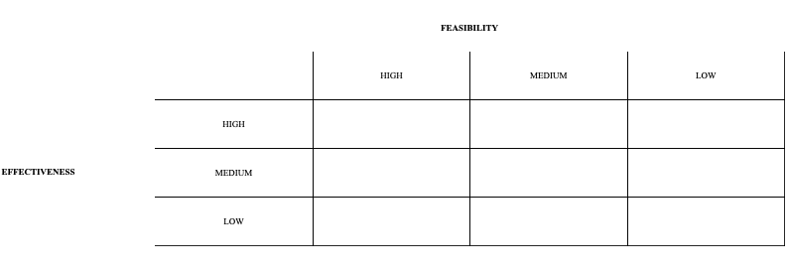
Step 6: Selecting the Best Public Policy Solution
Allow students to write their own curricula (pertaining to their backgrounds/cultures) to use in an Ethnic Studies class at West Side HS (WRITE CURRICULUM)
Work with legislators to pass a law requiring Ethnic Studies as part of NY State’s high school graduation requirements (LEGISLATION)
Reconfigure the scope and sequence of a Regents-based Global History class to contain Ethnic Studies content (MODIFY GLOBAL HISTORY CLASS)
C. I placed the legislation solution at high effectiveness, low feasibility because this policy would solve my social problem by mandating Ethnic Studies via educational legislation, however it is extremely hard to pass legislation like this, especially in NYS. Moreover, writing my own Ethnic Studies curriculum would also be very effective at solving my social problem and it is more feasible than legislation. Even so, I think it would only be moderately feasible because getting students to help you write curricula is hard and very time consuming. The modifying option I think is the most feasible of the three proposed novel solutions, however relative to the others, I do not think this option would be the most effective.
D. I would probably start by modifying units within the Global History class to reflect Ethnic Studies content. This option is the most feasible and effective because it uses pre-existing courses to teach ethnic studies curricula. All students need to take Global History to graduate so most students will be exposed to new narratives via this option.
List the three public policy alternatives from Step 5. Abbreviate each policy in order to use the matrix provided.
Complete the matrix (see next slide)
Discuss the reasons for your decision in the matrix
Discuss why you prefer one alternative over the other two
Students: if you are having trouble with Step 6 use this worksheet to help guide you

Slide 12
Step 6: Selecting the Best Public Policy Solution
Write Curriculum
Legislation
Modify Global History Class

Slide 13
Sources
https://flippedtips.com/plegal/javits/critical.html
https://www.youtube.com/watch?v=ZkxctjXPyEU
https://files.eric.ed.gov/fulltext/ED521869.pdf
Interview with Lilit Suffet, Principal at Edward A. Reynolds West Side HS
https://www.glassdoor.com/Job-Descriptions/Policy-Analyst.html
https://www.washingtonpost.com/local/education/new-college-board-curriculum-puts-the-african-diaspora-in-the-spotlight/2020/09/07/579631c2-ee1b-11ea-b4bc-3a2098fc73d4_story.html?hpid=hp_hp-top-table-low_apdiaspora-925am%3Ahomepage%2Fstory-ans

