Slide 1
Youths Lack Financial Literacy
John H. Finley Campus School, PS/MS 129
by Lakisha Brooks
Financial Literacy – the ability to understand how money works in the world. How someone makes it, manages it, and invests it. Financial Literacy leads to better decisions about money and more money in the long-run.

Slide 2
Why is Financial Literacy Important for Youth?
“Kids don’t need to know about money". Or so the argument goes. So why is financial literacy important for youth? One reason is that when they’re not taught good money habits and the reasoning behind them, kids will pick up and emulate the relationships with money of the adults in their lives. When they learn financial literacy at an early age, they become less impressionable to the attitudes of money held by the adults around them. Once kids know proper money management skills, they tend to keep them and use them throughout their lives. Early financial literacy teaches kids how to have a good relationship with money, an invaluable lifelong skill that won’t ever be forgotten.
Respond to the following and explain your choice and reason of your choice
Suppose you see a backpack and a pair of shoes that you want to buy. However, you only have enough money to buy one of them. Will you choose the backpack or the shoes? Explain

Slide 3
Use the Public Policy Analyst (PPA) steps to understand and address the problem.
Step1: Define the Problem
Step 2: Gather the Evidence
Step 6: Select the Best Policy Solution
Step 3: Identify the Causes
Step 5: Develop New Policy Solutions
Step 4: Examine Existing Policy
Notes:
Examining Existing Policy is not discussed in the PowerPoint, just used for the purposes of becoming familiar with PPA.

Slide 4
Step 1: Problem
Many kids lack the necessary knowledge and skills to become financially responsible adults.

Slide 5
Step 2: Evidence
Many youth have not received either formal or informal guidance on financial matters. So, they may not be ready to make sound financial choices:
A survey of 15-year-olds in the United States found that 18 percent of respondents did not learn fundamental financial skills that are often applied in everyday situations, such as building a simple budget, comparison shopping, and understanding an invoice.³
A report on the results of a financial literacy exam found that high school seniors scored on average 48 percent correct, showing a strong need for more comprehensive financial education for youth in high school.⁴
According to the 2008 wave of the National Longitudinal Survey of Youth, only 27 percent of youth knew what inflation was and could do simple interest rate calculations.
https://youth.gov/youth-topics/financial-capability-literacy/facts

Slide 6
Step 2: Evidence
40.2% of those with low levels of financial literacy relied on parents, friends, and acquaintances as their most important source of financial knowledge, compared to 20.8% of those with the highest levels of financial literacy (National Bureau of Economic Research).
http://www.nber.org/papers/w13565.pdf
Only 23% of kids surveyed indicated that they talk to their parents frequently about money (Money Confident Kids).
http://www.moneyconfidentkids.com/content/dam/money-confident-kids/PDFs/PKM-Surveys/2017_PKM_Results.pdf

Slide 7
Click on each image for video
Step 5: Develop New Solutions
When watching each video, write down one “take away” or something that stuck with you.
We will share them as a class.
Creating a Budget
Sticking to a Budget

Slide 8
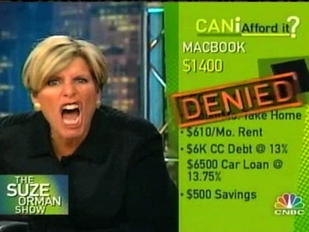
Suze Orman – The Financial Success Guru
Needs v. Wants
Can I Afford It?? – callers ask if they have enough money to buy a big purchase. Let’s take a look at a 11 year old caller…will he be approved?
Video: 11 year old calls in
Video: Will he be approved
Video: The Year od Denied

Slide 9
What can be done at home or in our community to correct the problem?
Parents can have their kids save 10% of their allowance each month.
Parents open a bank account for their child.
Have a savings jar at home or classroom.
Read stories about money, spending and saving.
Have a discussion about the cost and quality of the name brand items versus store brand items.
Allowing kids to go shopping with an adult and point out cost and sales.

Slide 10
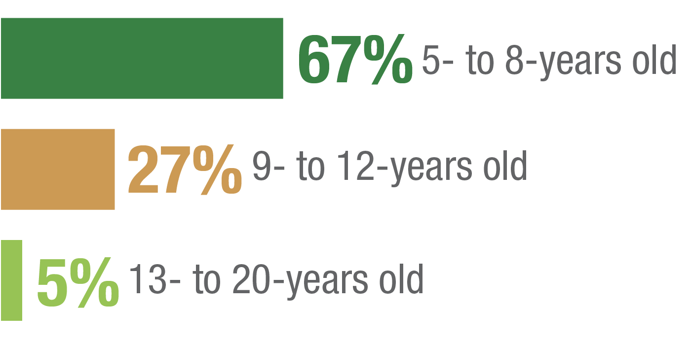
Achieving Financial Freedom Starts In the Home
When it comes down to parents’ expectations of their children and finances, 94% of parents believed that by the age of 12 a child should start learning about personal finances. While the majority of parents (92%) are leading by example by saving money for emergencies, college tuition, and retirement; many children still seem to lack the understanding of savings, interest and smart spending.
At what age should people start learning about personal finances?
https://www.juniorachievement.org/documents/20009/20652/2017-ja-youth-and-financial-literacy-survey.pdf

