Slide 1

Science
Recycling in NYC
By: Elan Bortniker

Slide 2
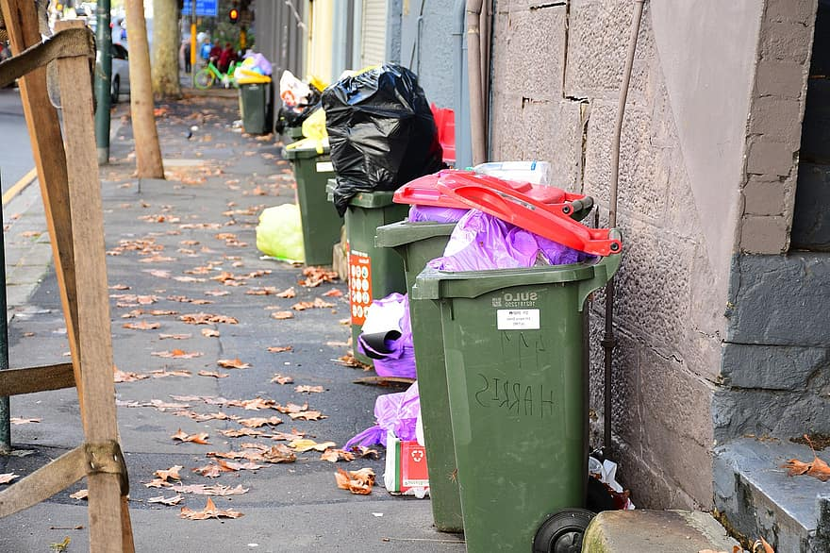
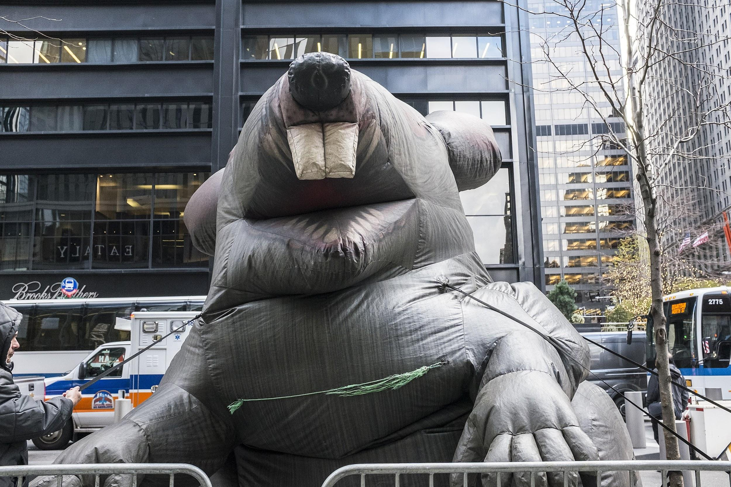
Do Now:
Do you think NYC does a good job recycling?

Slide 3
Six Steps of the Public Policy Analyst
1. Define the Problem
2. Gather the Evidence
3. Identify the Causes
4. Evaluate an Existing Policy
5. Develop Solutions
6. Select the Best Solution (Feasibility vs. Effectiveness)

Slide 4
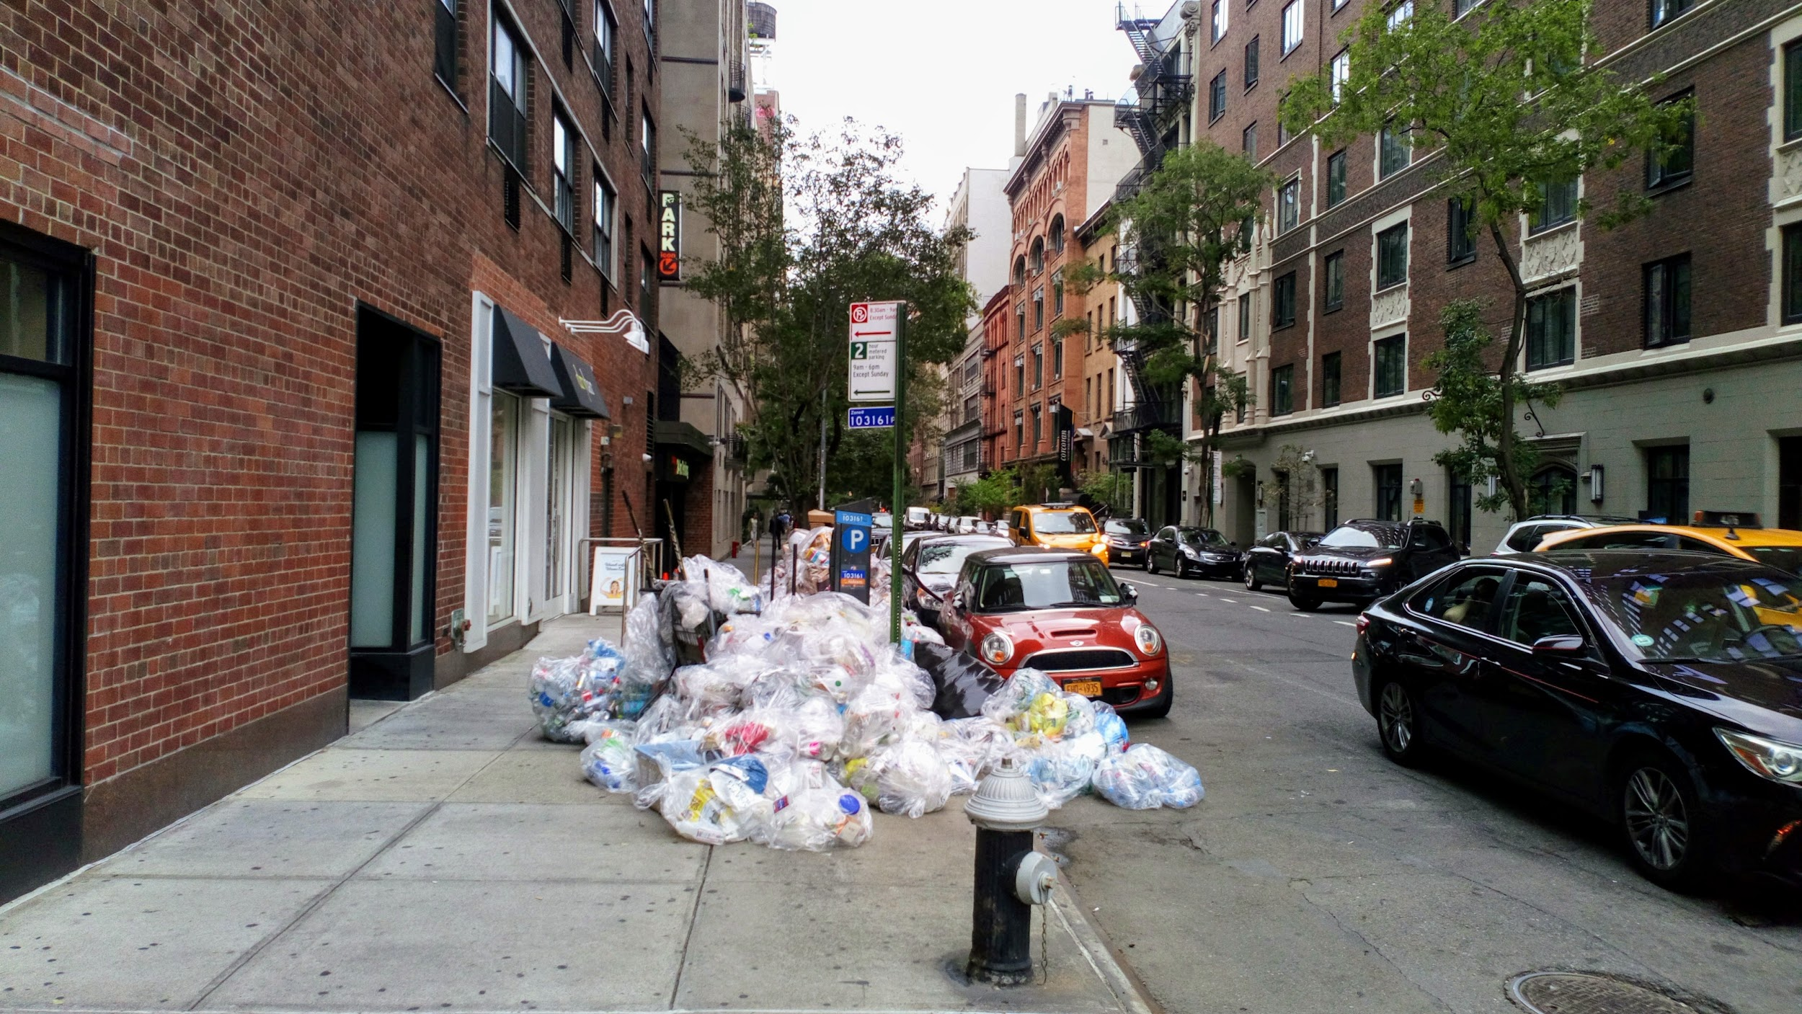
The Problem
The way New Yorkers recycle is currently inefficient

Slide 5
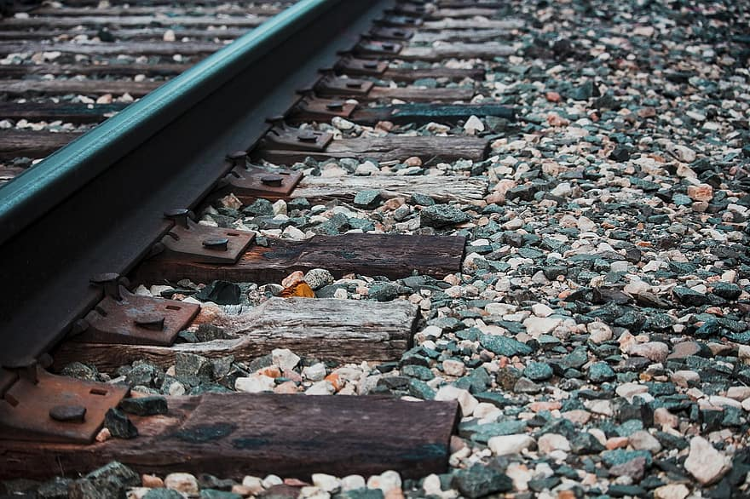
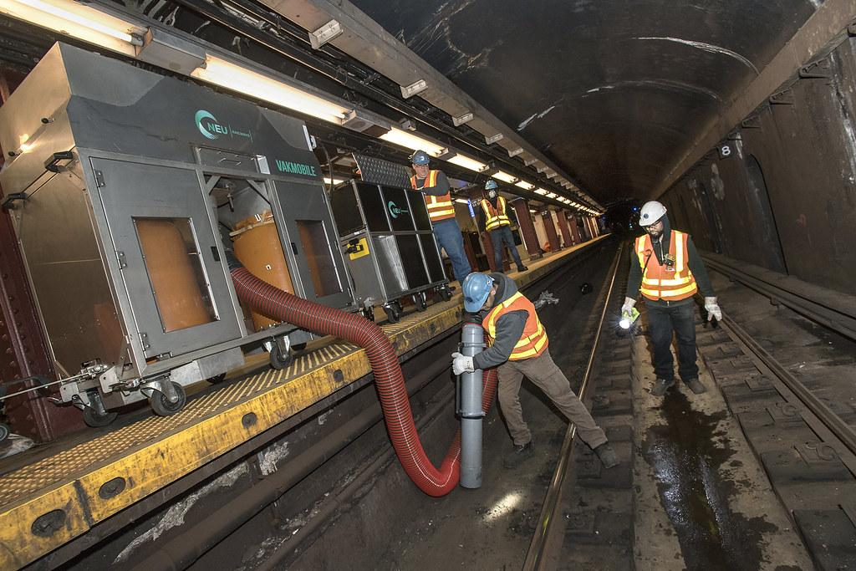
Gather the Evidence
NYC recycles only about a fifth of its garbage
  18 percent of trash from homes and about 25 percent from businesses
Cascading effects of not recycling
  clogged trash chutes in public housing
  Garbage that must be trucked out of the city
  Organic waste left to decompose and spew planet-warming methane gas

Slide 6
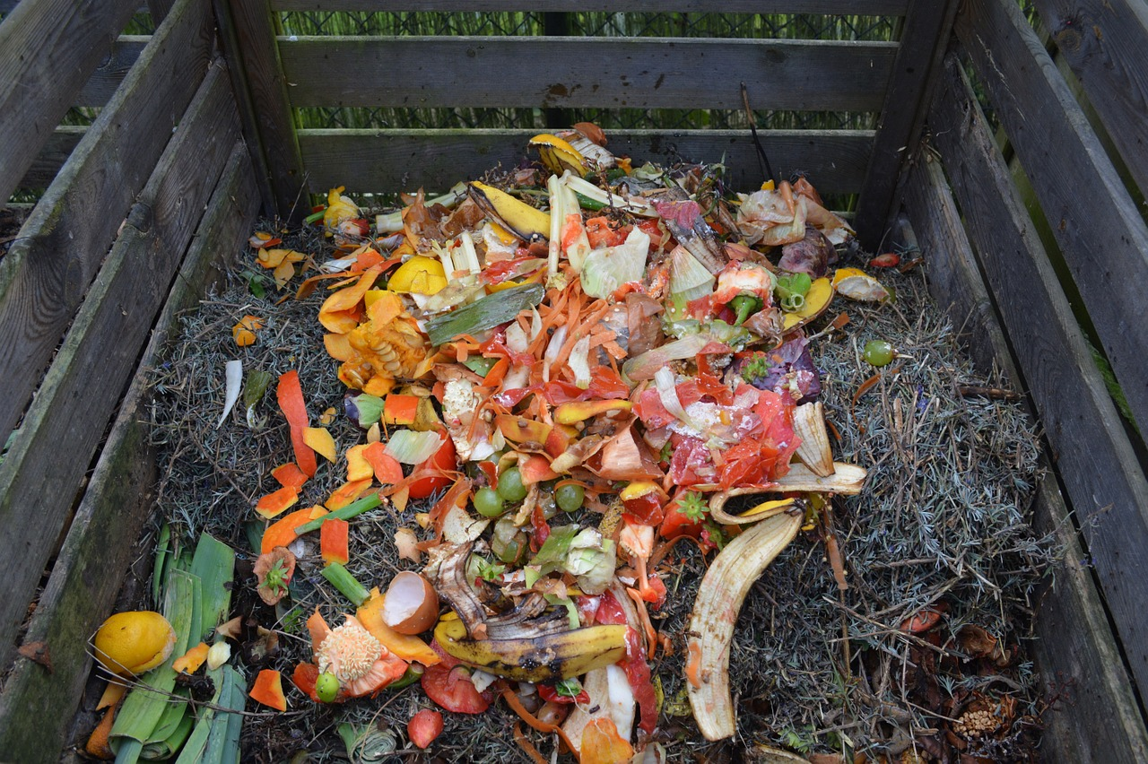
Identify the Causes
Composting food DOESN’t make the city $
Recycling bins are mismanaged, misplaced/public housing
Lax penalties in NYC
Garbage workers mix trash & recycling
Poor ROI on recyclable goods

Slide 7
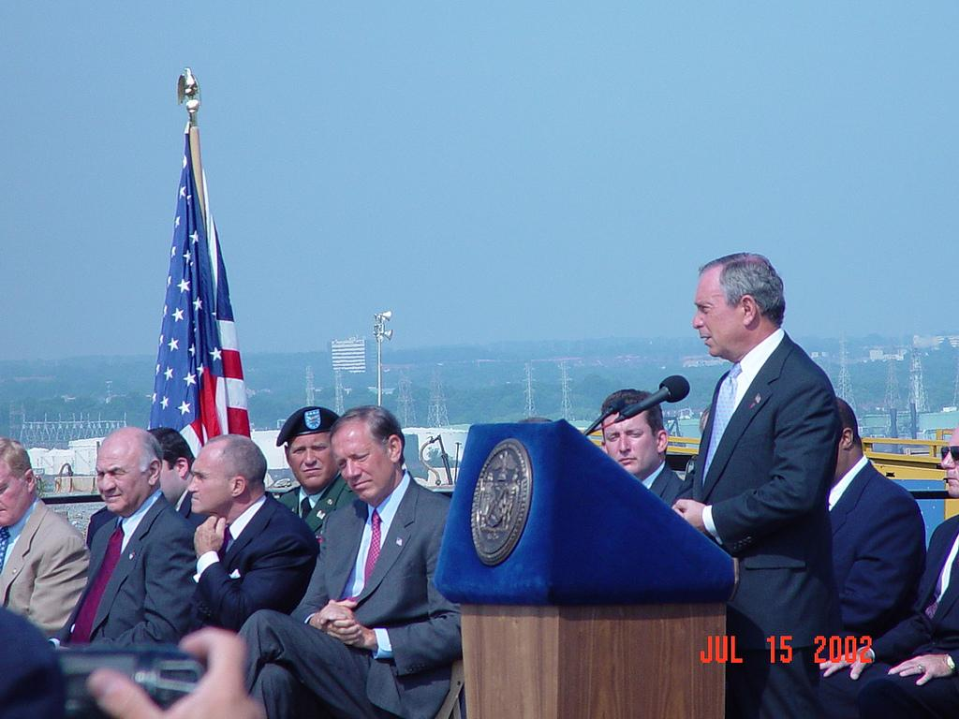
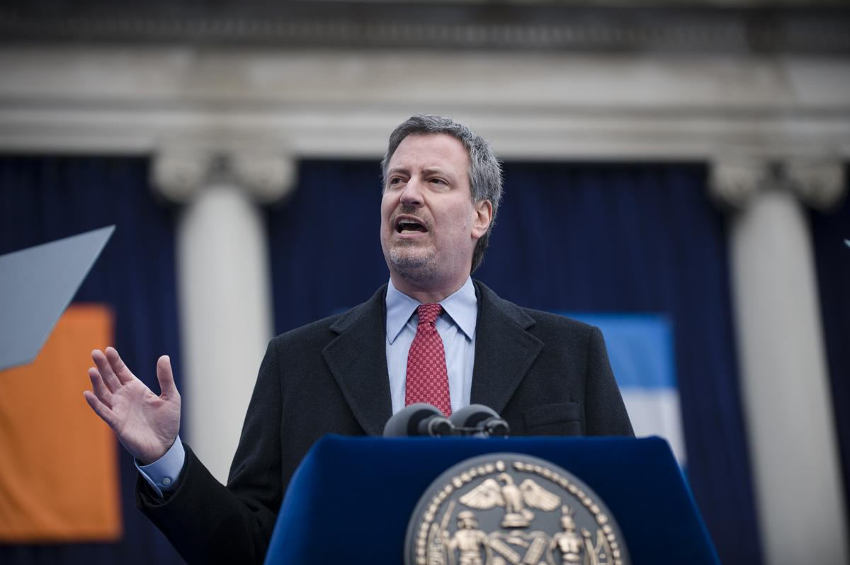
Evaluating Existing Policy
2016 zero-waste campaign aims to stop exports of garbage to faraway landfills by 2030
Solid Waste Management Act of 1988
Product Stewardship

Slide 8
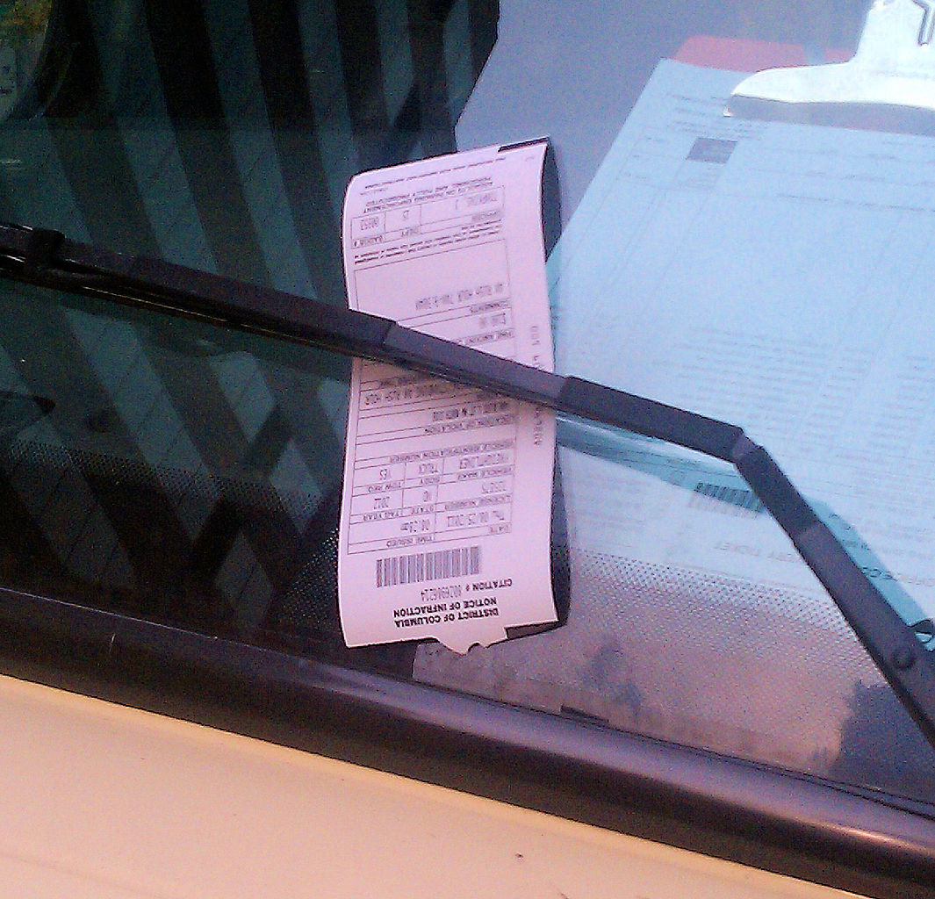
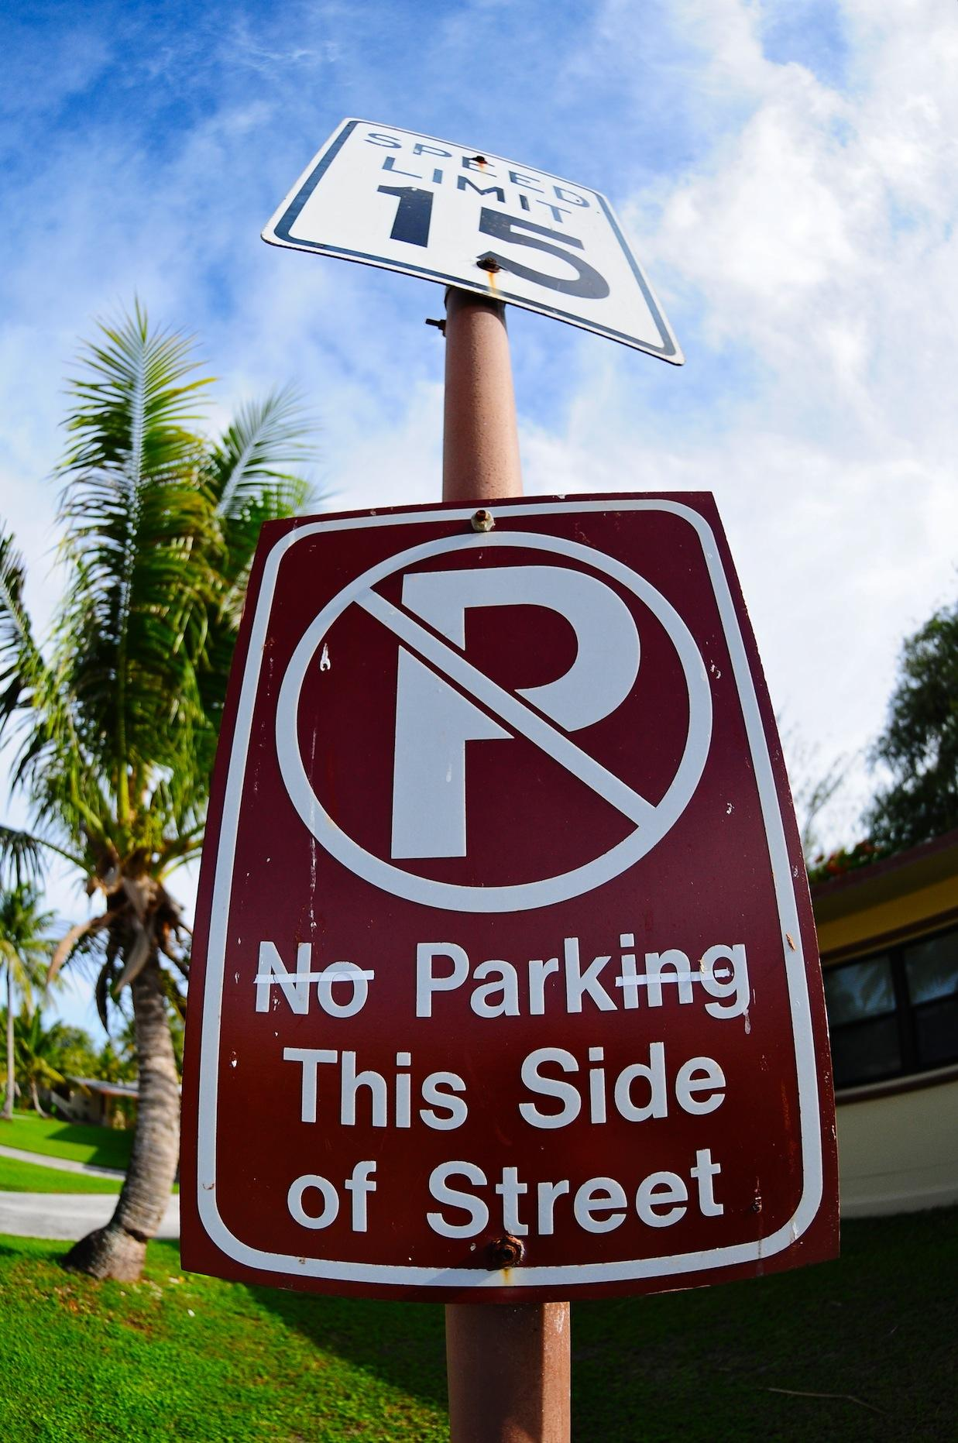
Develop Solutions
Incentives/disincentives
  Legislation
  Taxes
Support garbage workers
Restructure
Education

Slide 9

Your Solutions
Now how do you think NYC/New Yorkers can recycle more efficiently?

Slide 10
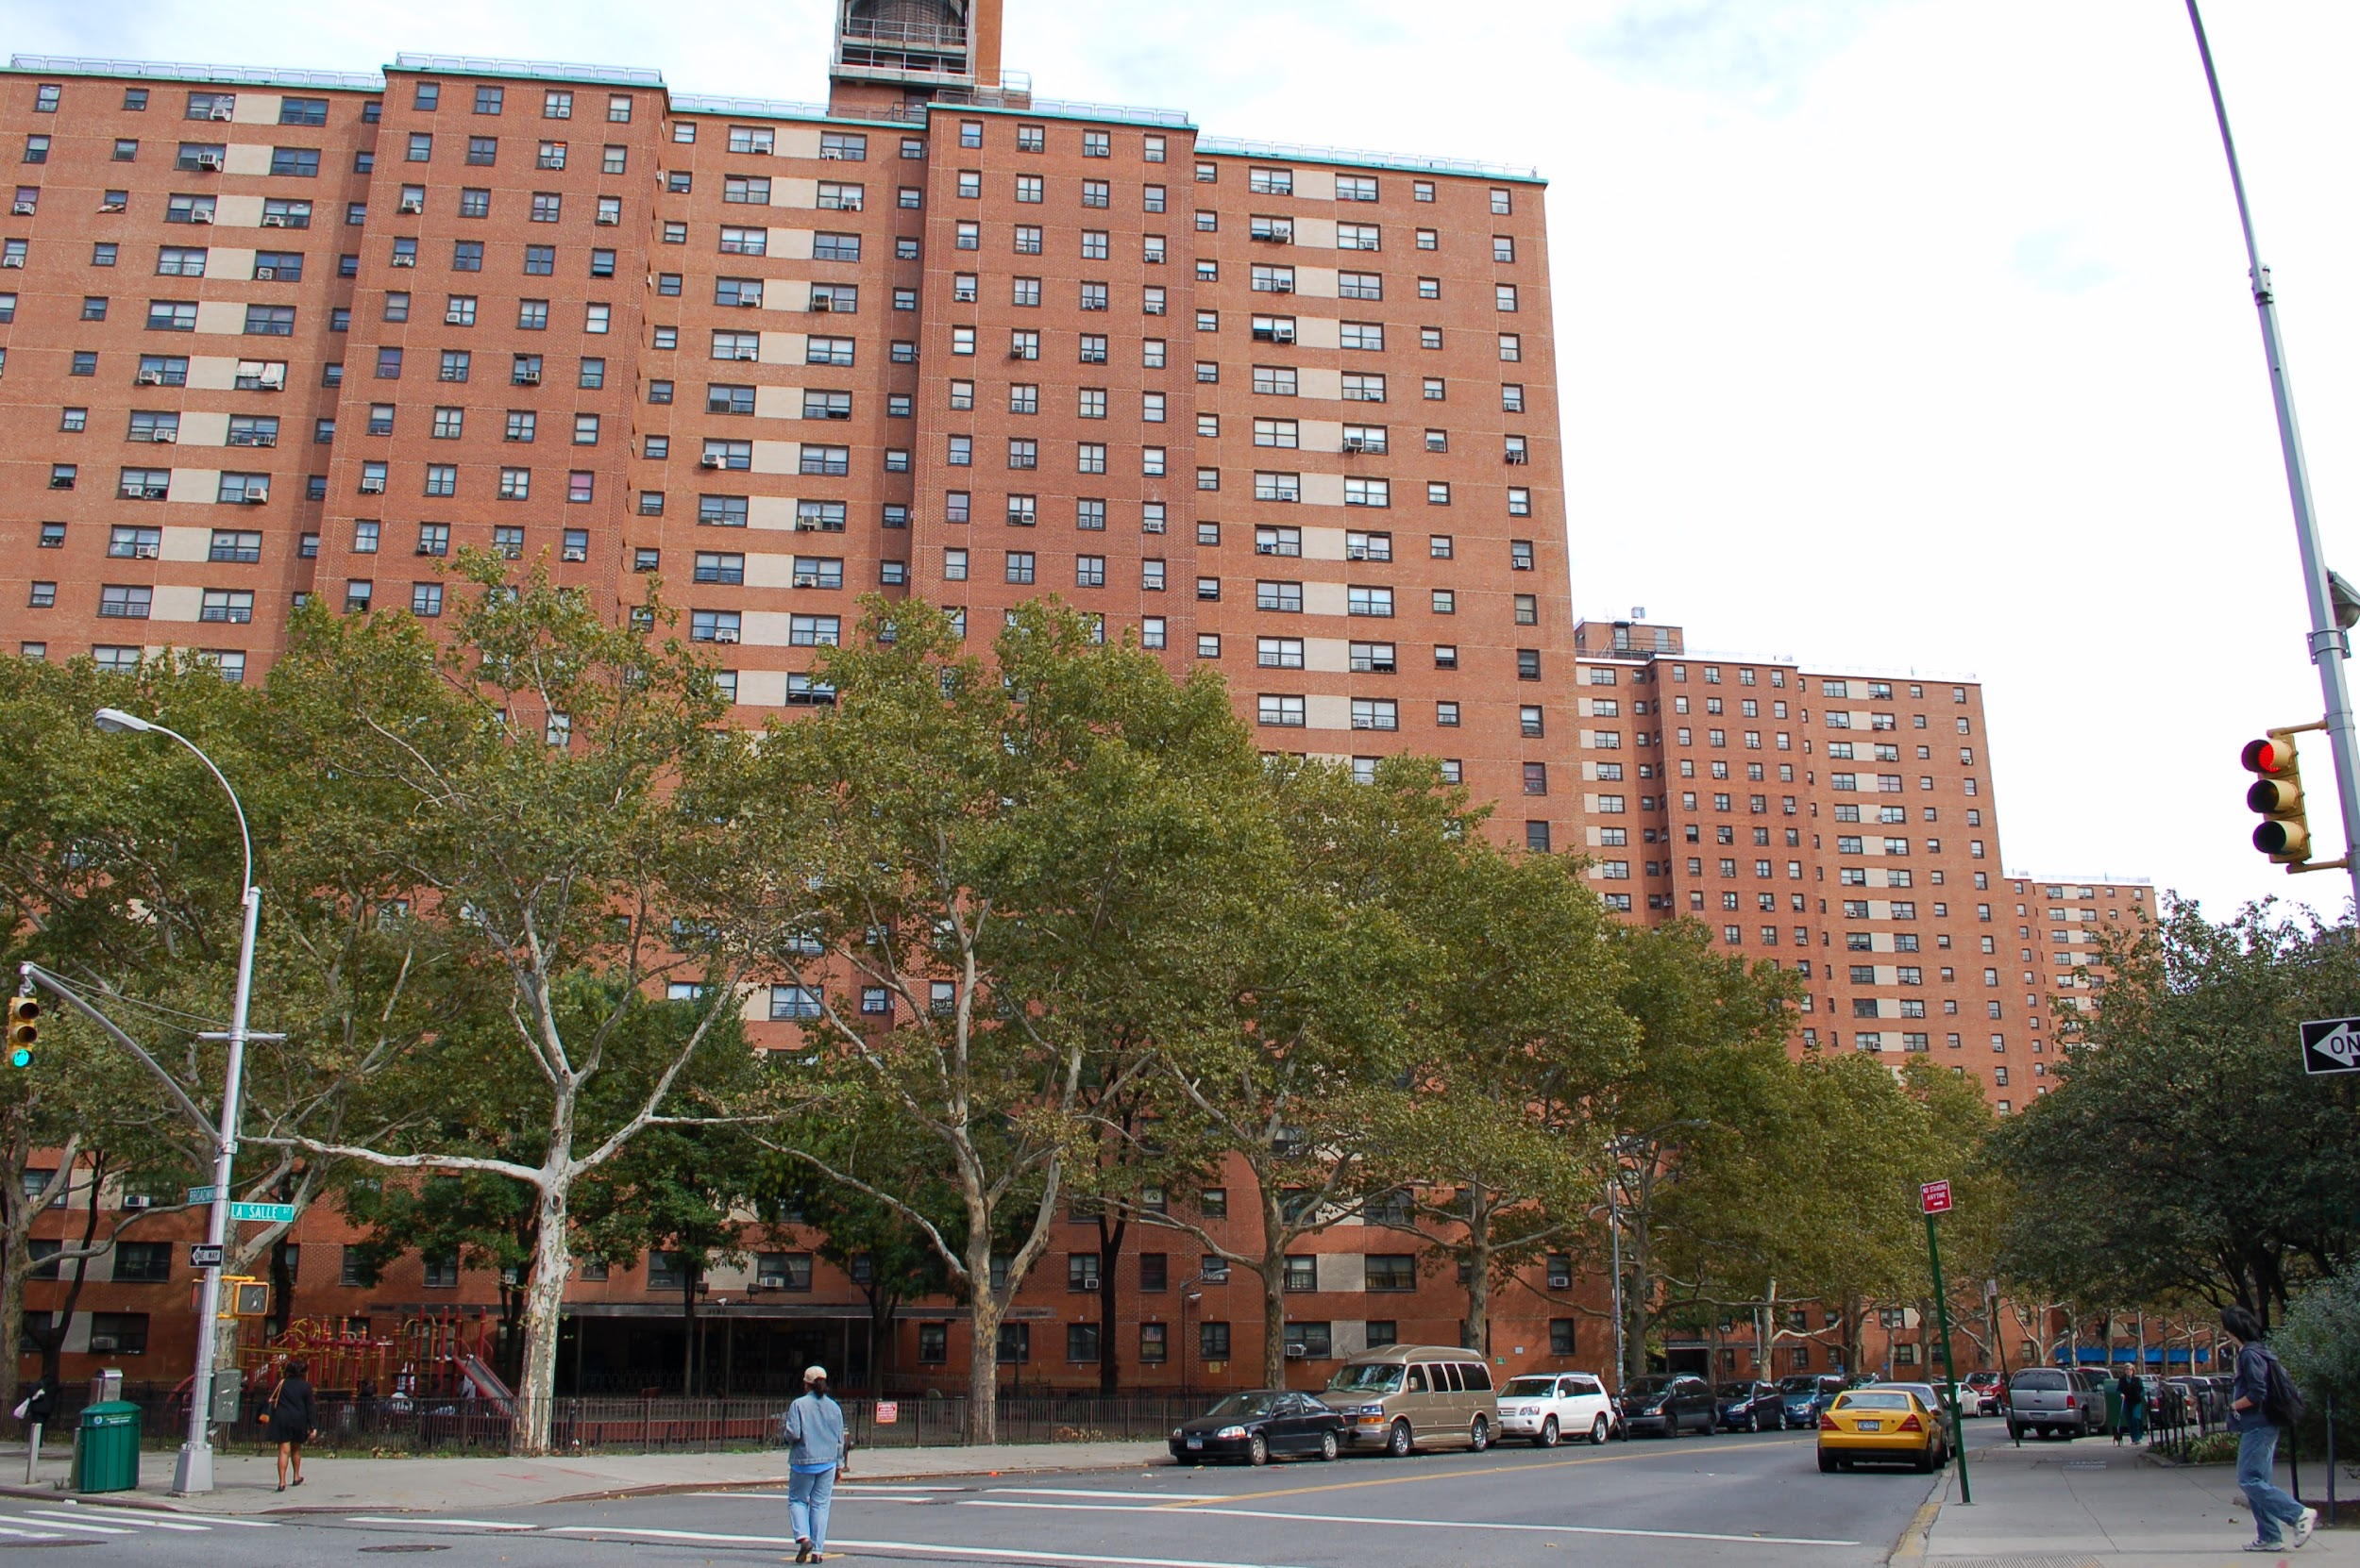
Select the Best Solution - Evaluate Effectiveness/Feasibility
Public housing - easy access to recycling cans

Slide 11
Sources
https://www1.nyc.gov/site/sustainability/initiatives/zero-waste-challenge.page
https://www.nytimes.com/2020/01/29/nyregion/nyc-recycling.html
https://www.dec.ny.gov/chemical/294.html

