Slide 1
In Russia, there is government oppression on citizens
10th Grade Social Studies Class

Slide 2
Do Now
In your opinion, do you think that people should have a voice in government or the government should be able to do what they think is right? Be sure to use specific details to support your response.

Slide 3
Guiding Question
Should governments be held accountable to their citizens?

Slide 4
Today’s Agenda Flow
Do Now
Guiding Question
Agenda
Review PPA
Group Discussion
Independent Practice
Exit Ticket

Slide 5
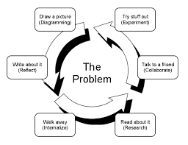
PPA - How can we solve problems in society?
Please examine the PPA Wheel below as we prepare to dive deeper into a societal ill.

Slide 6
PPA - What are the steps
Navigate the steps below as we dive into today’s PPA.
What is the problem?
What is the Evidence?
What are the causes?
What is the existing policy?
What policies can we create to correct the problem?
What is the BEST policy to correct the problem?
S
T
E
P
S

Slide 7
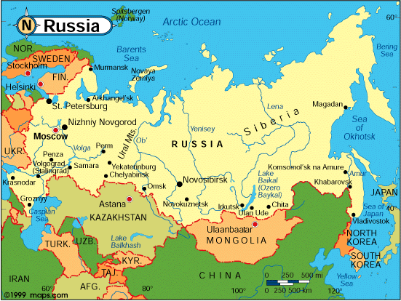
Today’s PPA
Today, you will be acting as public policy analysts to investigate the following problem:
In Russia, there is government oppression on citizens.

Slide 8
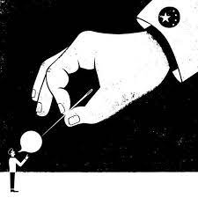
What is government oppression?
Government oppression is when the leaders of a nation abuse their powers to treat their people in an unjust manner.
Stop and jot: How have you either seen or experienced unjust treatment?

Slide 9
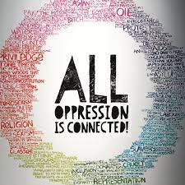
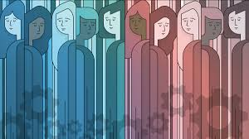
Leveraging your personal experiences…
How do you think the Russian government might be oppressing its citizens?

Slide 10
What is the evidence?
Table talk: Discuss with your learning partners how we might be able to collect evidence of the Russian government treating Russians in an unjust manner.
Then, jot down your ideas in your notebooks.

Slide 11
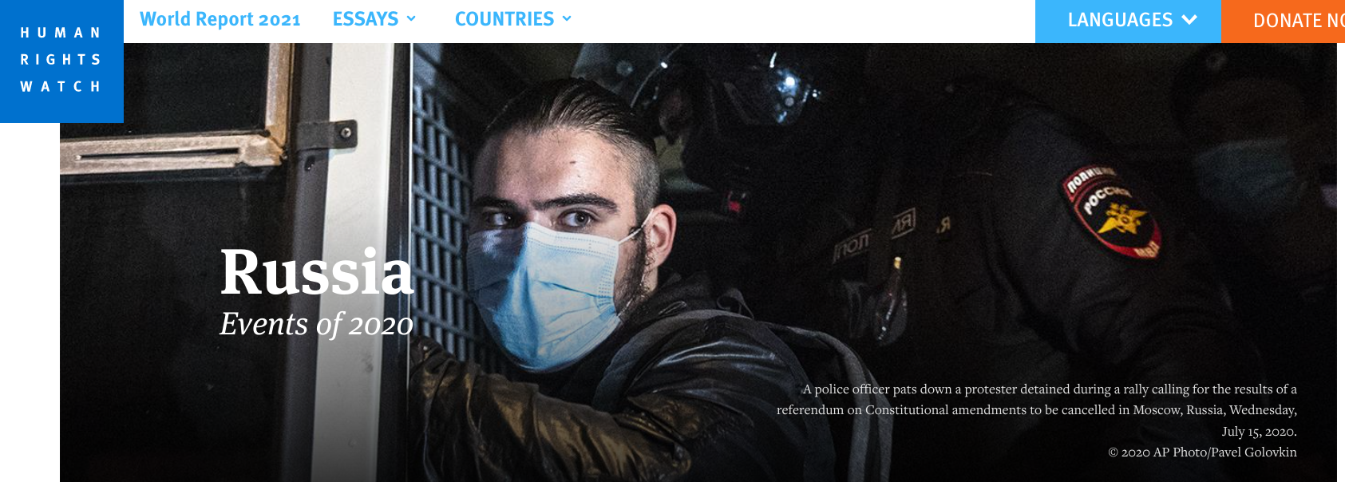
Oppression by the Russian Government
Revise your initial evidence list in your notebooks by self-directing your learning through exploring this website.

Slide 12
Causes of Government Oppression in Russia
Take the time to read through this website with your learning partners.
Then, create a timeline of Russian history that makes note of how Russian oppression might have taken shape since the Cold War.
Feeling stuck? Think: What policies did Stalin implement? How did the fall of the U.S.S.R. affect the Russian people's’ freedoms? How did Putin reimagine the policies initially created by Cold War leaders?

Slide 13
What is the existing policy?
To understand the rights of Russian citizens, analyze the Russian Constitution.
Then, collaborate with your tablemates by exploring www.sweetsearch.com for more information on existing policies created to keep the Russian people safe from their government.

Slide 14
How can we fix this societal ill?
Begin to answer this question by watching this video and reading the notes the World Bank published.

Slide 15
How can we fix this societal ill?
Watch this video, and begin to brainstorm in your notebook the different ways you personally can act as an upstander to government oppression.

Slide 16
Charting Feasibility and Effectiveness
Feasibility: How easy it is to complete a task?
Effectiveness: How quickly and efficiently does X solve our societal ill?

Slide 17
Exit Ticket
On your index card, answer the following question:
How can we best solve the problem of government oppression in Russia?

