Slide 1
The French Revolution
“47” American Sign Language and English High School
Ms. Blackburn

Slide 2
Steps of the GHPPA
1. Define the Problem
2. Gather the Evidence
3. Identify the Causes
4. Evaluate the Policy

Slide 3
Define the Problem
The French Revolution was a period of major social upheaval that began in 1787 and ended in 1799. It sought to completely change the relationship between the rulers and those they governed and to redefine the nature of political power.
At the end of the French Revolution, one monarchy was replaced with another one.

Slide 4
Define the Problem
with with your learning partner:
Write a statement that defines the problem with the French Revolution.

Slide 5
State the Problem
The third estate (peasants) wanted more political and social power in French society.

Slide 6
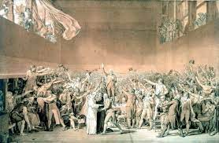
Gather the Evidence
In a desperate attempt to collect even more taxes, King Louis XVI called a meeting of the Estates General in 1788. However the people from the Third Estate used the meeting as a chance to tell the King what they thought was wrong with France and their lives and demand improvements. When the King refused to listen, members of the Third Estate went to a nearby Tennis Court and made an oath saying they would not move until the King had made improvements. In the Tennis Court several people made speeches. During this time, they also renamed themselves the 'National Assembly' rather than go by the term Estates General.

Slide 7
Gather the Evidence

Slide 8
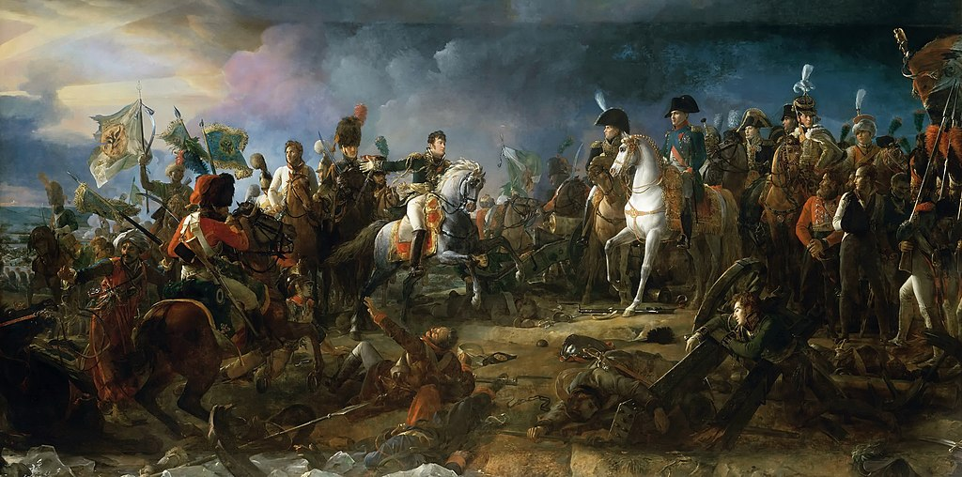
Gather the Evidence
The Napoleonic Wars were caused by lingering problems from the French Revolution such as the wars that began in 1792. These conflicts in France spilled over into other regions of Europe, creating instability. During the Napoleonic Wars, Napoleon Bonaparte had many victories.

Slide 9
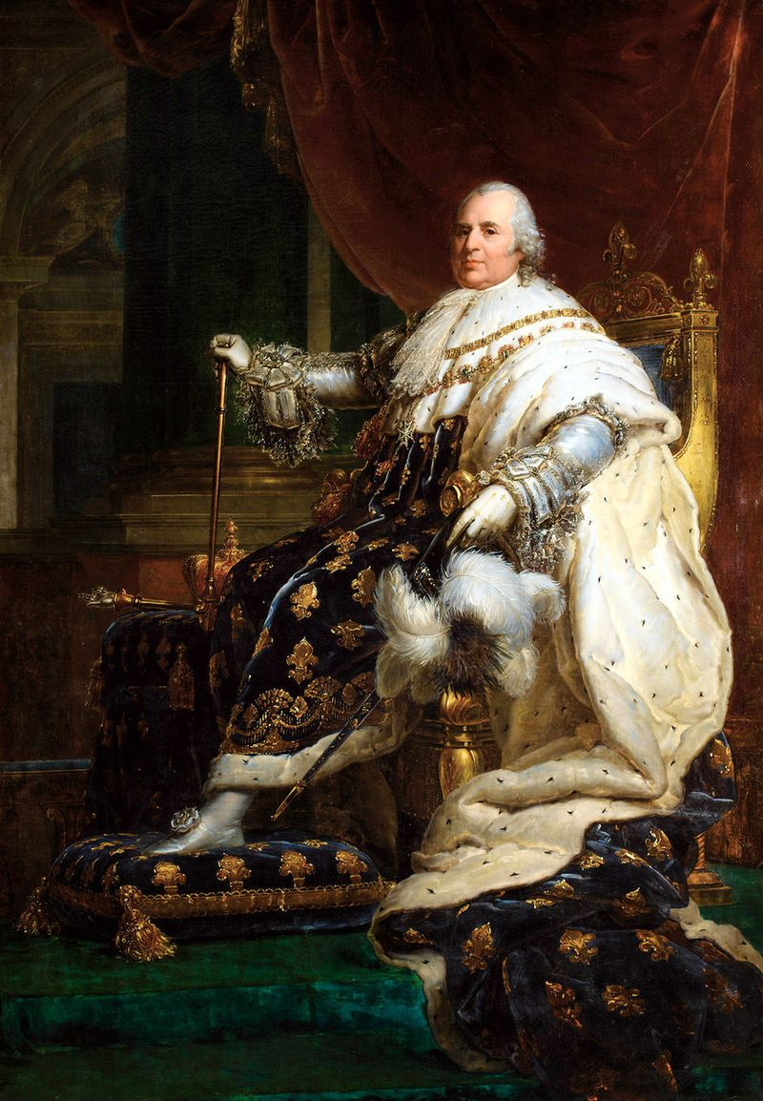
Gather the Evidence
Louis XVIII was the first ruler of the restored monarchy following the French Revolution and Napoleon’s loss of power. Louis XVIII organized a constitutional monarchy. This was his attempt to balance his power with the demands of those who supported the French Revolution. Under this government, Louis XVIII’s power was restricted by the constitution called the Charter of 1814. There was an advisory parliament that voted on laws and approved the budget. The return of Louis XVIII was a constitutional monarchy as compared to the previous French governments which were absolute monarchies where the monarch had absolute and unlimited power.

Slide 10
Identify the Causes
with with your learning partner:
Write “how” and/or “why” questions you would like to put in our parking lot to identify the causes.

Slide 11
the Causes
King Louis XVI was an absolute monarch, who believed he wielded nearly as much power as God.
The third estate was burdened with the brunt of taxes to pay for the Seven Years War and King Louis XVI’s lavish lifestyle.

Slide 12
Evaluate the Policy
The third estate:
Called a meeting of the Estates General
Created the National Assembly
Wrote the DoRoMaC
Had Tennis Court Oaths
Overthrew the monarchy
Instituted the Reign of Terror and executed King Louis XVI

