Slide 1
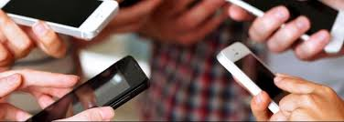
Cell phone Use @ M.H.H.S.
By Christine Bargellini/Mott Hall High School
CBargellini2@mothallhs.org

Slide 2
Public Policy ANalyst (PPA) Steps
Step #4: Evaluating Existing Public Policies
Step #5: Developing Public Policy Solutions
Step #6: Selecting the Best Public Policy Solution
Step #1: Defining the Social Problem:
Step #2: Gathering Evidence of the Problem:
Step #3: Identifying the Causes of the Problem

Slide 3
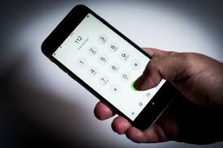
Step#1 Defining the Social problem
Definition: Cell Phone Use (during in-person or remote learning)
“Modern cell phones are capable of much more than just sending and receiving phone calls. Mobile phones used in today’s world allow users to send and receive text messages, emails, photos and video as well as access the Internet, play games, listen to music, use GPS (Global Positioning Systems) and more.”
According to Science Kids Website https://tinyurl.com/y4hwaq4j
Cell Phone Use @ M.H.H.S.

Slide 4

Step#2 Gathering Evidence of the problem
Evidence: Cell Phone Use At M.H.H.S.
Anecdotal Evidence Regarding Behavior 2019-2020 School year from Skedula:
Summary: Out of the first 100 anecdotals logged into Schedula from 9/10/2020 to 6/26/2020 34 involved cell phone use.
Cell Phone Use @ M.H.H.S.

Slide 5
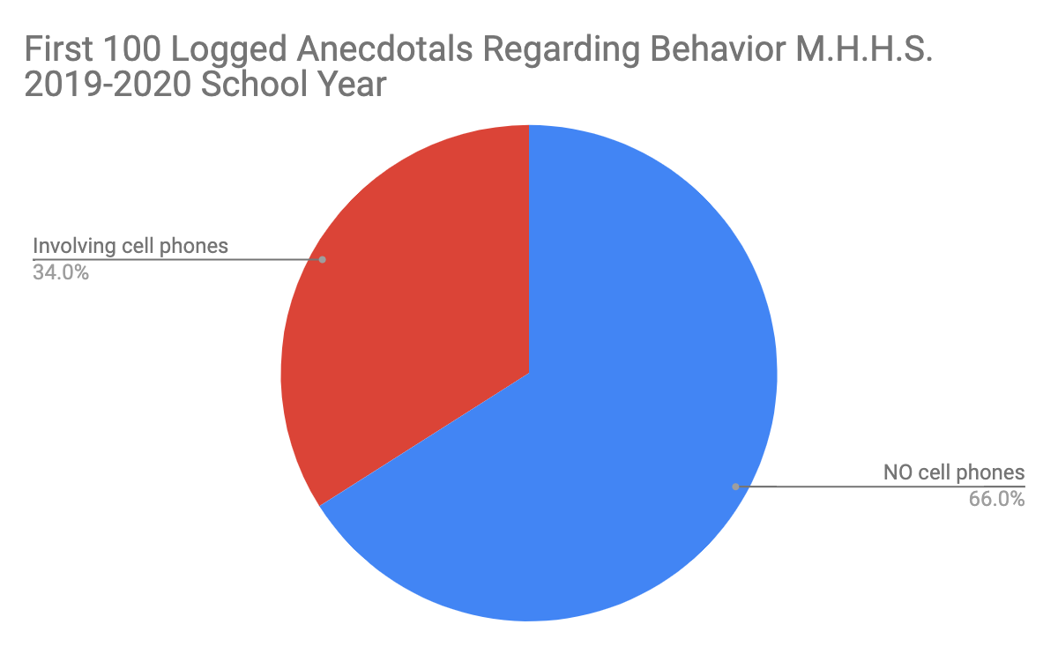

Slide 6
34%
The first 100 Behavior Anectdotals logged in 2019-2020 involved cell phones.
Question: is that significant? Why/Why not?

Slide 7
more evideNce to study...
Research on Cell phone use in school:
(Show highlighted evidence in class and discuss)
Away For the Day Research (website): https://tinyurl.com/y2zh5wy5
2019- Video- There’s a Cell Phone in Your Student’s Head (2 min.): https://tinyurl.com/yxqw96gn
2019-The Surprisingly Low-Tech Way Schools Are Keeping Students Off Tech: https://tinyurl.com/y2hqsd2o
2019-Research continually shows how distracting cell phones are—so some schools want to ban them: https://tinyurl.com/y4q3y824
2013- The Impact of Mobile Phone Usage on Student Learning: https://tinyurl.com/y2du6w2r

Slide 8
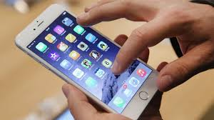
Step#3 Identifying the Causes of the problem
Teacher Modeling-using a different problem.
Student Task:
In your assigned groups of 3,or pairs, brainstorm at least three (3) causes of cell phone use at M.H.H.S.
Please use the graphic organizer provided on Google Classroom.
When task is completed, discuss with your group why or why not you use your cell phone at school.
Cell Phone Use
@ M.H.H.S.

Slide 9
Teacher Modeling Step #3-Identifying the Causes of the problem
Let’s say we wanted to identify causes of low test grades after a unit. We can brainstorm:
Students did not understand the lesson
The lessons were not effective
Students did not study the material

Slide 10
Student Generated Causes
Group #1
Group #2

Slide 11
Student Generated Causes (Continued)
Group #3
Group #4

Slide 12

Step#4 Evaluating Existing Public Policies
Regulation of the Chancellor Number: A-413 Subject: CELL PHONE AND OTHER ELECTRONIC DEVICES IN SCHOOLS Category: STUDENTS Issued: February 26, 2015
Summary: Cell Phone Ban in NYC Schools Lifted and each school is mandated to develop it’s own sell phone policy.
Cell Phone Use
@ M.H.H.S.

Slide 13
Evaluate Additional Existing Cell Phone Policies...
Mott Hall High School Cell Phone Policy:
Cell phones/electronics are allowed in school and only can be used when given permission by the classroom teacher.
Failure to comply will result in confiscation of cell phone/electronics and will only be given back to parents.
Mott Hall High School is not responsible for lost, damaged and/or stolen cell phones/electronics.
Individual M.H.H.S. Classroom Policies:
Follow M.H.H.S. policy strictly
Ask students to voluntarily surrender cell phones to be secured.
Mandate students surrender cell phones when in teacher’s classroom (to be secured)
___________________________________
San Matteo High School Cell Phone Policy (for comparison):
https://tinyurl.com/yxzcbbp3

Slide 14
Whole Class evaluation of existing Cell phone policies
M.H.H.S Cell phone Policy
The policy works because…
The policy does not work because...
Individual Classroom Policies
Classroom Policy (A,B,C) works because…
Classroom Policy (A,B,C) does not work because...

Slide 15
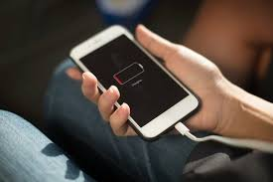
Step#5 Developing Public Policy Solutions
Teacher Modeling-using the low grade after a unit problem.
Student Task:
In your assigned groups of 3,or pairs, brainstorm at least three (3) public policy solutions for cell phone use at M.H.H.S.
Please use the graphic organizer provided on Google Classroom.
When task is completed,be sure your group can explain choices.
Cell Phone Use
@ M.H.H.S.

Slide 16
Teacher Modeling Step #5-Developing Public Policy Solutions
In developing a public policy solution for low test scores after a unit, I can brainstorm the following:
Determine the level of student understanding before the final test is given
Conduct after school tutoring
Give quizzes the next day before starting a new lesson

Slide 17
Student Generated Public Policy Development (Step#5)
Group #1
Group #2

Slide 18
Student Generated Policy Development (Cont.)
Group #3
Group #4

Slide 19
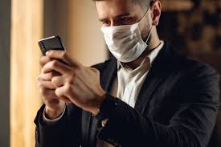
Step#6 Selecting the best public policy solution
Teacher Modeling-using the low grade after assessment problem.
Student Task:
In your assigned groups discuss choose and select one best public policy solution for cell phone use at M.H.H.S.using the graphic organizer in Google Classroom.
C. Whole Class will select the best public policy solution based on each group’s analysis.
Cell Phone Use
@ M.H.H.S.

Slide 20
Teacher Modeling Step #6-Selecting the best public policy solution
In developing the best public policy solution for low test scores after a unit, I have concluded through using the matrix:
Determine the level of student understanding before the final test is given
Conduct after school tutoring
Give quizzes the next day before starting a new lesson
I will show you how...

Slide 21
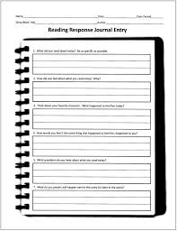
Graphic Organizer: Selecting the best public policy solution
https://tinyurl.com/y47kunm6

Slide 22
Teacher Modeling Step #6
Your problem (phrase):
Low test grades after a unit
1. List the three public policy alternatives from your graphic organizer.. Create a short word or abbreviation to summarize each policy and write it at the end of each policy.
1. | Determine the level of student understanding before the final test is given (Review for test)
2. | Conduct after school tutoring (Tutoring)
3. | Give quizzes the next day before starting a new lesson (Quizzes)

Slide 23
FEASABILITY (LIKELIHOOD of carrying out)
 | HIGH | MEDIUM | LOW
HIGH |  | Review for test
MEDIUM |  | Quizzes
LOW |  |  | Tutoring
EFFECTIVENESS

Slide 24
Teacher Modeling Step #6 (continued)
Reasoning:
Review for test - doable because it will be planned into the unit and done in class so most students will be present and /or given a review packet to complete.
Conduct after school tutoring- not feasible because it would be voluntary
Quizzes next day- some students may have anxiety around quizzes, may not prepare, may be absent. Will be effective for those who are consistently present and prepared.

Slide 25
Teacher Modeling Step #6 (Complete)
Preference explained:
Review for test
Will be planned into the unit
Done in class so most students will be present
Absent students can be given a review packet to complete.
Teacher office hours can supplement

Slide 26
Whole Class Step #6
Your problem (phrase):
Cell Phone Use @ M.H.H.S.
1. List the three public policy alternatives from your graphic organizer.. Create a short word or abbreviation to summarize each policy and write it at the end of each policy.
1.
2.
3.

Slide 27
FEASABILITY (LIKELIHOOD of carrying out)
 | HIGH | MEDIUM | LOW
HIGH
MEDIUM
LOW
EFFECTIVENESS

Slide 28
Whole CLass Step #6 (continued)
Reasoning:

Slide 29
Whole Class Step #6 (Complete)
Preference explained:
→

Slide 30
Congratulations! You have completed the Public Policy ANalyst (PPA) Steps!
Step #1: Defining the Social Problem:
Step #2: Gathering Evidence of the Problem:
Step #3: Identifying the Causes of the Problem
Step #4: Evaluating Existing Public Policies
Step #5: Developing Public Policy Solutions
Step #6: Selecting the Best Public Policy Solution

Slide 31
Be prepared to use the ppa steps in class throughout the year!

Slide 32
QUESTIONS?

Slide 33
Teacher notes (delete for classroom presentation)
Intended to introduce PPA steps to staff and/or students
Created for delivery for students over 2 class periods
Please highlight/lowlight the steps to your student’s instructional needs
Must take out of presentation mode when typing in class/group responses, then return to presentation mode to continue presenting
Have FUN!!!

