Slide 1
Addressing Plagiarism in School Assignments at PS/MS 129
By
Ms. K. Ashby PS/MS 129

Slide 2
Use the Public Policy Analyst (PPA) steps to understand and address the problem.
6. What is the best policy to correct the problem?
5. What policies can you create to correct the problem?
4. What is the existing policy?
3. What are the causes?
2. Where is the evidence?
1. What is the problem?
Image from http://clipart-library.com/clipart/382081.htm

Slide 3
The Problem
Some students are copying and pasting text from the internet and using it in their assignments without citing all sources.
Plagiarism

Slide 4
The Evidence How do we know this is an issue in our school?
Teachers have expressed concerns about students simply copying and pasting work from the internet.
Some students have commented about other students who copied words from the internet and received passing grades for the assignment.
Image from http://clipart-library.com/clipart/1265543.htm

Slide 5
The Evidence How is this an issue in other schools?
The Josephson Institute Center for Youth Ethics surveyed 43,000 high school students in public and private schools and found that:
59% of high school students admitted cheating on a test during the last year. 34% self-reported doing it more than two times.
One out of three high school students admitted that they used the Internet to plagiarize an assignment.
(https://www.plagiarism.org/article/plagiarism-facts-and-stats)
Published June 7, 2017

Slide 6
What Are the Main Causes?
Some students don’t fully understand plagiarism.
Some students want to take short cuts to finish quickly.
Some students don’t want to put in a full effort to get a grade.
Why
Image from http://clipart-library.com/clipart/qcBAnXMKi.htm

Slide 7
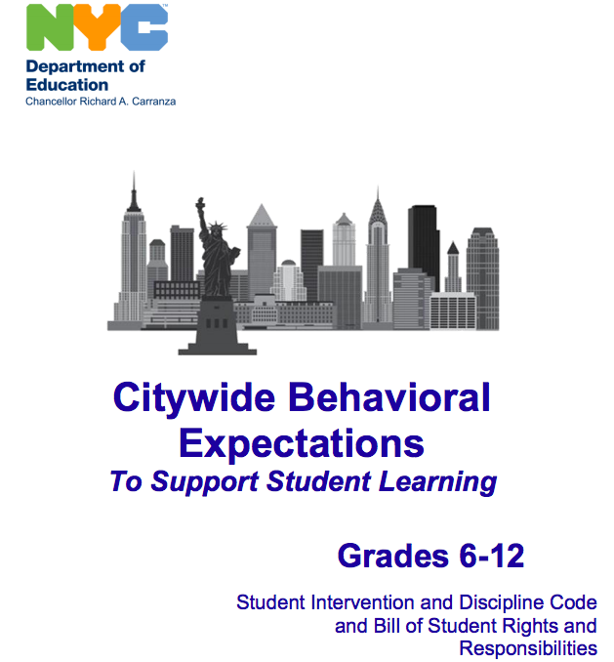
What is the existing policy? Citywide
NYC DOE Discipline Code (p. 34)
Level 3 Infractions – Disruptive Behavior
B31 Engaging in scholastic dishonesty which includes but is not limited to:
a. Cheating …
b. Plagiarizing …

Slide 8
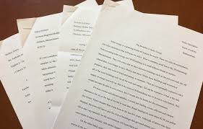
What is the existing policy? In Our School
The teacher may make you redo your work.
You may get a failing grade.
The teacher may have a conference with you and/or your parents/guardians.
Images from https://www.mma.org/mma-announces-winners-of-8th-grade-essay-contest/ and http://clipart-library.com/clipart/Denied-Stamp-Free-Download-PNG.htm

Slide 9
What can you do to correct the problem?
Embed quotes/evidence into your own sentences.
Summarize or paraphrase evidence and introduce it.
Use MLA citations.
ALWAYS
Cite
Your Sources
Image from https://premiumbpthemes.com/clipart/get

Slide 10
Task
What can the school do to correct the problem?
How can we address plagiarism in our school? Choose one of the causes we have discussed (or find one of you own) and use the PPA steps to find a reasonable solution. Then write a letter to the principal explaining your policy and why it is the best option. Make sure that your cite your sources.

