Slide 1
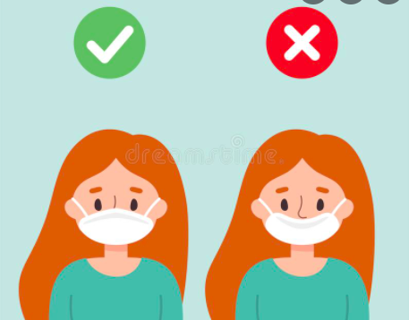

Mask wearing at PS 149
Brittain Altomare
5th Grade PS 149
Baltomare@schools.nyc.gov

Slide 2

PPA Steps - The way we can analyze a problem. A public policy is a government action usually intended to deal with a social problem. Every day policies are enacted in your school, city, state, country and throughout the world that will affect your life.
1. Define the problem
2. Gather the Evidence
3. Identify the Causes
4. Evaluate an Existing Policy
5. Develop Solutions
6. Select the Best Solution (feasibility vs. effectiveness)

Slide 3
Step 1: Define the Problem http://flippedtips.com/plegal/tips/select.html
Many students do not follow mask wearing rules at PS 149.
Activity:
Click this link and respond to the survey!
https://www.menti.com/zmqu1vqdin

Slide 4

Step 2: Gather the Evidence http://flippedtips.com/plegal/tips/gather.html
Statistics:
https://www.chalkbeat.org/2021/8/26/22643549/covid-masks-schools-research
https://www.cdc.gov/coronavirus/2019-ncov/science/science-briefs/transmission_k_12_schools.html
Activity:
Spend some time navigating the above website, making sure to unpack the data from both links. Then turn and talk, what is one thing you NOTICE about the data around masks in schools. What is one thing you still WONDER about the data surrounding masks in schools.

Slide 5
Step 3: Identify the Causes http://flippedtips.com/plegal/tips/identify.html
Masks are uncomfortable.
Unable to afford nicer masks that stay on the face well.
Masks for children are hard to find.
Forgetfulness.
Parents not supporting the mask mandates.
Turn and Talk: What is one of the reasons you might not wear your mask? Or wear it incorrectly? Let’s add some of your responses to the list!

Slide 6
Step 4: Evaluate an Existing Policy http://flippedtips.com/plegal/tips/existing.html
Incentives for mask wearing (pizza parties, extra recess, prize box)
Phone calls home when students do not wear their masks.
Parent meetings.
Posters up in hallways, bathrooms, and classrooms encouraging proper mask wearing.
Classroom meetings held to explain the importance of mask wearing.

Slide 7

Step 5: Develop Solutions http://flippedtips.com/plegal/tips/solutions.html
What new ideas can we develop to help improve mask wearing?
Turn and Talk: Work with your partner for 5 minutes to brainstorm one potential new idea to help improve mask wearing. When the 5 minutes are done we will share out your ideas, and why you think it might improve mask wearing at PS 149.
Potential new ideas:
Form a student “mask wearing” team.
Incentivize mask wearing.
Order more comfortable, non reusable masks for the students (in different colors and patterns!)
Positive phone calls home when a student successfully wears their mask for a full day.

Slide 8
Step 6: Select the Best Solution http://flippedtips.com/plegal/tips/bestsol.html
Proposed Alternative Solutions:
A student mask wearing team.
Purchasing custom masks that are more comfortable/aesthetically pleasing.
Turn and Talk: Now we will work on improving these solutions and putting them in action! Take each proposed solution and work with a partner to write a detailed list of instructions on how we will make them happen at PS 149!

Slide 9
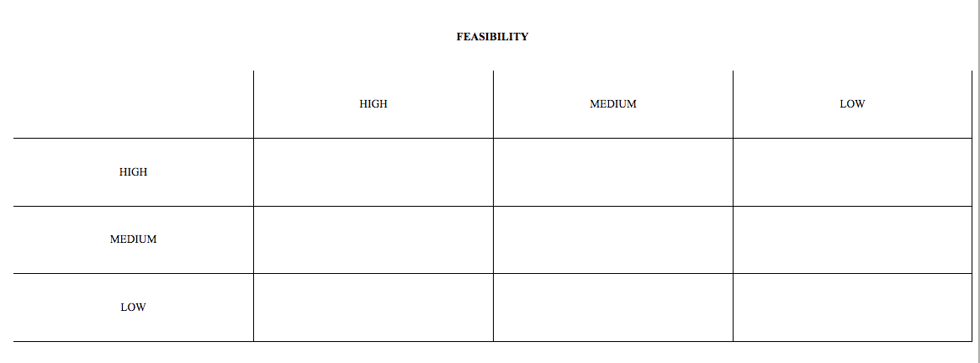
Feasibility vs. Effectiveness
Work with a partner to put our proposed solutions in the feasibility vs. effectiveness table.

Slide 10

Best Proposed Solution
Everyone is going to put their favorite proposed solution on a piece of paper and submit anonymously!
As a class we will vote on our BEST proposed
solution and submit to our principal for review.
Once our solution is reviewed by the principal it will be
posted in the hallway and sent home in a flyer!
Good luck!

