Slide 1
Excessive Tardiness at PS 149
Brittain Altomare
5th Grade PS 149
Baltomare@schools.nyc.gov

Slide 2

PPA Steps
1. Define the problem
2. Gather the Evidence
3. Identify the Causes
4. Evaluate an Existing Policy
5. Develop Solutions
6. Select the Best Solution (feasibility vs. effectiveness)

Slide 3

Step 1: Define the Problem http://flippedtips.com/plegal/tips/select.html
Students are excessively tardy at PS 149.
Activity:
Click this link and respond to the survey!
https://www.surveymonkey.com/r/XY6Y2BD

Slide 4

Step 2: Gather the Evidence http://flippedtips.com/plegal/tips/gather.html
Statistics:
https://infohub.nyced.org/reports/school-quality/information-and-data-overview/end-of-year-attendance-and-chronic-absenteeism-data
Activity:
Spend some time navigating the above website, making sure to unpack the data from the school link. Then respond to the prompt in the padlet below.
Padlet Prompt: What is one thing you noticed after looking at the data? Why do you think the data is put into different categories such as “ethnicity, gender, and poverty.”
https://padlet.com/baltomare5/h8mssbj33l31tsts

Slide 5

Step 3: Identify the Causes http://flippedtips.com/plegal/tips/identify.html
Lack of resources.
Long commute.
No adult at home to create positive morning routines.
Bullying.
Little siblings.
School Anxiety.
Lack of motivation.
Turn and Talk: What is one of the reasons you might be late to school? You have 2 minutes to write your responses on a strip of paper.
Snowball Technique - students will then ball up their responses and throw them gently into the middle of the room. The teacher will collect them and read them aloud, allowing the students who created that strip of paper to explain their response.

Slide 6

Step 4: Evaluate an Existing Policy http://flippedtips.com/plegal/tips/existing.html
Incentives.
Phone calls home.
Free breakfast.
Parent meetings.
First class of the day is Science or Social Studies.
Respond to the following prompt in this padlet: https://padlet.com/baltomare5/mawn31sui5c0jon0
Padlet Prompt: Which of the above policies is most likely to get you to come to school on time? Which does not work for you at all? Explain why you think one of those policies is better than the other.

Slide 7

Step 5: Develop Solutions http://flippedtips.com/plegal/tips/solutions.html
What new ideas can we develop to help improve student attendance at PS 149?
Turn and Talk: Work with your partner for 5 minutes to brainstorm one potential new idea to help improve student tardiness. When the 5 minutes are done we will share out your ideas, and why you think it might improve attendance at PS 149.
Potential new ideas:
Form a student tardiness team.
Morning “wake up” phone calls home.
More frequent incentive parties for students who have 100% attendance and 100% being on time.
Frequent parent calls home.
Provide additional transportation resources.

Slide 8

Step 6: Select the Best Solution http://flippedtips.com/plegal/tips/bestsol.html
Proposed Alternative Solutions:
A student tardiness team.
More frequent phone calls home.
Being on time incentive parties.
Turn and Talk: Can we improve any of these proposed solutions?

Slide 9
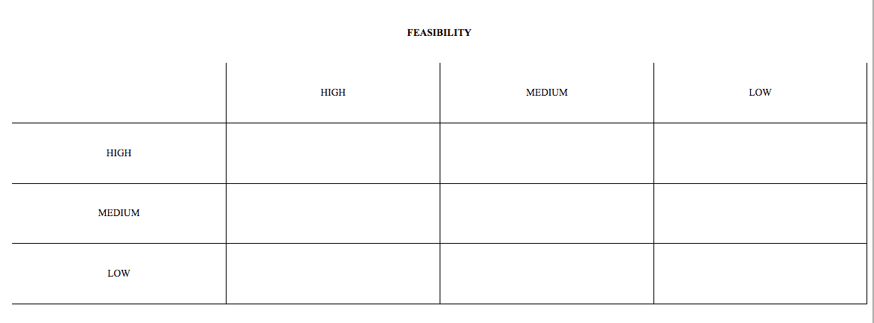
Feasibility vs. Effectiveness
Work with a partner to put our proposed solutions in the feasibility vs. effectiveness table.

Slide 10

Best Proposed Solution
Click the following link and respond to our PPA survey!
https://www.surveymonkey.com/r/NRW3PFG

